Slide 1
Real-Time Cyber Physical Systems Application on MobilityFirst
Winlab Summer Internship 2015

Slide 2



WINLAB SUMMER
2015
TEAM MEMBERS
Karthikeyan Ganesan
Wuyang Zhang
Zihong Zheng
Graduate student, ECE Department, Rutgers University
Graduate student, ECE Department, Rutgers University
Graduate student, ECE Department, Rutgers University

Slide 3

WINLAB SUMMER
2015
WHAT IS CYBER-PHYSICAL SYSTEM?
WIKI SAYS: A cyber-physical system (CPS) is a system of collaborating computational elements controlling physical entities.
Internet of Things(IoT):
The network of physical objects or "things" embedded with electronics, software, sensors and connectivity.

Slide 4

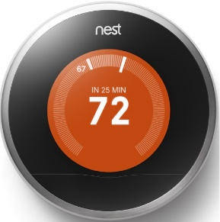
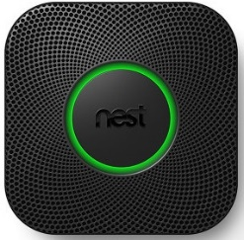
WINLAB SUMMER
2015
A FEW IOT PRODUCTS
Basically about the smart home
Control4
Home
Automation
MIT Distributed Robot Garden
HUE Bulbs
Smoke + CO
Thermostat
An autonomous greenhouse based on autonomous robots and sensors
Smart Home Solution:
Giving Your Home the Smart It Deserves
Personal Wireless Lighting
A reinvention of the smoke and carbon monoxide detector
Nest Learning Thermostat: Automatic Temperature Controller

Slide 5




WINLAB SUMMER
2015
TREND
What is happening in the current market
Brillo OS: a stripped down version of Android for IoT
Weave: the IoT protocol for everything
Windows 10 IoT Core
With a few compactable hardwares
IoT Field
A Smarter Planet:
All about Data, Social, Cloud, and Mobile
HomeKit
A framework for communicating with and controlling connected accessories

Slide 6

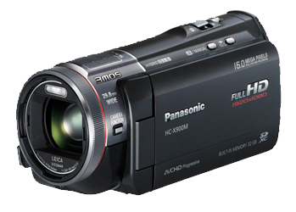
WINLAB SUMMER
2015
PRELIMINARY GOAL OF OUR PROJECT
CPS Application based on MF
Server side:
Implement server application for object recognition;
Simple graphical interface to display results
MobilityFirst Virtual Network
Client side:
Run an instance of camera system;
Transmits video in standard format

Slide 7
WINLAB SUMMER
2015
Mobility First (MF)
Part of Future Internet Architecture Program
Replaces fixed-Host/Server model
Mobility centric architecture (Considers Frequent shifts in Device’s location)
Uses a Globally Unique Identifier (GUID) and a Global Name Resolution Service (GNRS)

Slide 8
WINLAB SUMMER
2015
Mobility First for CPS
MF allows for lower latency for mobile devices.
Data is sent directly to mobile device’s network
CPS can benefit greatly from lower latency.
Implementation will also showcase the performance benefit achieved.

Slide 9
WINLAB SUMMER
2015
Week 1 Work
01
Related Materials
MoblityFIrst: A Robust and Trustworthy Mobility-Centric Architecture for the Future Internet
02
Orbit MF Exercise
MobilityFirst Network
Ping Test
03
MF API

Slide 10
WINLAB SUMMER
2015
MobilityFirst
MoblityFIrst: A Robust and Trustworthy Mobility-Centric Architecture for the Future Internet
GUID
Dominance over using IP to identify and locate devices
GNRS
Name Resolution
GSTAR
Extension of CNF
Robust & effective routing mechanism

Slide 11
WINLAB SUMMER
2015
MobilityFirst Ping Test on Orbit
Goals: software components & deploy configure script
Software Component
Set Node Group
Execute Event & Command
Def Router
DefGNRS
DefHost Stack
Set Router groups
Set Host Groups
Start Router
Start GNRS
Start Client Network Protocol Stack

Slide 12
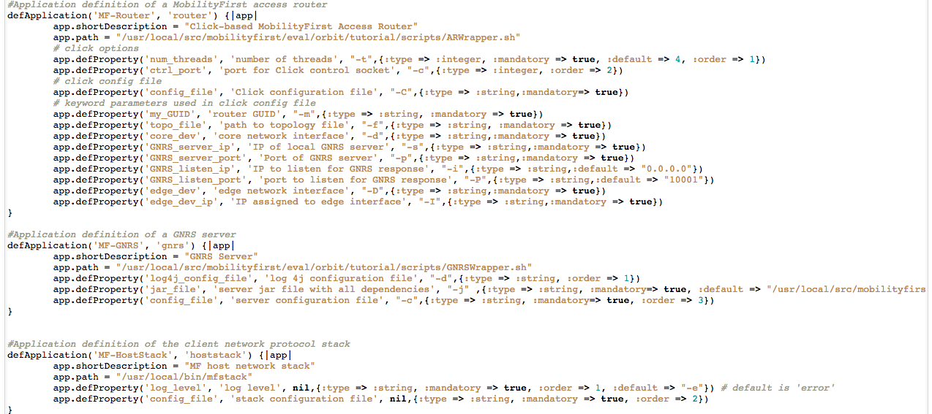
WINLAB SUMMER
2015
MobilityFirst Ping Test on Orbit
Software Component

Slide 13
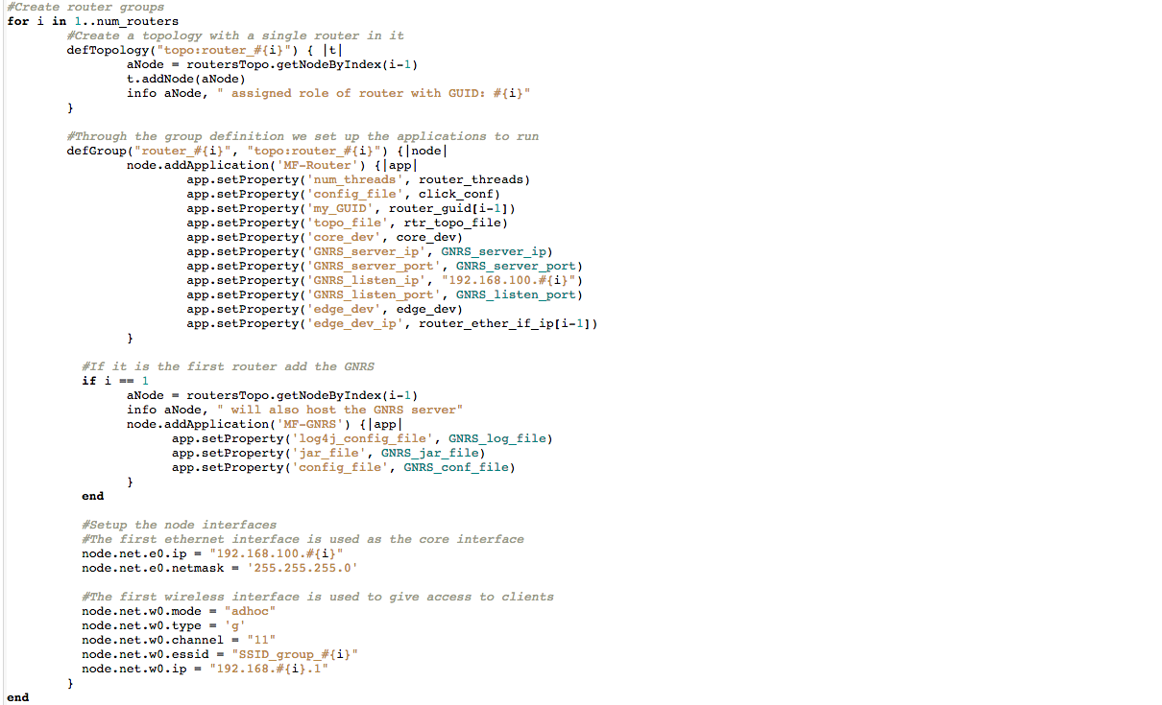
WINLAB SUMMER
2015
MobilityFirst Ping Test on Orbit
Set Node Group

Slide 14
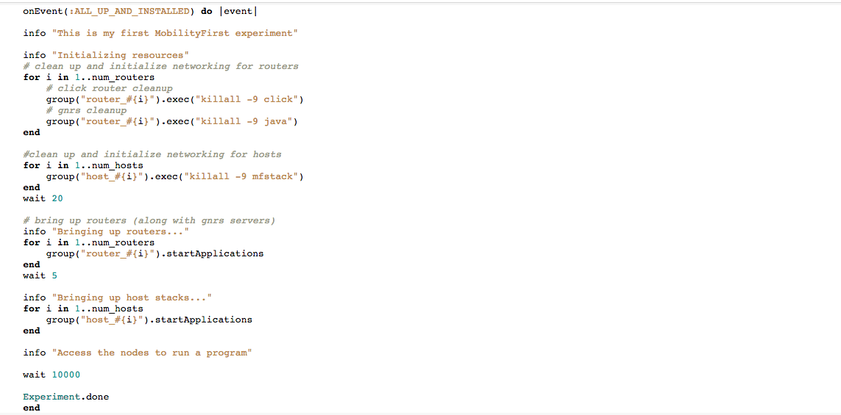
WINLAB SUMMER
2015
MobilityFirst Ping Test on Orbit
Start Events

Slide 15
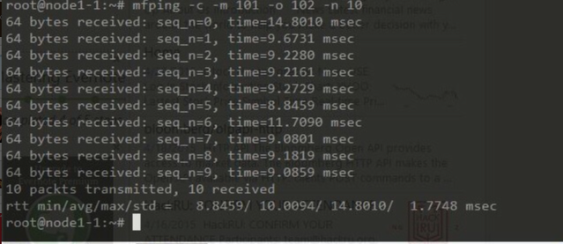
WINLAB SUMMER
2015
MobilityFirst Ping Test on Orbit
Results

Slide 16
WINLAB SUMMER
2015
Next Week Work
Run Orbit Experiment 2 & 3
》
Test Basic App using MF’s Virtual Network

Slide 17
Question

