Slide 1
Real-Time Cyber Physical Systems Application on MobilityFirst
Winlab Summer Internship 2015
Karthikeyan Ganesan, Wuyang Zhang, Zihong Zheng

Slide 2

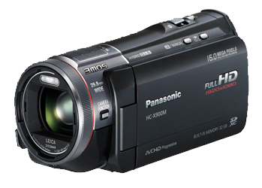
WINLAB SUMMER
2015
PRELIMINARY GOAL OF OUR PROJECT
CPS Application based on MF
Server side:
Implement server application for object recognition;
Return the result
MobilityFirst Virtual Network
Client side:
Run an instance of camera system;
Transmits video in standard format;
Simple graphical interface to display results

Slide 3
WINLAB SUMMER
2015
OUTLINE OF THE PROGRESS
SERVER
CLIENT
Database
Image Process
Camera
Display
COORD
COORD
Network
Network

Slide 4
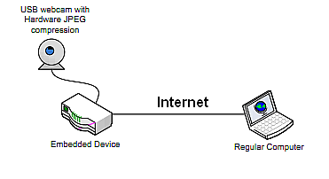
WINLAB SUMMER
2015
CAMERA PART
How do we implement
Basically based on the free software MJPG-streamer (Linux C)
MJPG-streamer: a command line application that copied JPG-frame from a single input plugin to multiple output plugin
Features: for embedded devices with very limited resources in terms of RAM and CPU
Current: lots of implementations with Raspberry Pi

Slide 5
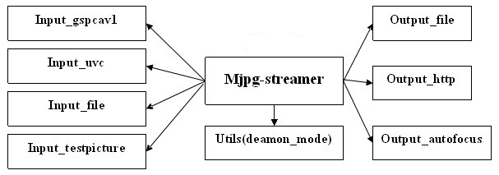
WINLAB SUMMER
2015
MORE INFO
libjpeg for encoding
libv4l2 for camera driving
Output_file_cps
Transmit format: mjpeg
FPS: undecided
Resolution: 640*480
Protocol: TCP
Camera Model: undecided

Slide 6
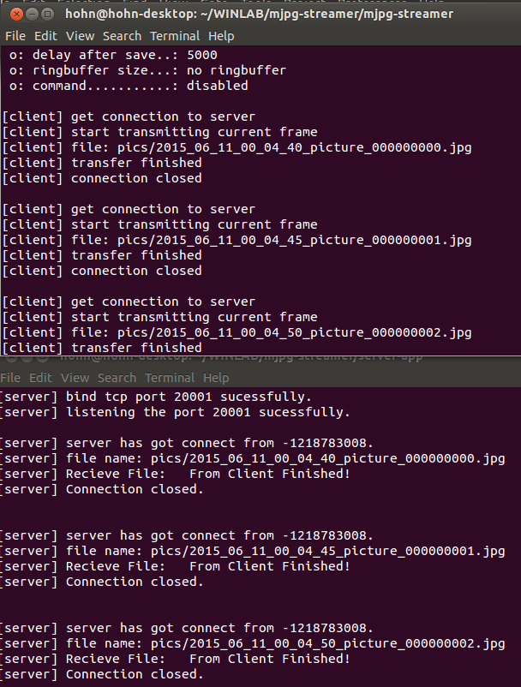
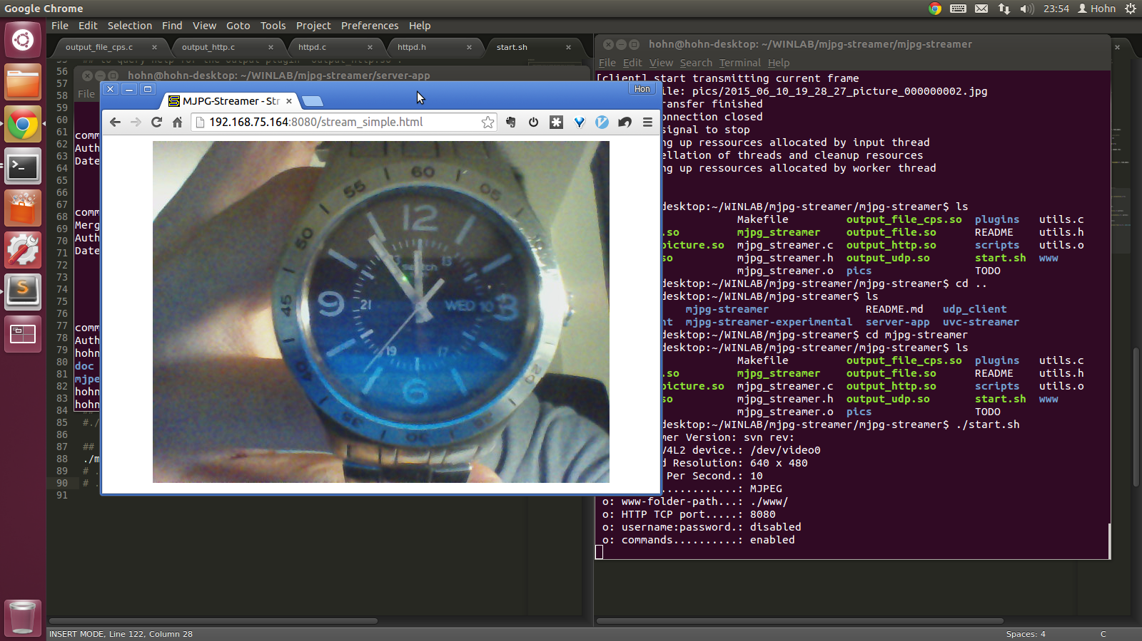
WINLAB SUMMER
2015
DEMO
Two main threads for transmitting:
Sending frames
&
Receiving results

Slide 7
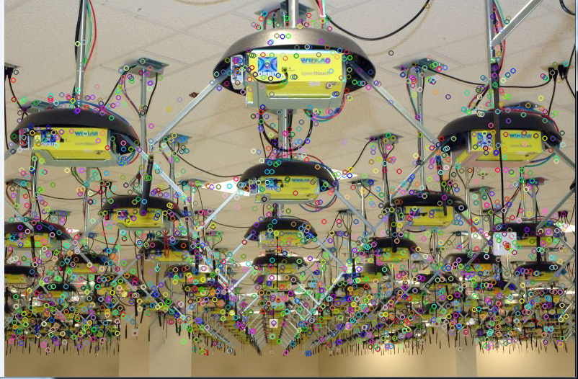
WINLAB SUMMER
2015
Object Identify & Match

Slide 8
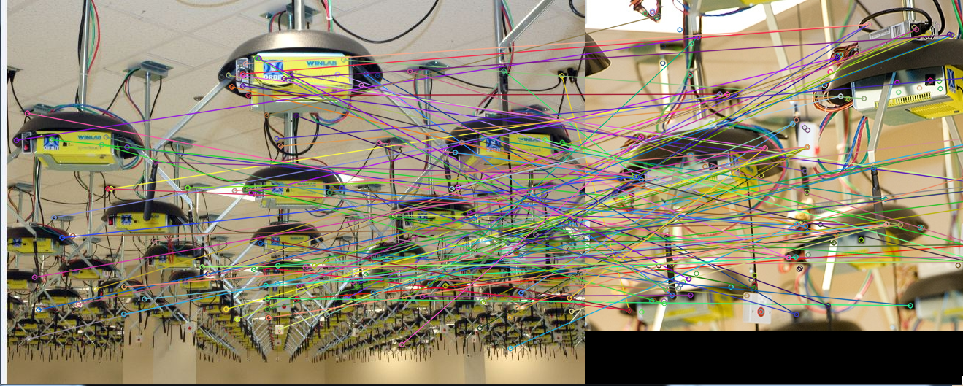
WINLAB SUMMER
2015
Object Identify & Match (SURF)

Slide 9
WINLAB SUMMER
2015
Progress & Next Week Plan
Complete single object identify less than 1s.
Image Size : 100 Kb
Database Size : 3 images
Also the combination of Image Part and Camera Part
Enlarge size of each image
Improve Performance of Accuracy & Latency
Expand Database Size
Compare performance of SURF & FREAK

Slide 10
WINLAB SUMMER
2015
Question

