Slide 1
Real-Time Cyber Physical Systems Application on MobilityFirst
Winlab Summer Internship 2015
Karthikeyan Ganesan, Wuyang Zhang, Zihong Zheng

Slide 2

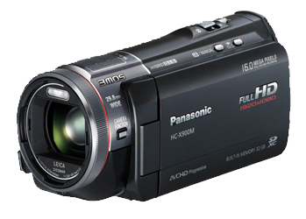
WINLAB SUMMER
2015
PRELIMINARY GOAL OF OUR PROJECT
CPS Application based on MF
Server side:
Implement server application for object recognition;
Return the result
MobilityFirst Virtual Network
Client side:
Run an instance of camera system;
Transmits video in standard format;
Simple graphical interface to display results

Slide 3
WINLAB SUMMER
2015
OUTLINE OF THE PROGRESS
SERVER
CLIENT
Database
Image Process
Camera
Display
COORD
COORD
Network
Network
General One

Slide 4
WINLAB SUMMER
2015
How Object Detection Algorithms Work
Feature Detection
  Identifying Points of Interests within Image(Edges,Corners,Blobs,etc.)
  Like a Partial differential of Image gradient
  SURF uses a modification of the “Determinant of Hessian” method
Feature Extraction
  Translate the pixel information to a reduced representation
  Extract a Descriptor or 'Features Vector' containing relevant information to perform required tasks
  Multiple diverse schemes available. Most prominent are SURF, ORB, FREAK.

Slide 5
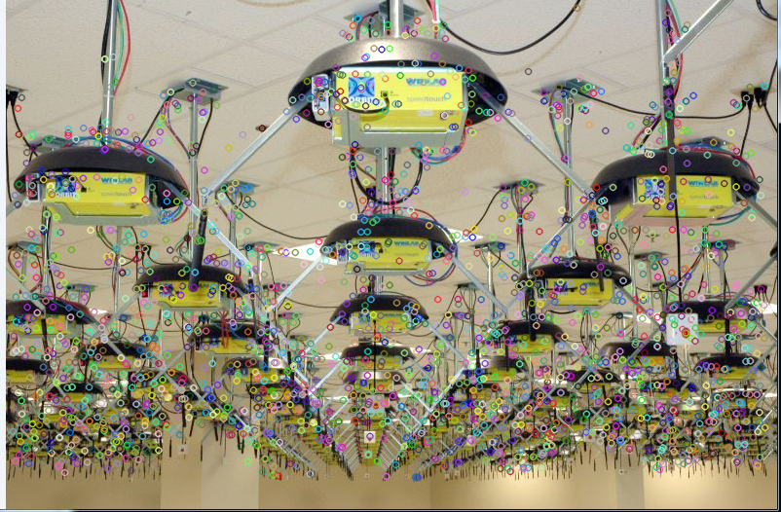
WINLAB SUMMER
2015
Image Match
FOR THE BEST PPT
Find Descriptors
GET MORE
Match Descriptors

Slide 6
WINLAB SUMMER
2015
Image Match
Descriptor:64 Demensions Vector
Image: n×64 vectors Matrix
[d00 d01 d02…………d63 d64
d10 d11 d12…………d163 d164
.
.
.
dn0 dn1 dn2……….dn63 dn64]
Image

Slide 7
WINLAB SUMMER
2015
Image Match
Find Descriptors Surf
Pixel -> Hessian Matrix -> Determinant ->feature value
  Build Scale Space -> Compare feature val -> locate descriptor
Scale: proportional ratio of a linear dimension of the model to the same feature of the original.
  Calculate Sum of Harr Wavelet -> Direction of descriptor

Slide 8
WINLAB SUMMER
2015
Image Match
Match Descriptors
Source Image | Database Image
Descriptor Index | Descriptor Index | Mapped Image Index
1 | 49 | 1
2 | 87 | 1
3 | 403 | 2
n | 9785 | 56

Slide 9
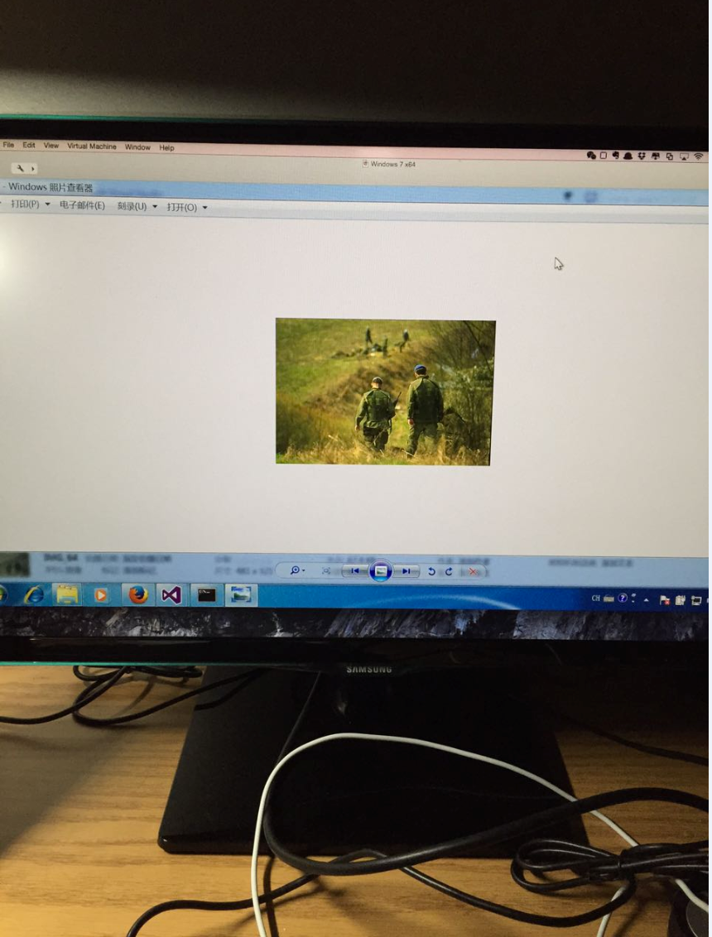
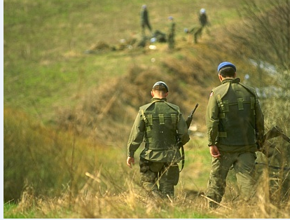
WINLAB SUMMER
2015
Image Match
Achievement
Match Image from Database of 100 images Within 2159ms

Slide 10
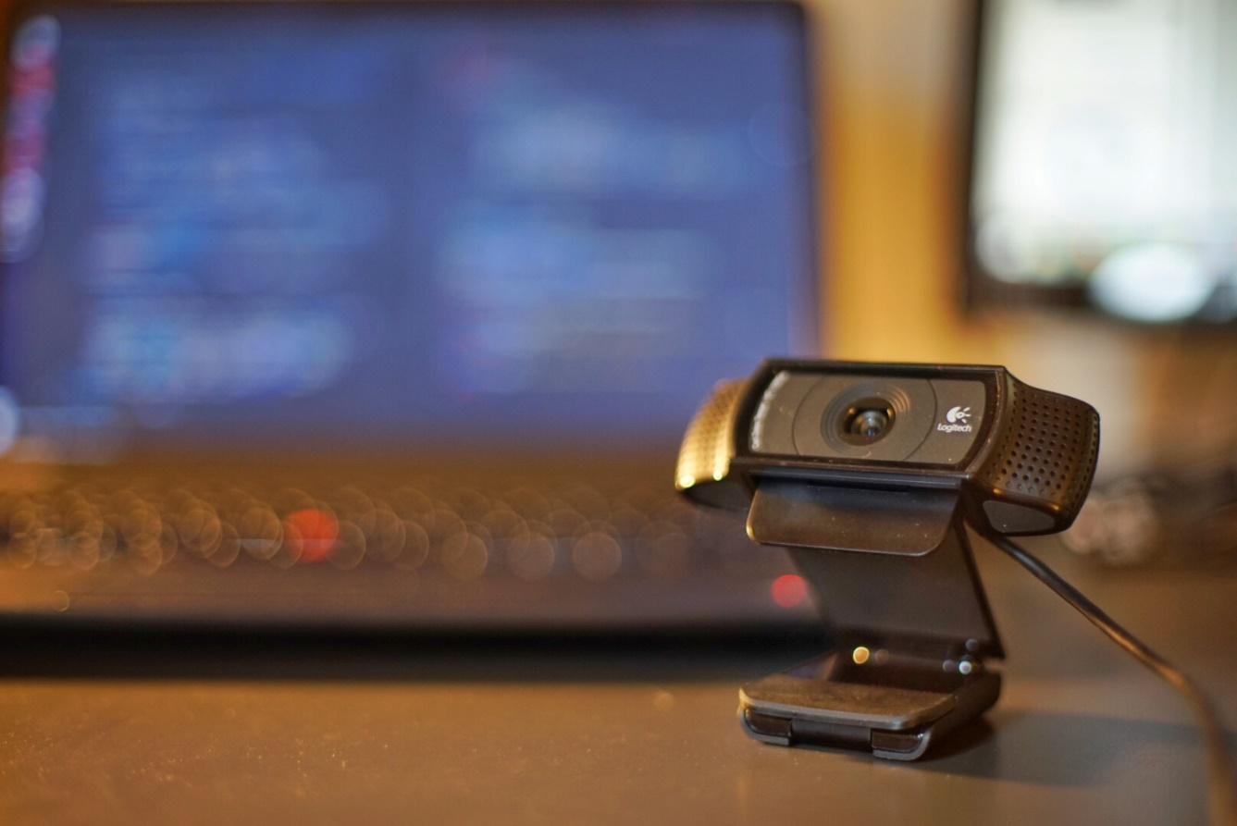
WINLAB SUMMER
2015
NEW WEBCAM ARRIVED!
Camera Model: Logitech HD C920
Transmit format: mjpeg
FPS: 10/seconds
Resolution:
>=640*480
Up to 1080p(1920*1080)
Protocol: TCP

Slide 11
WINLAB SUMMER
2015
CAMERA PART
Two Plans:
Continue using MJPG-streamer + QT or GTK
Switch to use OpenCV library directly to construct a basic version application
MJPG-streamer: a command line application that copied JPG-frame from a single input plugin to multiple output plugin
QT: framework mainly for developing application software with graphical user interfaces
GTK: a cross-platform widget toolkit for creating graphical user interfaces
OpenCV(Open Source Computer Vision): a library of programming functions mainly aimed at real-time computer vision

Slide 12
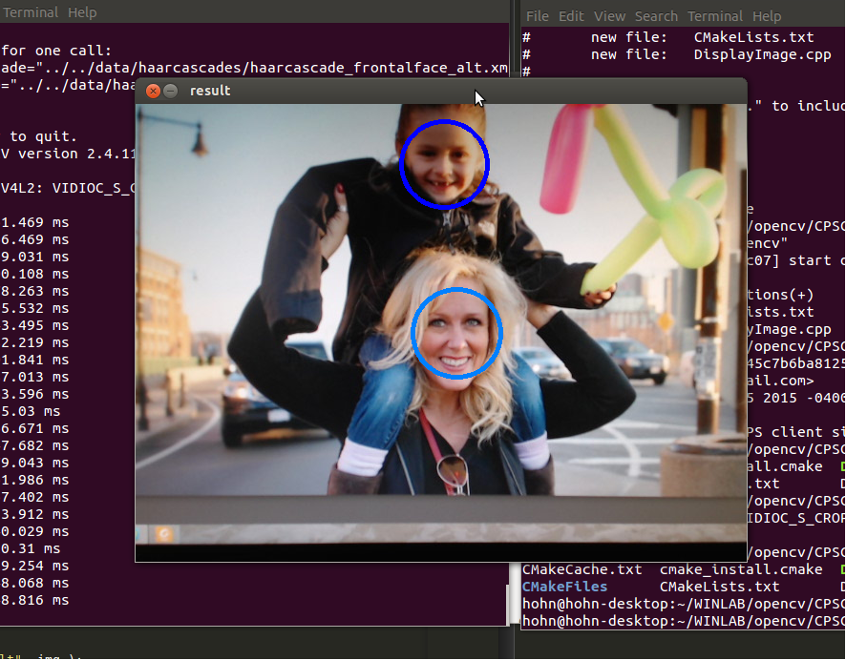
WINLAB SUMMER
2015
DEMO
It is just a local version. The whole application is still developing, especially the Displaying and the Application Protocol part.

Slide 13
WINLAB SUMMER
2015
Next Week Plan
Finish the basic version client side application base on OpenCV
Migrate the Image processing program to Linux platform, also try to add more features to it
Do the essential combination between client and server side

Slide 14
WINLAB SUMMER
2015
Question

