Slide 1
Real-Time Cyber Physical Systems Application on MobilityFirst
Winlab Summer Internship 2015
Karthikeyan Ganesan, Wuyang Zhang, Zihong Zheng

Slide 2

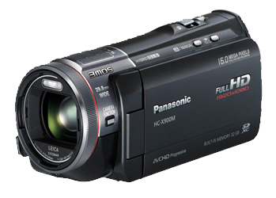
WINLAB SUMMER
2015
PRELIMINARY GOAL OF OUR PROJECT
CPS Application based on MF
Server side:
Implement server application for object recognition;
Return the result
MobilityFirst Virtual Network
Client side:
Run an instance of camera system;
Transmits video in standard format;
Simple graphical interface to display results

Slide 3
WINLAB SUMMER
2015
OUTLINE OF THE PROGRESS
SERVER
CLIENT
Database
Image Process
Camera
Display
COORD
COORD
Network
Network
General One

Slide 4
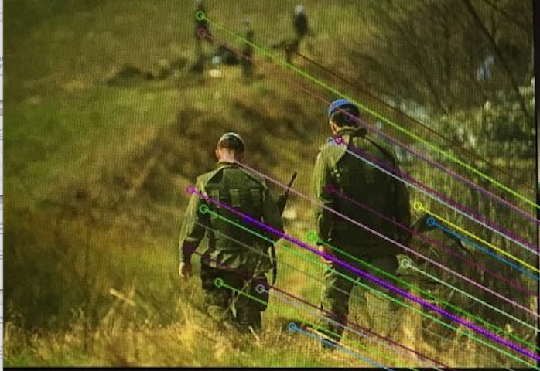
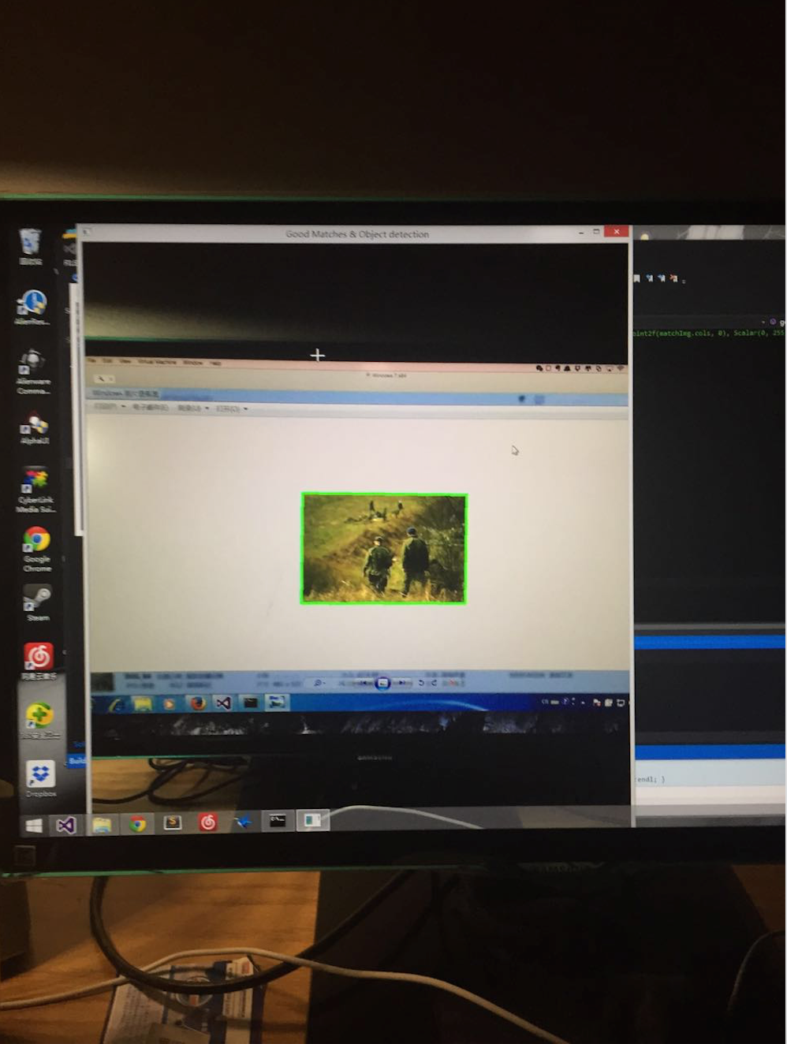
WINLAB SUMMER
2015
SERVER API
The server provides several APIs to process requests from a client.
void matchImg(string srcImgAdd)
vector<float> calLocation()
void locateDrawRect()
void locateDrawCircle()

Slide 5
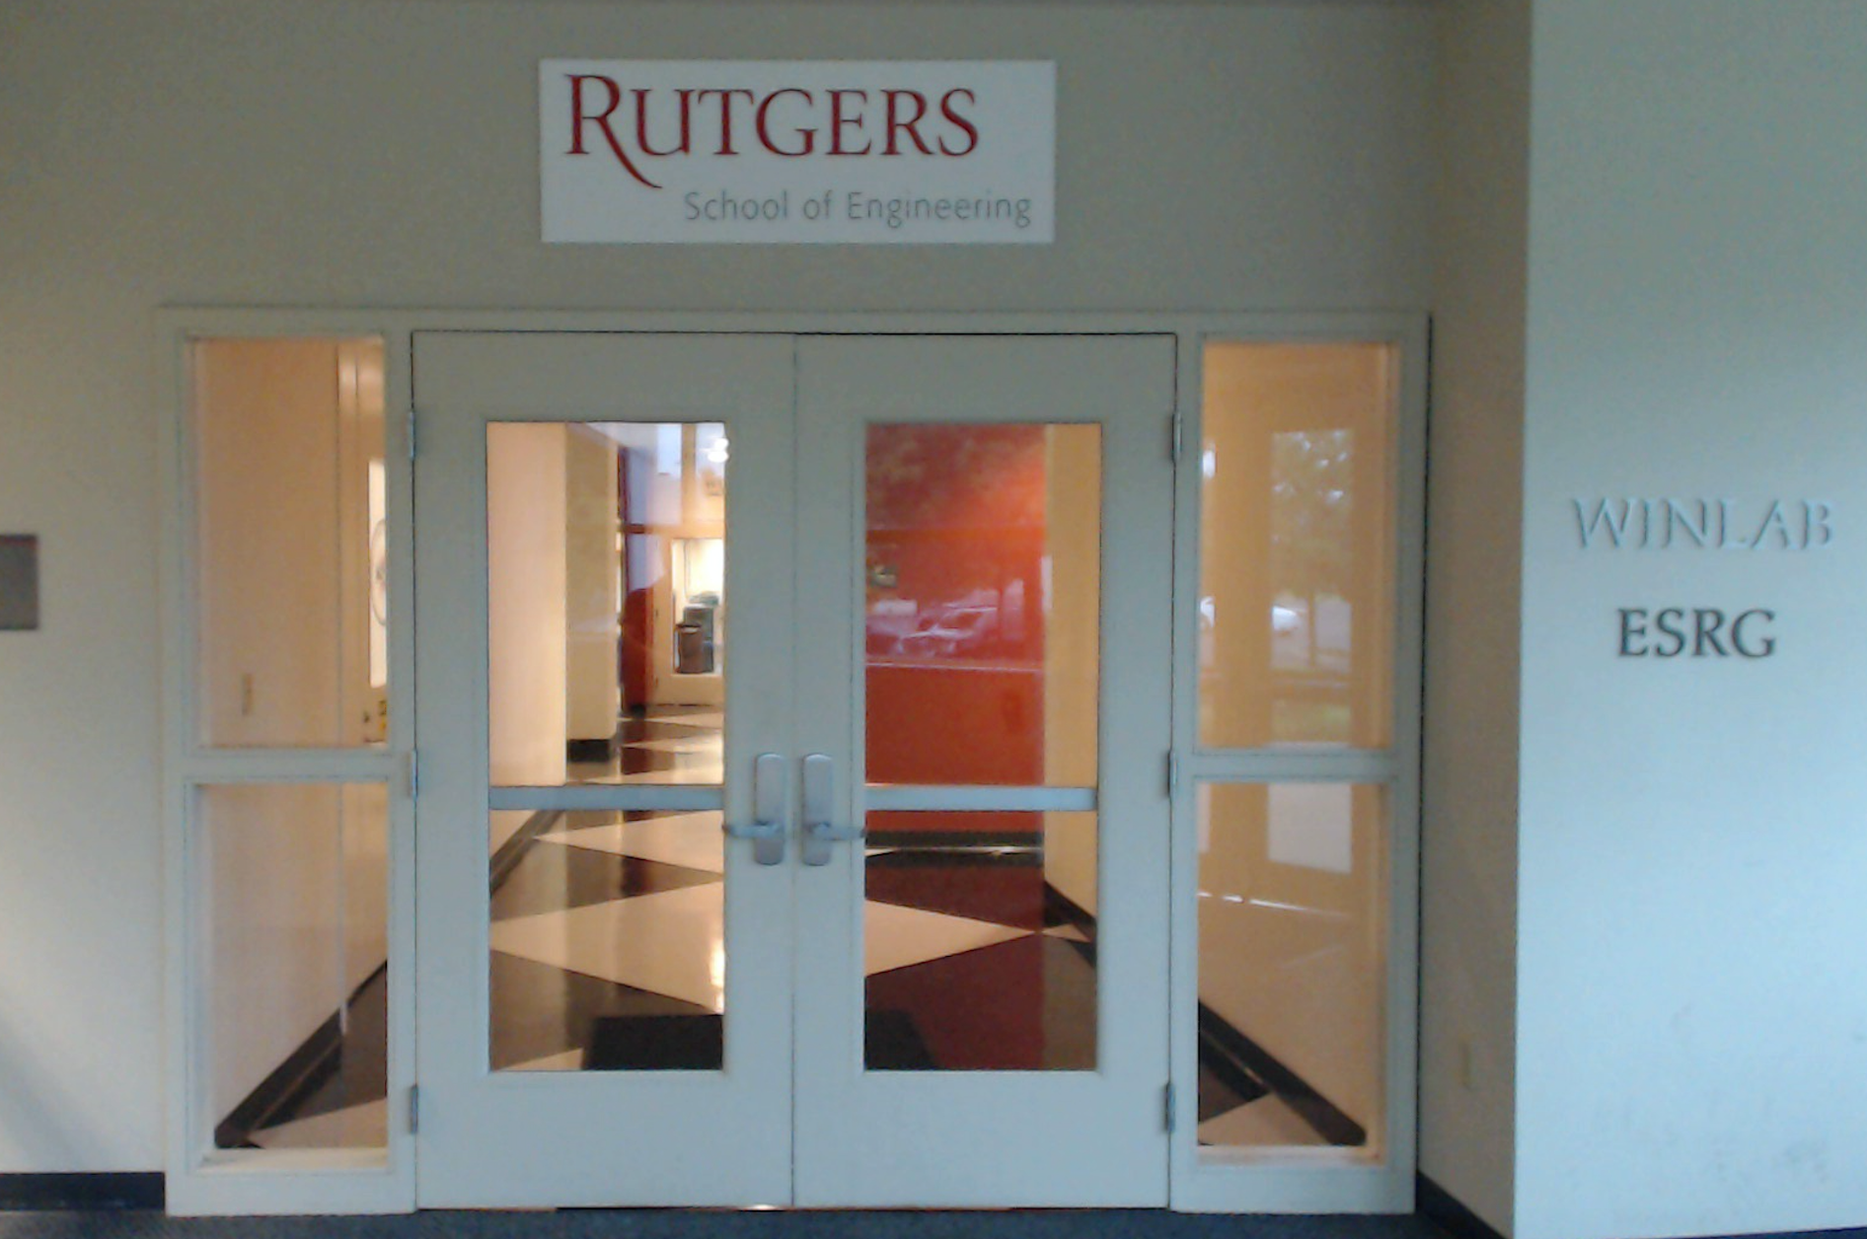
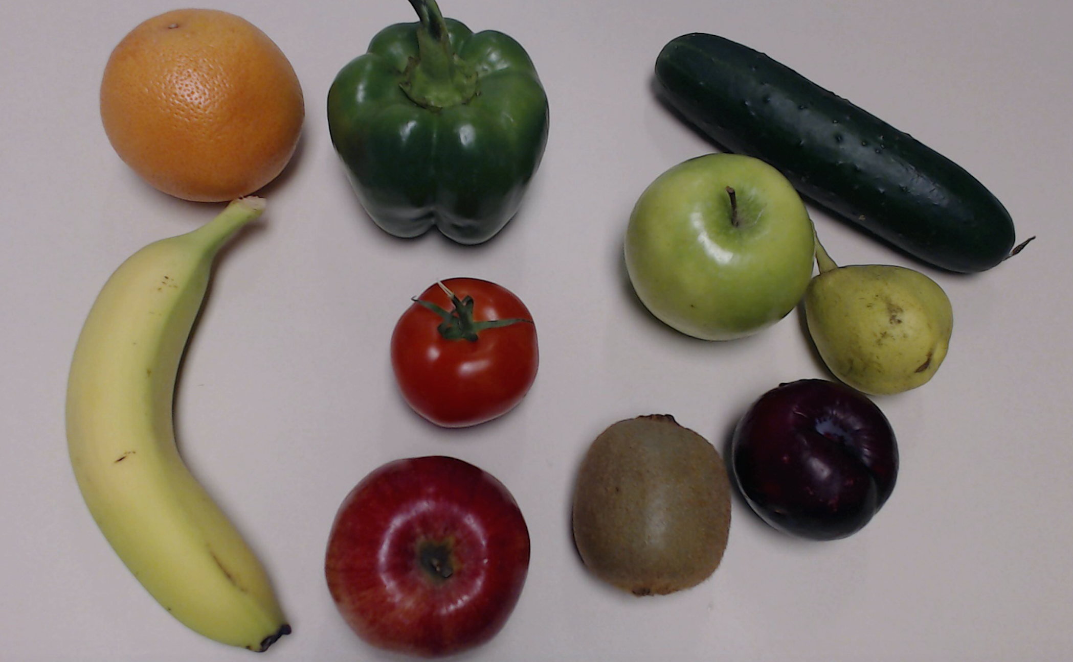
WINLAB SUMMER
2015
SERVICES PLANS
Find Attachments on objects
Find calories in your fruits

Slide 6
WINLAB SUMMER
2015
FEATURE MATCHING
Descriptors represent Image’s Key point pixel data as vectors
Descriptors of test Image were compared to the descriptors extracted from training images and the image with maximum number of matches was selected
High possibility of false positives
Does not take advantage of all the data available in the training set.

Slide 7
WINLAB SUMMER
2015
CLASSFIER
Trained using multiple positive and negative images(Images that definitely do not contain the object)
Uses a Machine Language Algorithm like SVM to classify to a cluster based on training images
Built-in functions to apply the classifier to an image to locate object
Built-in functions to locate the object on the image
Possibly more Expensive and unusable on a live application recognizing multiple objects

Slide 8
WINLAB SUMMER
2015
INTRASTRUCTURE PART
Two Plans:
Continue using MJPG-streamer + QT or GTK
Switch to use OpenCV library to directly construct a basic version application
MJPG-streamer: a command line application that copied JPG-frame from a single input plugin to multiple output plugin
QT: framework mainly for developing application software with graphical user interfaces
GTK: a cross-platform widget toolkit for creating graphical user interfaces
OpenCV(Open Source Computer Vision): a library of programming functions mainly aimed at real-time computer vision

Slide 9
WINLAB SUMMER
2015
MISSIONS HAVE BEEN DONE
Overall: Both server side and client side programs are capable to do the basic services we expected, including video catching, file transmitting, image matching, sending back result and displaying the information
Server side: Capable to receive the encoded image file, match the real-time frames with the 100 images in its database, also could calculate the coordinate of the matched object, and send the result info back to the client
Client side: Be equipped to catch the real-time video through the camera, encode the frames and send them to the server in a certain frequency, when the result is sent back, set up the windows to display them

Slide 10
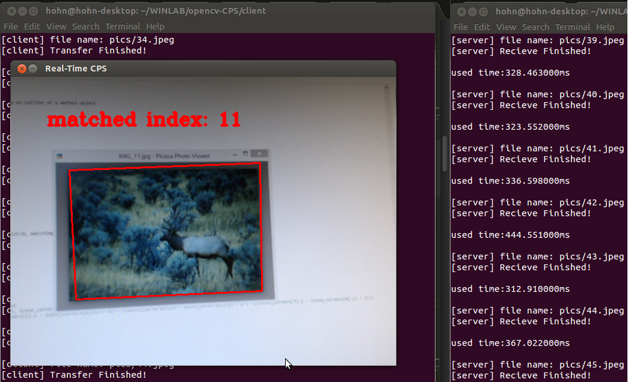
WINLAB SUMMER
2015
DEMO
The basic version application is finished. The client side is now displaying the result, including matched index and coordinate. It also draw the outline of the object.

Slide 11
WINLAB SUMMER
2015
Next Week Plan
Try to add some more useful services
Improve the stability and performance of the whole application
Start study on the Mobility First materials and get ready to do the migration
Learn stuffs about cloud computing

Slide 12
WINLAB SUMMER
2015
Question

