Slide 1
Real-Time Cyber Physical Systems Application on MobilityFirst
Winlab Summer Internship 2015
Karthikeyan Ganesan, Wuyang Zhang, Zihong Zheng

Slide 2

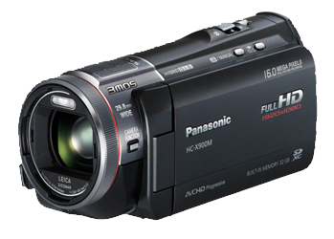
WINLAB SUMMER
2015
PRELIMINARY GOAL OF OUR PROJECT
CPS Application based on MF
Server side:
Implement server application for object recognition;
Return the result
MobilityFirst Virtual Network
Client side:
Run an instance of camera system;
Transmits video in standard format;
Simple graphical interface to display results

Slide 3
WINLAB SUMMER
2015
OUTLINE OF THE PROGRESS
SERVER
CLIENT
Database
Image Process
Camera
Display
COORD
COORD
Network
Network
MobilityFirst API

Slide 4
WINLAB SUMMER
2015
Mobility First for CPS
MF allows for lower latency for mobile devices.
Data is sent directly to mobile device’s network
CPS can benefit greatly from lower latency.
Implementation will also showcase the performance benefit achieved.

Slide 5
WINLAB SUMMER
2015
MobilityFirst
MoblityFIrst: A Robust and Trustworthy Mobility-Centric Architecture for the Future Internet
GUID
Dominance over using IP to identify and locate devices
GNRS
Name Resolution
GSTAR
Extension of CNF
Robust & effective routing mechanism

Slide 6
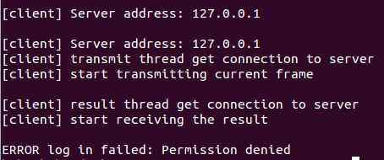
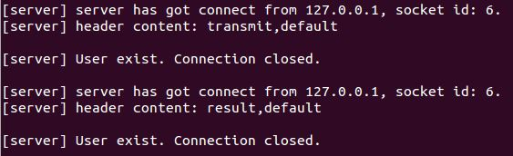
WINLAB SUMMER
2015
APPLICATION PART
Few more features are added to the application!
User ID: Clients could now enter their own id when run the application
Duplicate User Detection: Server would deny the client if its user ID is already log in
client
server

Slide 7
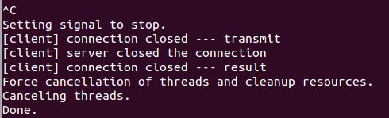
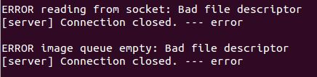
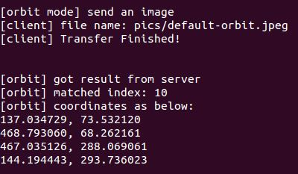
WINLAB SUMMER
2015
NEW FEATURES
Close elegantly: Both client and server would release the resources when disconnect.
server
client
Orbit Mode: Do the imitation of camera catching on orbit nodes

Slide 8
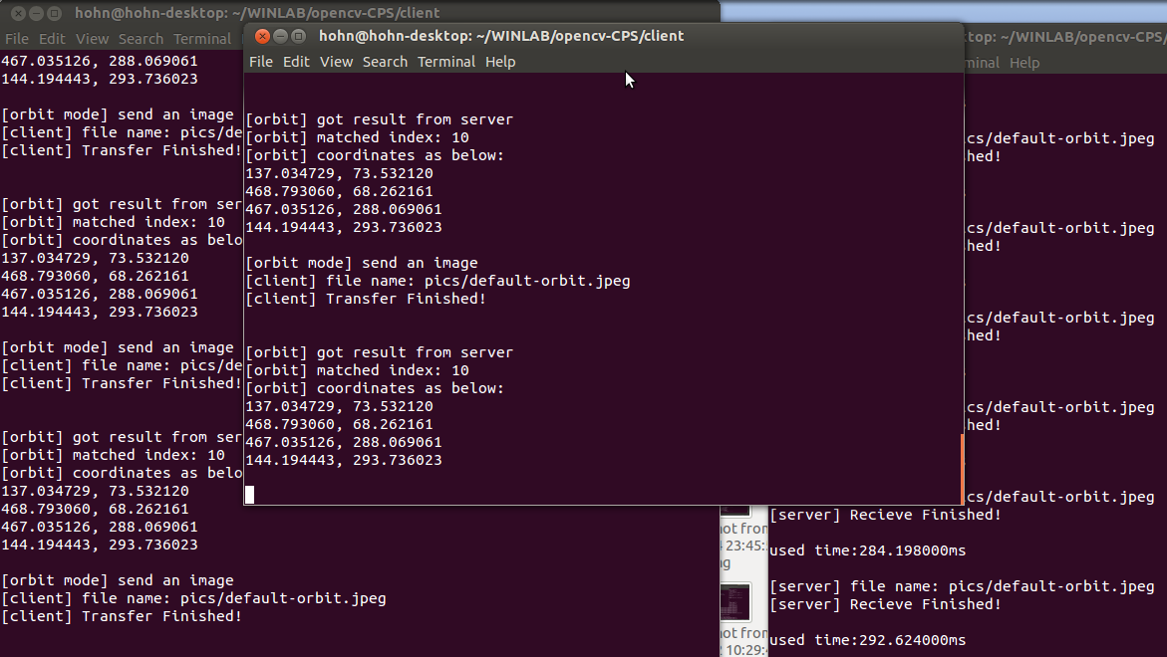
WINLAB SUMMER
2015
NEW FEATURES
Multi-clients: Achieved by allocating every client a unique semaphore and an image queue.

Slide 9
WINLAB SUMMER
2015
EMBEDDED WITH MF API
Environment Mission Done:
Finished set up a new image for orbit nodes aim for CPS application:
Installed the OpenCV Library.
Changed the g++ version to a higher one.
Figured out a way to compile the application and link both the OpenCV & MFAPI Libraries with “pkg-config” tool.
Saved the configured image as “mf-cps-1to1.ndz” in repository machine

Slide 10
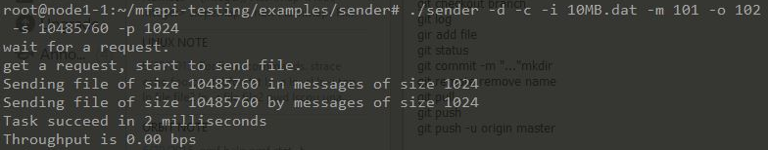
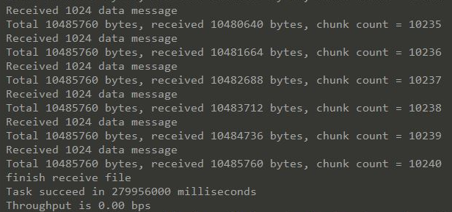
WINLAB SUMMER
2015
Sender:
EMBEDDED WITH MF API
Successfully run the sample codes.
Still modifying the application to use the MF api.
Receiver:
…
Client node
Server node
MF
Scheme of the first step

Slide 11
WINLAB SUMMER
2015
Next Week Plan
Continue modify the application codes aim to run with the MF network
Test latency and stability of running application with MF network on ORBIT
Learn stuffs about cloud computing

Slide 12
WINLAB SUMMER
2015
Question

