Slide 1
Real-Time Cyber Physical Systems Application on MobilityFirst
Winlab Summer Internship 2015
Karthikeyan Ganesan, Wuyang Zhang, Zihong Zheng
Shantanu Ghosh, Avraham Cooper

Slide 2

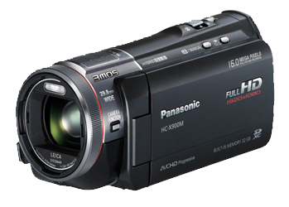
WINLAB SUMMER
2015
PRELIMINARY GOAL OF OUR PROJECT
CPS Application based on MF
Server side:
Implement server application for object recognition;
Return the result
MobilityFirst Virtual Network
Client side:
Run an instance of camera system;
Transmits video in standard format;
Simple graphical interface to display results

Slide 3
WINLAB SUMMER
2015
OUTLINE OF THE PROGRESS
SERVER
CLIENT
Database
Image Process
Camera
Display
COORD
COORD
Network
Network
MobilityFirst API

Slide 4
WINLAB SUMMER
2015
EMBEDDED WITH MF API
Progress: Successfully finished the basic version of CPS application using MFAPI.
Client node
Server node
MF
Issues Encountered:
(1) TCP socket we used to employ is connection-oriented, while MF socket is not.
(2) We used plenty sockets for communication in TCP version, but it would not work for MF.
Scheme of the first step

Slide 5
WINLAB SUMMER
2015
Solution and Implementation
Message Distributor: aims to distribute the message
received through the unique GUID, create connections between different threads in client and server based on MFAPI
Additional Header: Add specific content to define which thread should receive the message and what operation it should do.
For example:
“create” for new connection
“accepted, id” for connection accepted (followed with the new created id),
“sock, id” for transmitting message for the specific id followed.
“close, id” for close the channel for the id followed
Notice that: different threads (or different connections) would have different id,
so there are Multiple ids for one GUID in the program

Slide 6
WINLAB SUMMER
2015
Solution and Implementation
Methodology: employed the producer and consumer model, achieved with semaphore and blocking queue
MsgDistributor::listen() -> every message the source GUID received would come to this function, then the listen() would parse the header
and judge which thread(id) should receive this message
then push the content into the queue.
MsgDistributor::recv(id, …) -> wait for the message queue of specific id, if it is
filled, then take out the message
Other functions:
MsgDistributor::connect()
MsgDistributor::accept()
MsgDistributor::send(id, …)
MsgDistributor::close(id, …)

Slide 7
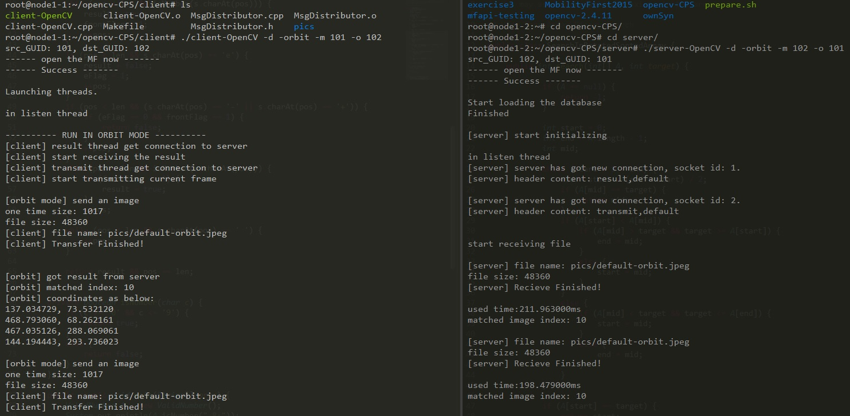
WINLAB SUMMER
2015
Client
DEMO
Server

Slide 8

WINLAB SUMMER
2015
Fog Network
A network architecture that uses one or a collaborative multitude of end-user clients or near-user edge devices to carry out a substantial amount of storage, communication and control, configuration, measurement and management.
mciiogijehkdemklbdcbfkefimifhecn/icons/newd.png

Slide 9
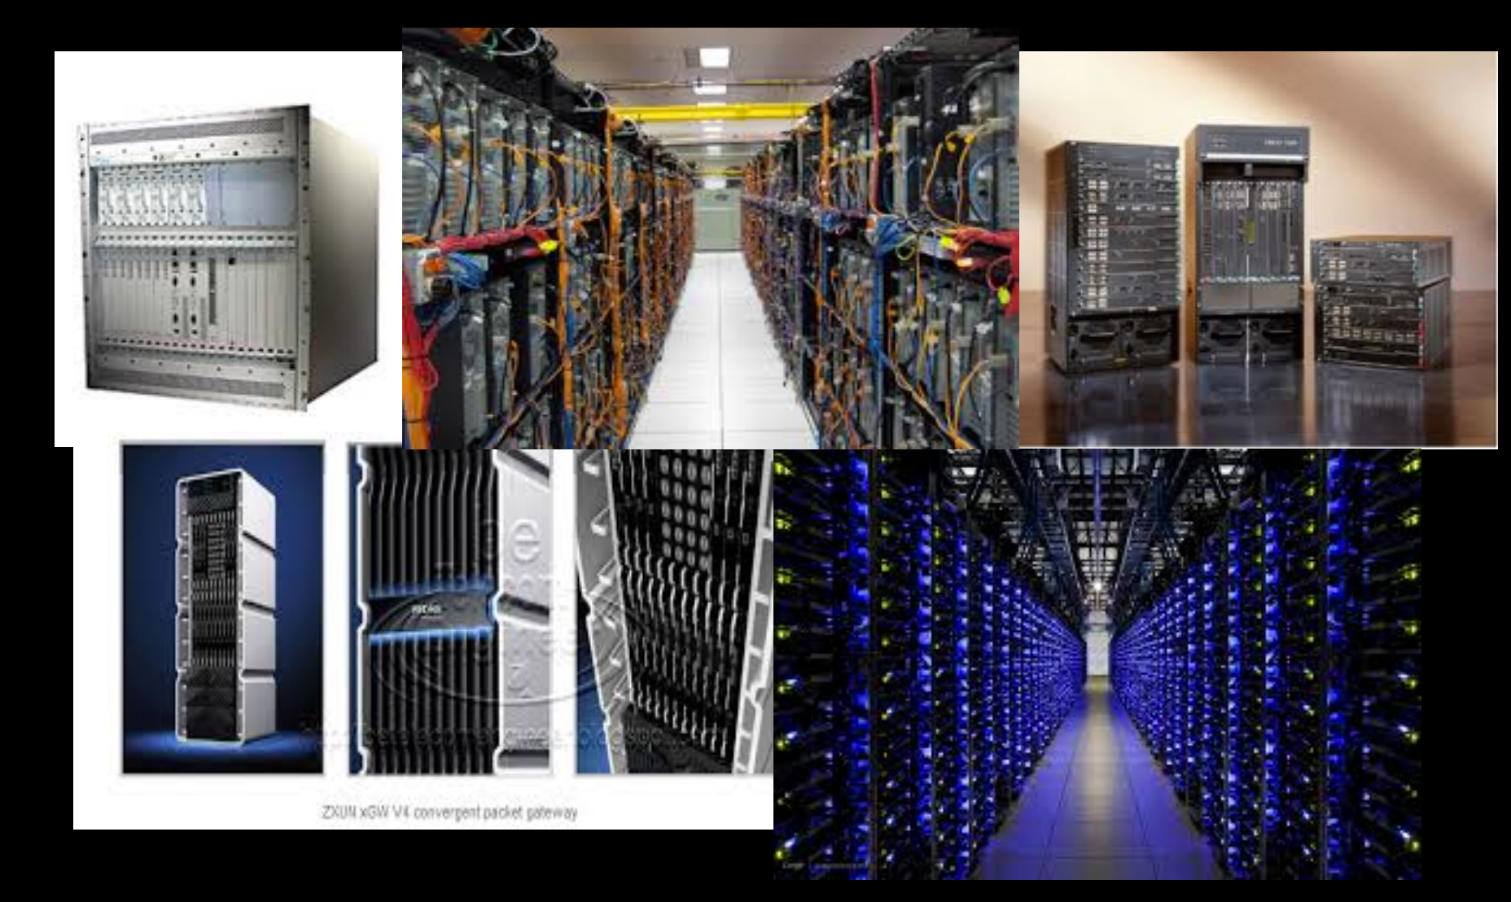
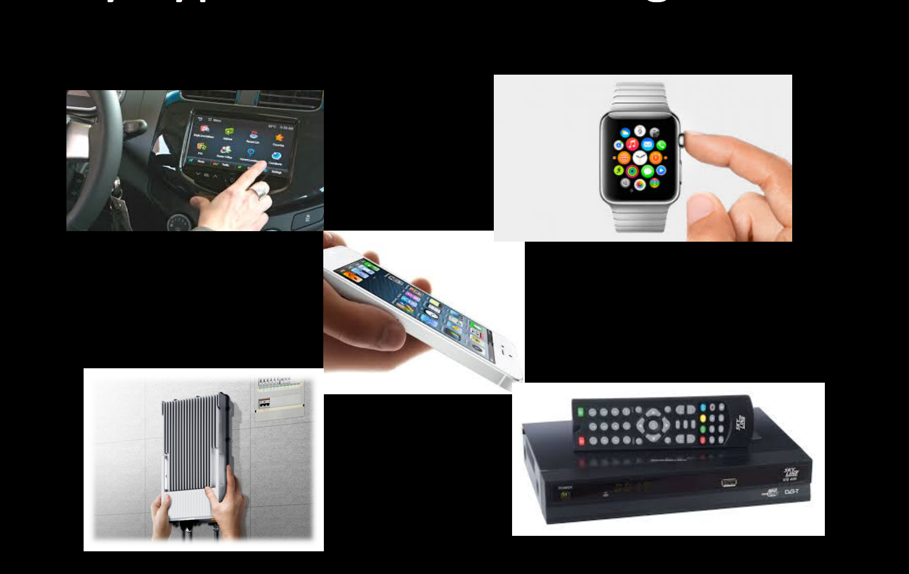
WINLAB SUMMER
2015
Contrast
http://www.5gsummit.org/docs/slides/Mung-Chiang-5GSummit-Princeton-05262015

Slide 10

WINLAB SUMMER
2015
Why Fog
Proposed in: Fog Computing and Its Role in the Internet of Things
Real-Time processing: right here and now
Rapid innovation and affordable scaling
Client-centric objectives
Pooling of local content/storage/processor

Slide 11

WINLAB SUMMER
2015
Why Fog
NB campus
New York
Newark campus
John’s iPhone

Slide 12
WINLAB SUMMER
2015
Next Week Plan
Complete the disconnection part for the application using MFAPI
Further study the interplay relation between cloud network and fog network
Start to play with Google Glass

Slide 13
WINLAB SUMMER
2015
Question

