Slide 1
Real-Time Cyber Physical Systems Application on MobilityFirst
Winlab Summer Internship 2015
Karthikeyan Ganesan, Wuyang Zhang, Zihong Zheng
Shantanu Ghosh, Avi Cooper

Slide 2
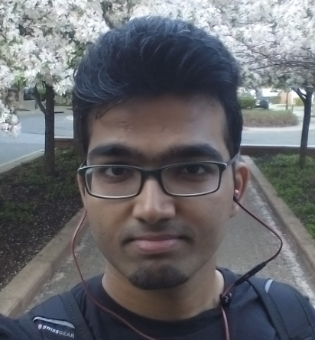
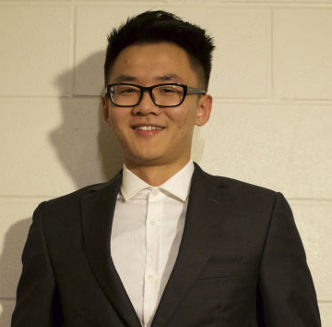
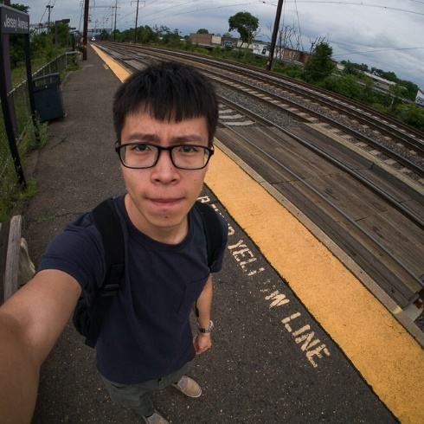
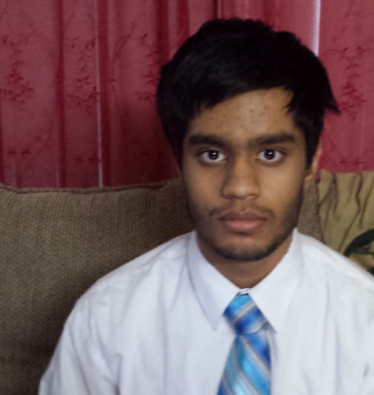
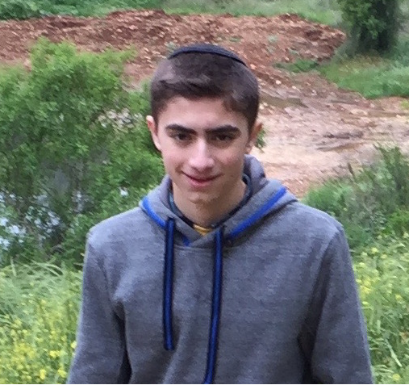
WINLAB SUMMER
2015
TEAM MEMBERS
Karthikeyan Ganesan
Wuyang Zhang
Zihong Zheng
Shantanu Ghosh
Avi Cooper

Slide 3
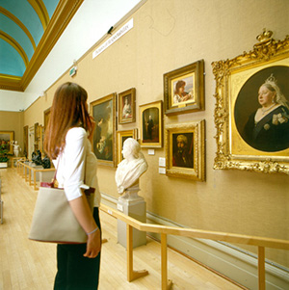
WINLAB SUMMER
2015
BACKGROUND
Suppose a Japanese tourist is walking in MoMA…He/She may ask
Author?
Year?
Background Introduction?
Communicating directly with a local server would provide faster service rather than having data routed through the user’s home network.
A CPS system built on mobility first network can allow the tourist to obtain information about these paintings in a fast and hassle free way.
http://www2.le.ac.uk/departments/english/undergraduate/images/new%20walk%20museum.jpg

Slide 4
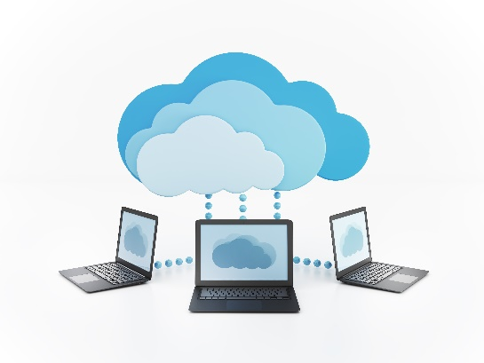
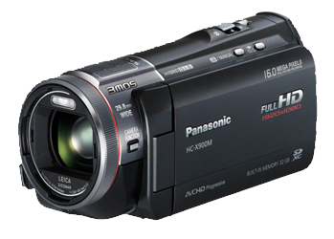
WINLAB SUMMER
2015
PRELIMINARY GOAL OF OUR PROJECT
CPS Application based on MF
Server side:
Implement server application for object recognition;
Return the result
MobilityFirst Virtual Network
Client side:
Run an instance of camera system;
Transmits video in standard format;
Simple graphical interface to display results

Slide 5
WINLAB SUMMER
2015
OUTLINE OF THE PROGRESS
LOCAL SERVER
CLIENT
Database
Image Process
Camera
Display
COORD
COORD
Network
Network
MobilityFirst API

Slide 6
WINLAB SUMMER
2015
Mobility First (MF)
Part of Future Internet Architecture Program
Replaces fixed-Host/Server model
Mobility centric architecture (Considers Frequent shifts in Device’s location)
Uses a Globally Unique Identifier (GUID) and a Global Name Resolution Service (GNRS)

Slide 7
WINLAB SUMMER
2015
MobilityFirst
MoblityFIrst: A Robust and Trustworthy Mobility-Centric Architecture for the Future Internet
GUID
Dominance over using IP to identify and locate devices
GNRS
Name Resolution
GSTAR
Extension of CNF
Robust & effective routing mechanism

Slide 8
WINLAB SUMMER
2015
Mobility First for CPS
MF allows for lower latency for mobile devices.
Data is sent directly to mobile device’s network
CPS can benefit greatly from lower latency.
Implementation will also showcase the performance benefit achieved.

Slide 9
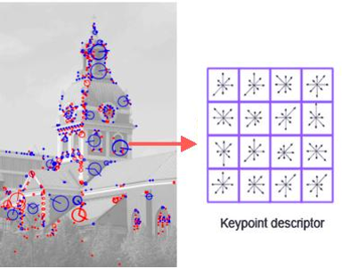
WINLAB SUMMER
2015
Image Match
Descriptor of Image
Sensitive points which
are the convolution result of pixels with Hessian Matrix
64 Demensions Vector
N × 64 vectors
(N depends on the resolution of an image and also the value of minHessian parameter in Speeded Up Robust Features[SURF] )
http://www.codeproject.com/KB/recipes/619039/SIFT.JPG

Slide 10
WINLAB SUMMER
2015
Image Match ( Preprocessing Image Database )
Suppose each image has 100 descriptors
IMG_1
IMG_2
….
IMG_99
IMG_100
Descriptor 1 to 100
Descriptor 200 to 300
…
Descriptor 9,800 to 9,900
Descriptor 9,900 to 10,000

Slide 11
WINLAB SUMMER
2015
Image Match ( Matching )
Descriptors of Requested Image
Descriptors of Database Image
Database Image
Descriptor 1
Descriptor 2
….
Descriptor 99
Descriptor 100
Descriptor 1
Descriptor 2
…
Descriptor 9,999
Descriptor 10,000
Image 1
Image 2
…
Image 99
Image 100
find a descriptor in database with
the smallest Euclidean distance
map to image index

Slide 12
WINLAB SUMMER
2015
Image Match ( Matching )
Calculate mapped times of images
Image 1 | 6
Image 12 | 2
Image 34 | 10
Image 65 | 4
Image 78 | 2

Slide 13
WINLAB SUMMER
2015
CURRENT FRAME
Image Recognition: Successfully achieved image recognition under half second with acceptable accuracy. Current database size is 100 (images).
Application Part: Application based on Linux/TCP is already built up and achieved the basic Museum Scenario function.
Application using the MobilityFirst network is also built, but could now only run in the orbit lab.
Google Glass: Got the Bluetooth communication working. Now trying to live stream the video to the phone and do the combination with MF.

Slide 14
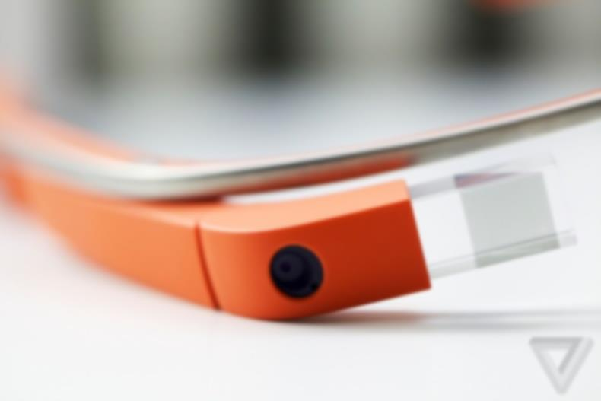



WINLAB SUMMER
2015
Google Glass
Why Google Glass? Glass provides us with access to both a camera that is recording exactly what the user is seeing, and a way to give information back to the user unobtrusively. What the user sees and how they sees it is very important.
Glass captures video
Outline of process:
Video Data
Results
Bluetooth
Video Data
Why the phone as a go between? Glass is relatively low on battery and computing. Transferring networking to a phone will improve both battery life and networking speeds.
MF
Results
Server runs image recognition software
Android phone handles networking

Slide 15
WINLAB SUMMER
2015
Google Glass- Progress
Previous progress: The android Bluetooth APIs have been implemented on the Glass and the phone and data can be transferred in between them. Separately, the MobilityFirst client code has been written for C++ and needs to be implemented in Java for android. (MobilityFirst already support Java and android.)
Future Goals: The camera data collection needs to be implemented on the Glass and the MobilityFirst client code needs to be converted to be used for android. Also, a system to tell the user the results of the image recognition algorithm needs to be designed.

Slide 16
WINLAB SUMMER
2015
EMBEDDED WITH MF API
Issues Encountered:
(1) TCP socket we used to employ is connection-oriented, while MF socket is not.
(2) We used plenty sockets for communication in TCP version. But for MF, both client and server would only have one GUID.
Client node
Server node
MF
Scheme of the first step
Solution:
Develop a Message Distributor to classify and distribute the message received through the unique GUID.
Basically achieved by adding additional header to define who and what.

Slide 17
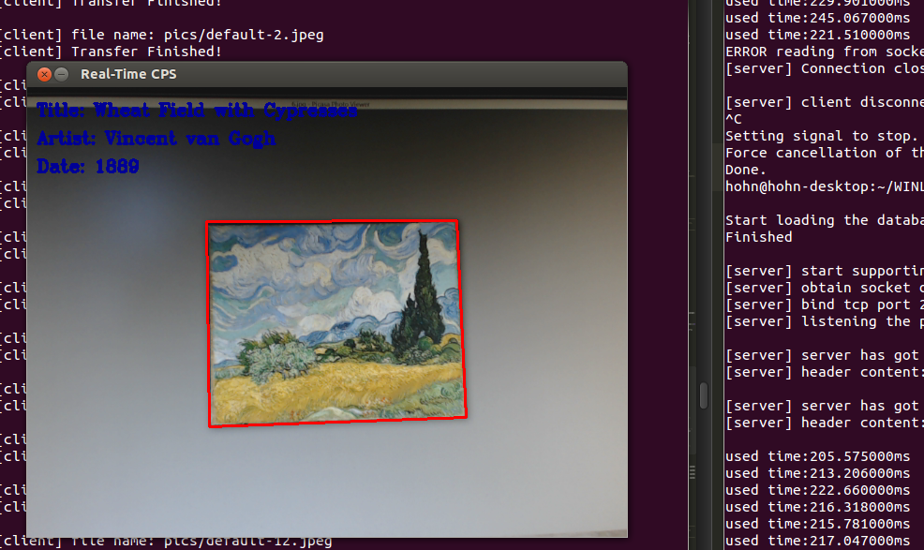
WINLAB SUMMER
2015
DEMO
This is the TCP version. The client side is now displaying the result, including title, artist and date of the paintings.

Slide 18
WINLAB SUMMER
2015
Next Week Plan
Continue to set up the connection between mf network and the general computer.
Develop the client program based on google glass and Android phone.
Try to improve the speed and accuracy of the recognition on Image processing aspect and on the cloud computing aspect.
Determine how to implement optimal data encryption using cryptographic/utility functions from the OpenSSL core library.

Slide 19
Question

