Slide 1
Satellite CDN
Week 1 Presentation by:
Seo Bo Shim

Slide 2

Team Members
Seo Bo Shim

Slide 3
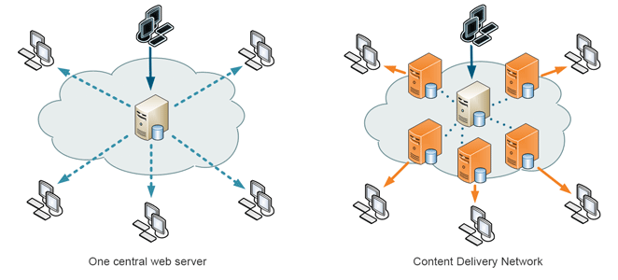
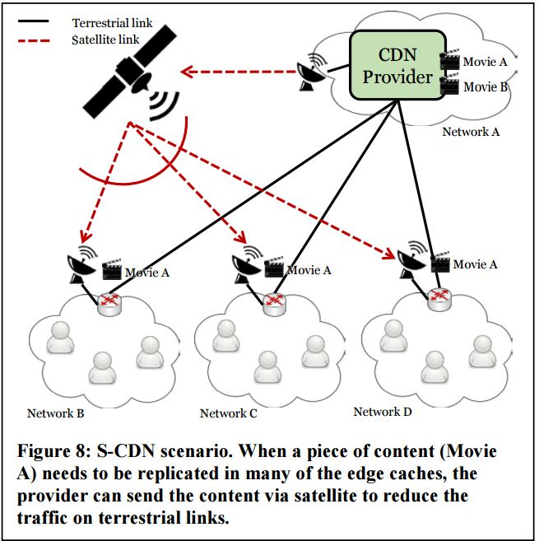
(CDN) Content Delivery Network
User receives content faster than requesting from central server
Utilize multi-casting capabilities of satellites for supporting physical CDNs
Fig 1. “Content Delivery Network”
Fig 2. “Satellite Content Delivery Network”

Slide 4
MobilityFirst
Develop S-CDN framework with MobilityFirst
        Support functions of content-oriented applications without overlay networks
Network Environment 2 Trial
Goal: Integrate of satellite multicast capabilities into a content delivery network based on MobilityFirst (for OTT content)
Routes packet to the object (phone, laptop)
Content is assigned
Human-Readable Name
Globally Unique Identifier
Global Name Resolution Service
Network Address

Slide 5
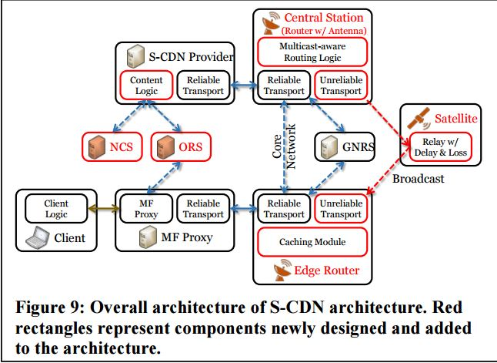
S-CDN with MobilityFirst
Routing Logic – decide to send content via satellite or terrestrial links
Transport Protocol for satellite transmission
Edge caching on routers. Hard Drive with fast access
NCS – grants GUID to content
ORS – allows users to pre-screen content before querying
Fig 3. S-CDN Overview

Slide 6
Next Week
No overall action items
What still needs to be implemented?
Details of the Implementation

Slide 7
References
“Fig 1. Content Delivery Network” by Kanoha, distributed under a CC BY-SA 3.0 License. https://en.wikipedia.org/wiki/Content_delivery_network
“Fig 2. & Fig 3.” in Section 4.3 Network Environment (NE) Trials. “The Next-Phase MobilityFirst Project - From Architecture and Protocol Design to Advanced Services and Trial Deployments", 2016 Project Report.
The Next-Phase MobilityFirst Project - From Architecture and Protocol Design to Advanced Services and Trial Deployments", 2016 Project Report
F. Zhang et al., "Content Delivery in the MobilityFirst Future Internet Architecture," 35th IEEE Sarnoff Symposium, 2012.

