Slide 1

Satellite CDN
Week 2 Presentation by:
Seo Bo Shim

Slide 2
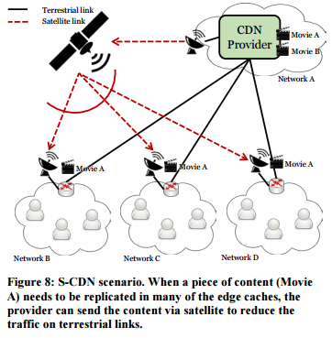
Overview
Satellite Content Delivery Network necessary for reducing traffic in physical CDN links when distributing popular content
MobilityFirst written over Click Router → focus on lower-level implementation
Fig. 1

Slide 3
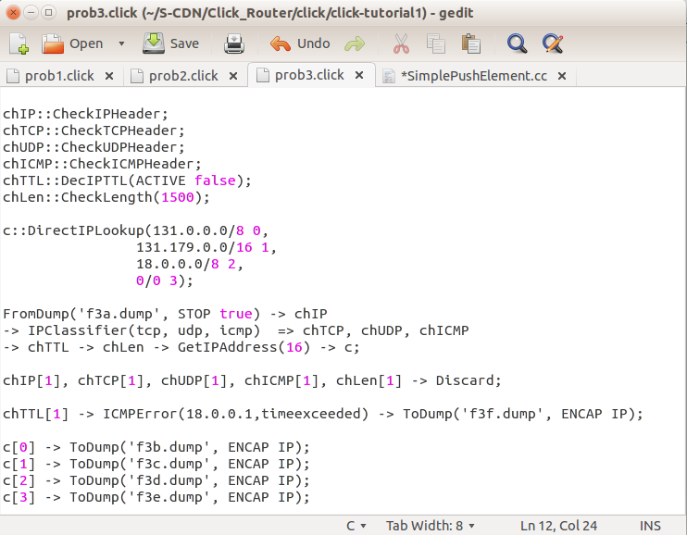
This Week
Click Modular Router
    Online tutorial
    Intro to CommNet Click tutorial
    Checking Headers and Destination IPs
Custom elements & packets – C++
Linux & VirtualBox
  Setting up environment

Slide 4
Next Week
Test out Click Router Configurations across two consoles
    Test out projects with custom elements
Be able to send and receive packets across two physical consoles
What’s next after learning Click?

Slide 5
References
“Fig 1” in Section 4.3 Network Environment (NE) Trials. “The Next-Phase MobilityFirst Project - From Architecture and Protocol Design to Advanced Services and Trial Deployments", 2016 Project Report.

