Slide 1

Satellite CDN
Week 3 Presentation by:
Seo Bo Shim

Slide 2
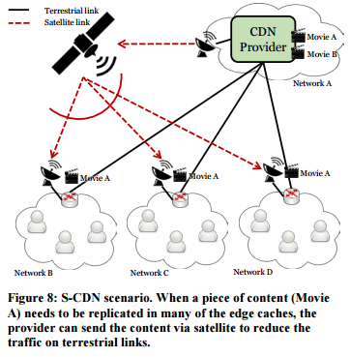
Project Overview
New Goal: Develop a Graphical User Interface for the S-CDN demo
Visualize that measurements stored in OML server, which is gathered from monitors that are using the OML API
    To be done in JavaScript
Fig. 1

Slide 3
This Week
Completed Click Projects
    Successfully created custom elements that:
      Generate timed packets
      Reads packet header and sorts based on type
    Built a custom packet format for the header
Understanding building blocks of MF → Know where to tell OML to take measurements from
Set up Orbit Account and in the process of deploying MF Network

Slide 4
Next Week
Successfully deploy an MF Network
Be able to monitor some statistics (in_pkts, out_pkts, bitrate_mbps, etc), from routers → eventually expand # of stats and visually display stats.
Iron out the details of what exactly needs to be monitored and visualized in the GUI

Slide 5
References
“Fig 1” in Section 4.3 Network Environment (NE) Trials. “The Next-Phase MobilityFirst Project - From Architecture and Protocol Design to Advanced Services and Trial Deployments", 2016 Project Report.

