Slide 1

Satellite CDN
Week 4
Presentation by:
Seo Bo Shim

Slide 2
Project Overview
Develop a GUI for the S-CDN caching demo
Clearly show the difference in speed in delivery of content between:
  Client 1: request content from source
  Client 2: request content from cache
Edge Router w/ Cache
Content Source
MF Proxy
Client 1
Bottle-neck
MF Proxy
Client 2
Connection 1
Connection 2

Slide 3
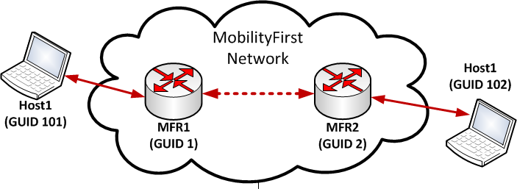
This Week
Figured out how to load wireless driver --> Successfully ran MF examples 1&3 over a wireless interface
Reading Orbit documentation and working through errors
Tried the example in setting up an OML server to gather data from MF experiment

Slide 4
Next Week
Deploy MF with cache enabled
Successfully start OML server and monitor router statistics
Figure out how to transfer data from OML server into a JavaScript GUI
  JSON?
Project Website

