Slide 1
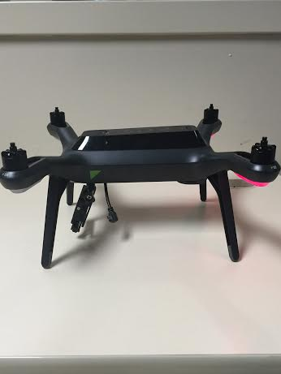
SDR & Spectrum
Week 10
Nicholas Lurski, Srijoy Dutta, Nithin Tammishetti, Shi Wang, Noah Paladino

Slide 2
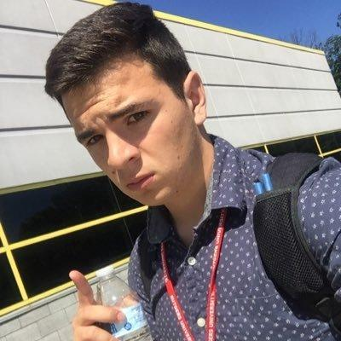

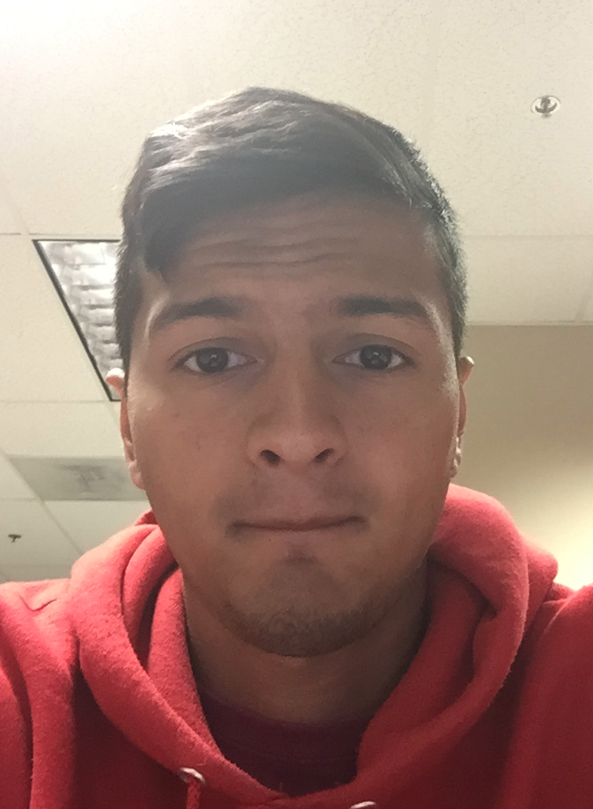

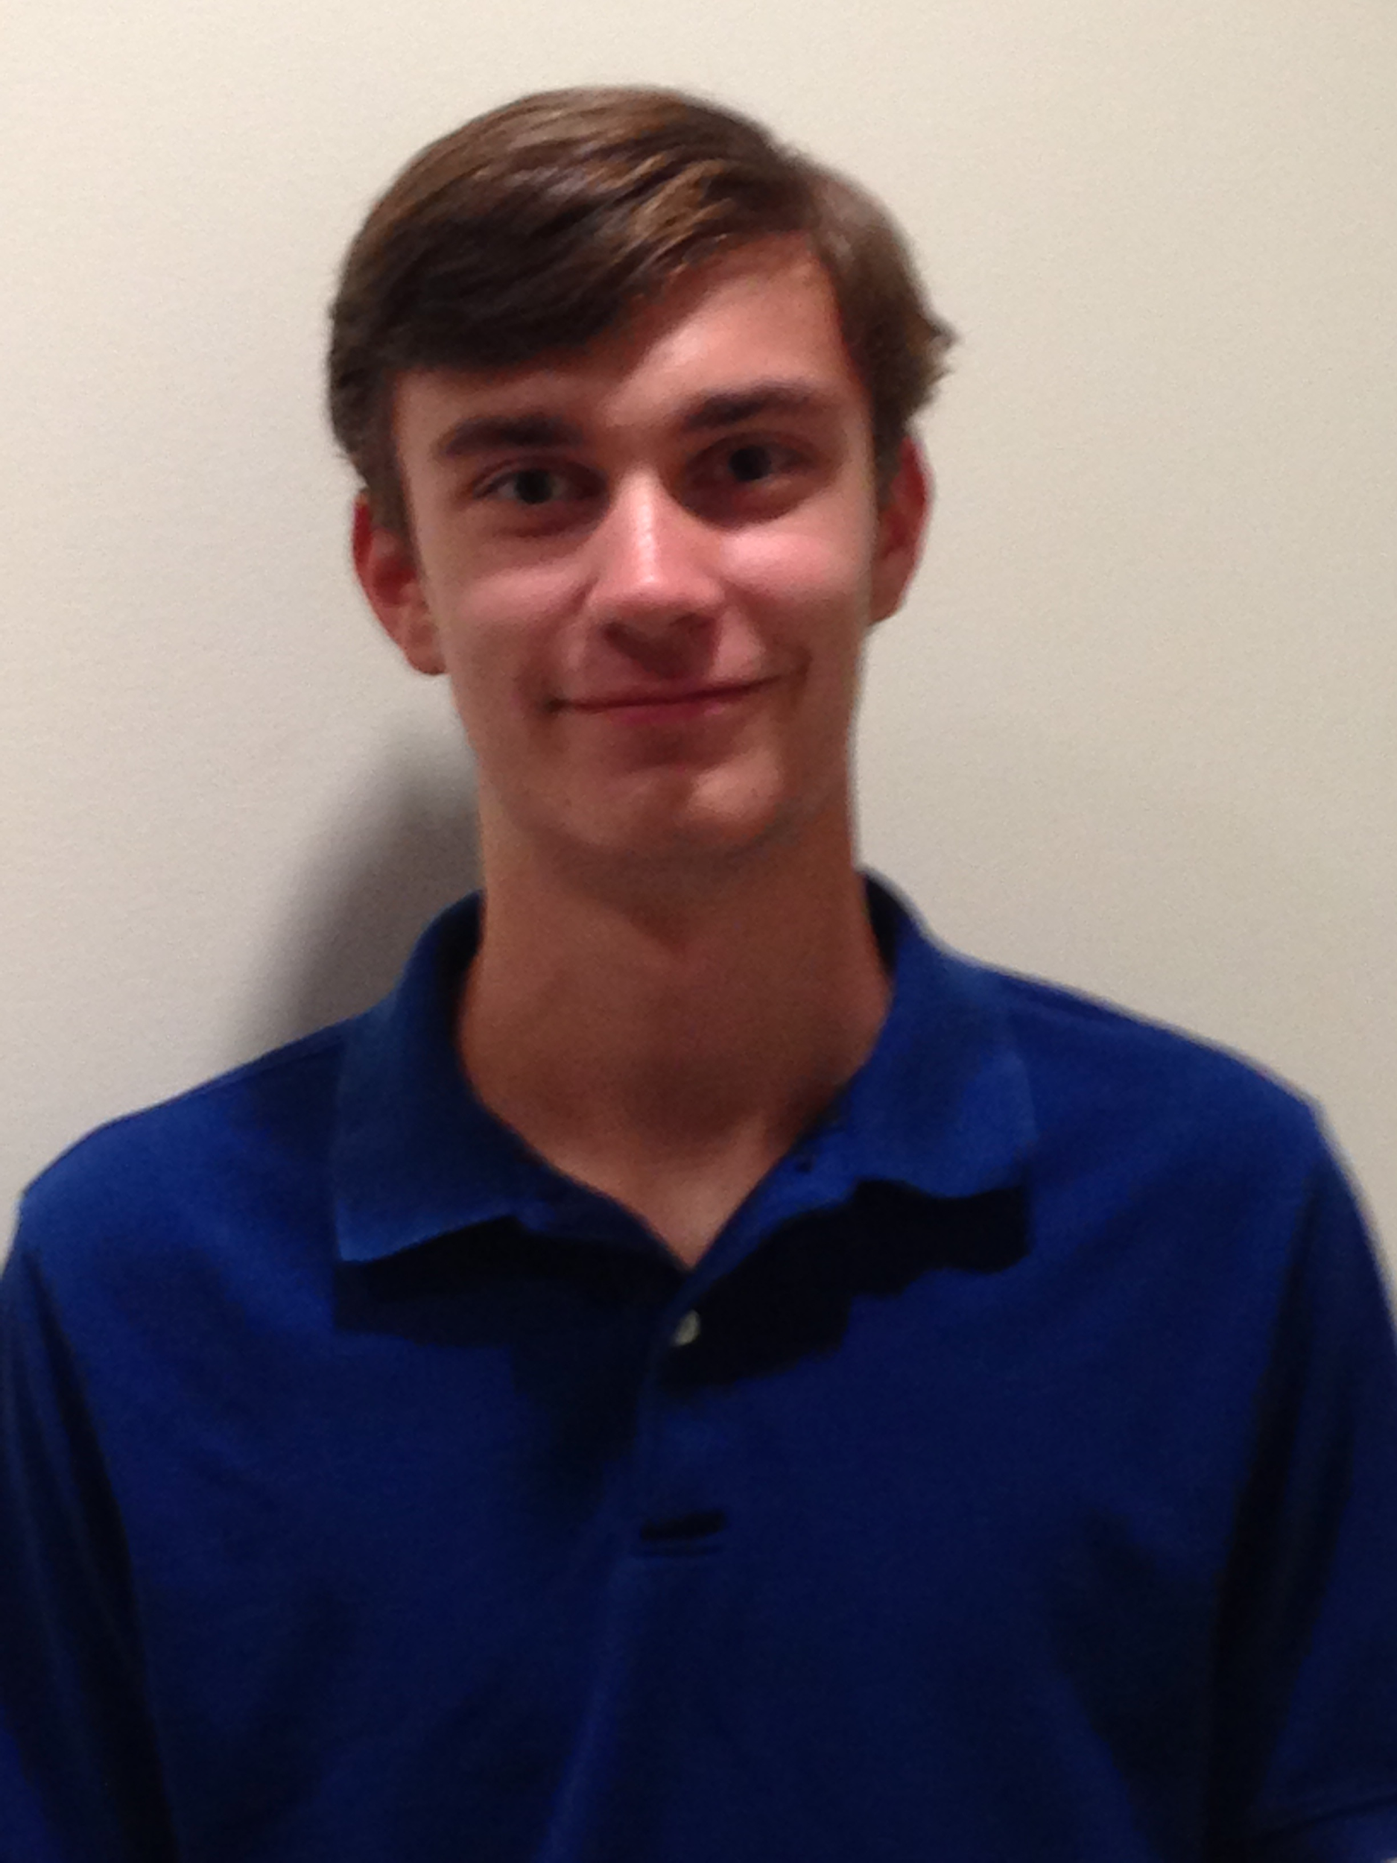
The Team
Nick Lurski
-RU Undergrad
Shi Wang
- RU Grad Student
Srijoy Dutta - Maryland Undergrad
Nithin Tammishetti
- RU Undergrad
Noah Paladino
- High School

Slide 3
Project Description
SDR & Spectrum: We are manipulating a drone to fly around and collect spectrum from an area for the purpose of regulation and enforcement. The spectrum will be collected and analyzed. We plan to operate at 900 MHz (frequency of cellular networks), so that we can locate potential mobile phone jammers using the drone.

Slide 4
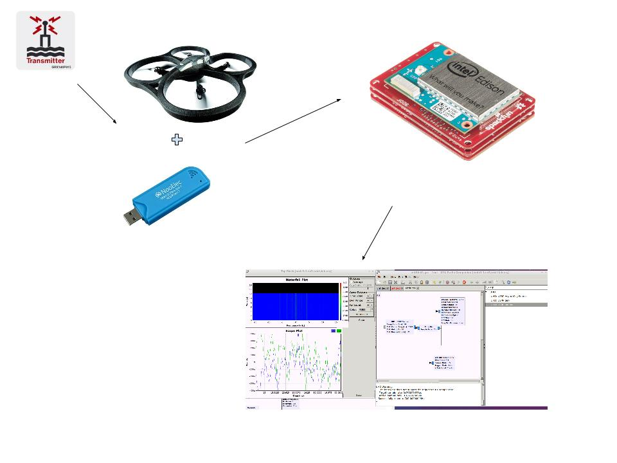
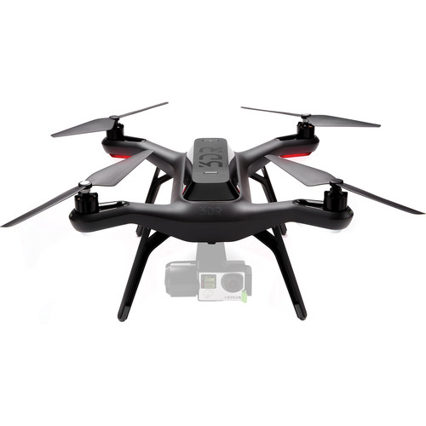

Slide 5
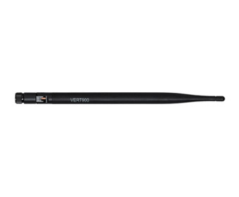
This Week’s Accomplishments
Received antenna that we plan to use for duration of project
  Vert900
    824 - 960 MHz
    Perfect for Cellular Frequencies
Flew SDR Solo with antenna, RTL-SDR, and Intel Edison attached
Found a new battery pack to replace the broken Edison
Did simulation for channel

Slide 6
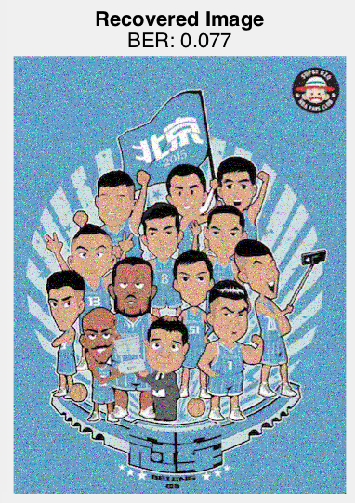
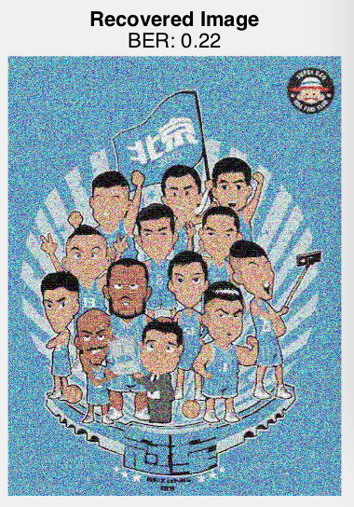

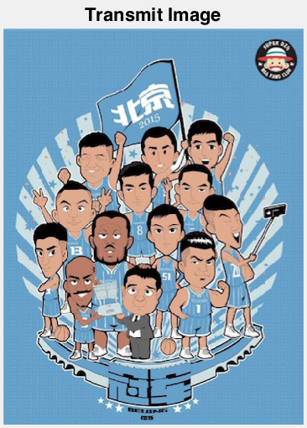
Result of Simulation
SNR=10dB
with channel estimation
BER=0.077
SNR=5dB
with channel estimation
BER=0.22
SNR=5dB
without channel estimation
BER=0.24

Slide 7
This Week’s Challenges
The drone fell over and the Intel Edison breakout board broke :(
  Received an older Edison, which didn’t have Intel battery
Figuring out how to do a dry run of experiment
Balancing components when mounting them on the drone
3D print case for Edison

Slide 8
Next Week’s Goals
Testing the reading of signals from Orbit Nodes
  Signal represents interference/jamming
Design case for Edison breakout board

