Slide 1
SDR & Spectrum
Massive MIMO
Week 3
Nicholas Lurski, Srijoy Dutta, Nithin Tammishetti, Shi Wang,
Bhargav Gokalgandhi

Slide 2



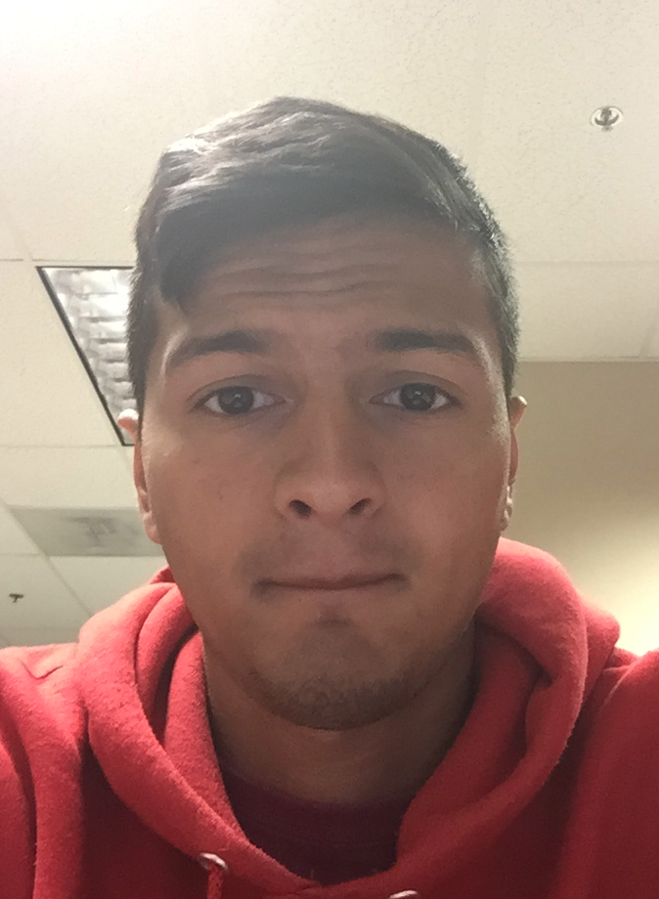

The Team
Nick Lurski
-RU Undergrad
Bhargav Gokalgandhi
- RU Grad Student
Shi Wang
- RU Grad Student
Srijoy Dutta - Maryland Undergrad
Nithin Tammishetti
-RU Undergrad

Slide 3
Project Description
SDR & Spectrum: We are manipulating a drone to fly around and collect spectrum from the ORBIT nodes. The spectrum will be collected and analyzed.
Massive MIMO: Collecting data from the testbed, performing offline and online processing of the data, and performing a channel estimation scheme.

Slide 4
This Week’s Accomplishments
Tested drone with weighted Raspberry PI + RTL attached
Set up Raspberry PI with Ubuntu installed
Familiarized self with RTL_TCP + SDR#
Developed script to set up Raspberry PI as “Central Interface”
Massive MIMO:
  Got familiarized with ORBIT Testbed grid
  Transmitted signals from a node in the grid and received the signals at the Massive MIMO Testbed
  Collected data for offline processing

Slide 5
This Week’s Challenges
Weight of components (Raspberry PI + RTL-SDR Dongle + Antenna + Cable) too much for drone
Issues with wireless connectivity
  Ad-Hoc networks
  Raspberry PI wireless
Massive MIMO:
  Biggest challenge : Bandwidth and Memory!!!
  Getting data from all X310s simultaneously
  Bugs in the codes and image files

Slide 6
Next Week’s Goals
Look for ways to overcome drone’s weight limits
Figure how to use one battery to power computer & drone
Figure out how to use Xbox360 Controller to pilot drone
  Easier for testing
Research different wide-band antenna designs
Massive MIMO:
  Read papers related to Massive MIMO and pilot signals
  Get data from all channels (each antenna) simultaneously
  Understand different programs related to sending and
receiving of signals
Notes:
Right now, we are not going to let the drone carry the Raspberry Pi. We plan to use a 32-feet USB line to connect the
drone and the Raspberry Pi. If we can get a more powerful drone, we will put the Raspberry Pi on the drone and try to
figure out how to use one battery to power the computer and drone.
Then, for easier testing, we try to figure out how to use Xbox360 Controller to pilot drone.
Since we need to reveive a wide range spectrum. For better reception, we will research wide-band antenna designs. We are
gonna search for different type of antennas and get to know their propeties and prices.

