Slide 1
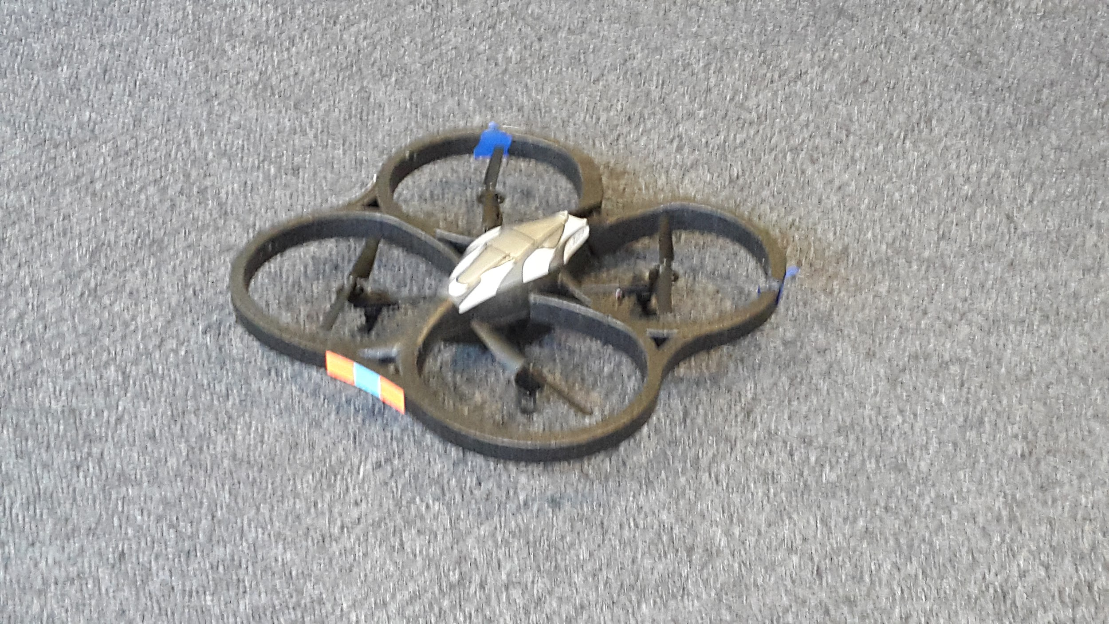
SDR & Spectrum
Massive MIMO
Week 4
Nicholas Lurski, Srijoy Dutta, Nithin Tammishetti, Shi Wang,
Bhargav Gokalgandhi

Slide 2
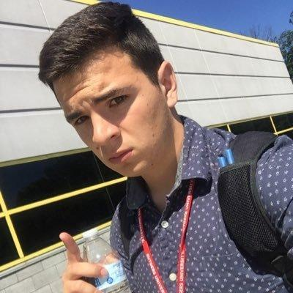


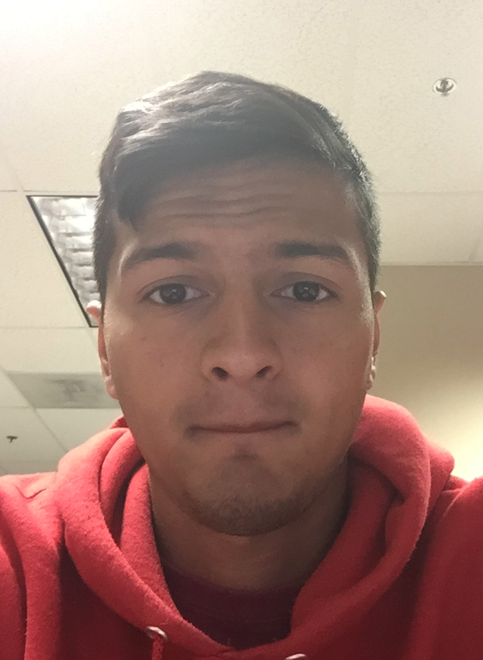

The Team
Nick Lurski
-RU Undergrad
Bhargav Gokalgandhi
- RU Grad Student
Shi Wang
- RU Grad Student
Srijoy Dutta - Maryland Undergrad
Nithin Tammishetti
-RU Undergrad

Slide 3
Project Description
SDR & Spectrum: We are manipulating a drone to fly around and collect spectrum from the ORBIT nodes. The spectrum will be collected and analyzed.
Massive MIMO: Collecting data from the testbed, performing offline and online processing of the data, and performing a channel estimation scheme.

Slide 4
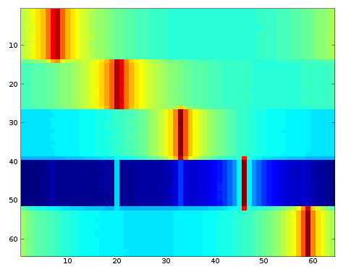
This Week’s Accomplishments
Ran WiSERD tutorials on sandboxes 3 and 7
Experimented with signal plotting in Octave
Flew drone successfully with RTL_SDR
attached
Setup the project website
Learned to use the GNU Radio Companion
with USRP devices
Massive MIMO
Started reading papers, presentations and
lectures related to Massive MIMO and OFDM.
Reading how OMF works and how scripting is done.
Performed tutorials on the grid using benchmark scripts.

Slide 5
This Week’s Challenges
Interference from DC Motors!!!
  The noise from motors is affecting signal quality at all frequencies
Some issues with OMF
Antenna problems
  Experiment with other higher quality antennas
Massive MIMO
Understanding various concepts introduced in
the papers and lectures.
New terms and encoding methods not read before.
Understanding the benchmark scripts.
(not much experience with Python and Ruby).
Problems with baseline-uhd image file.

Slide 6
Next Week’s Goals
Take testing from the sandboxes to the grid
  Multi-receiver/multi-transmitter setup
Learn more about USRP2 radios, and signal processing
Find a solution for dealing with noise from motors
Massive MIMO
Setup the project website.
Understand the OFDM benchmark script and understand ways in which it can be edited.
Then use the edited script to transmit signals using OFDM and
receive it on one of the nodes.

