Slide 1
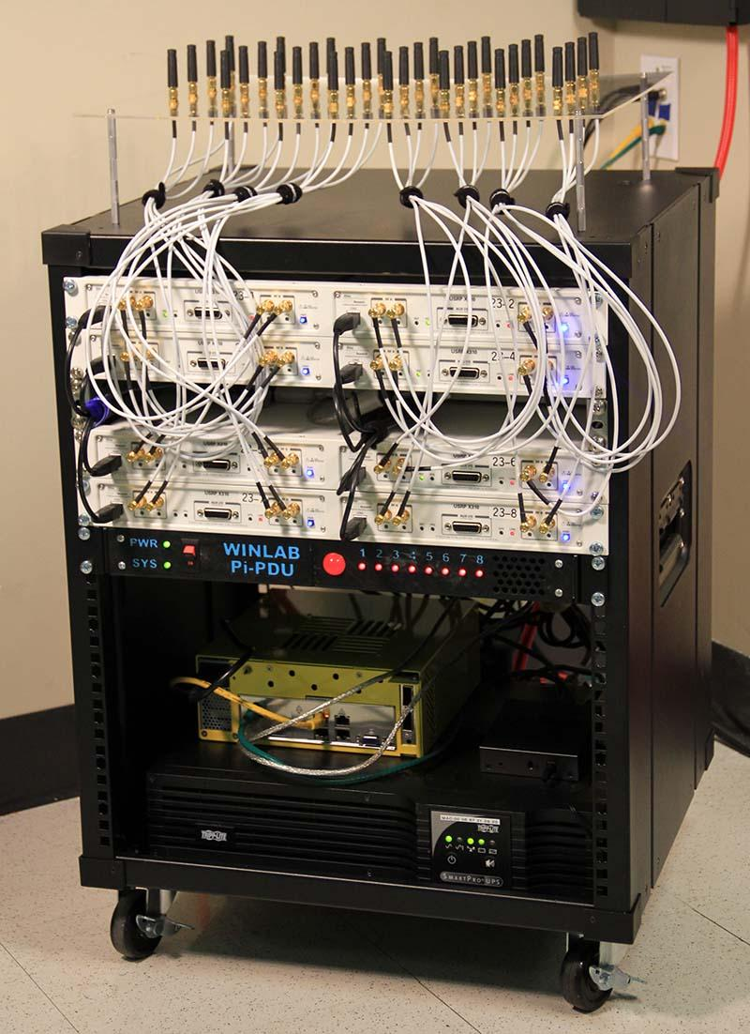
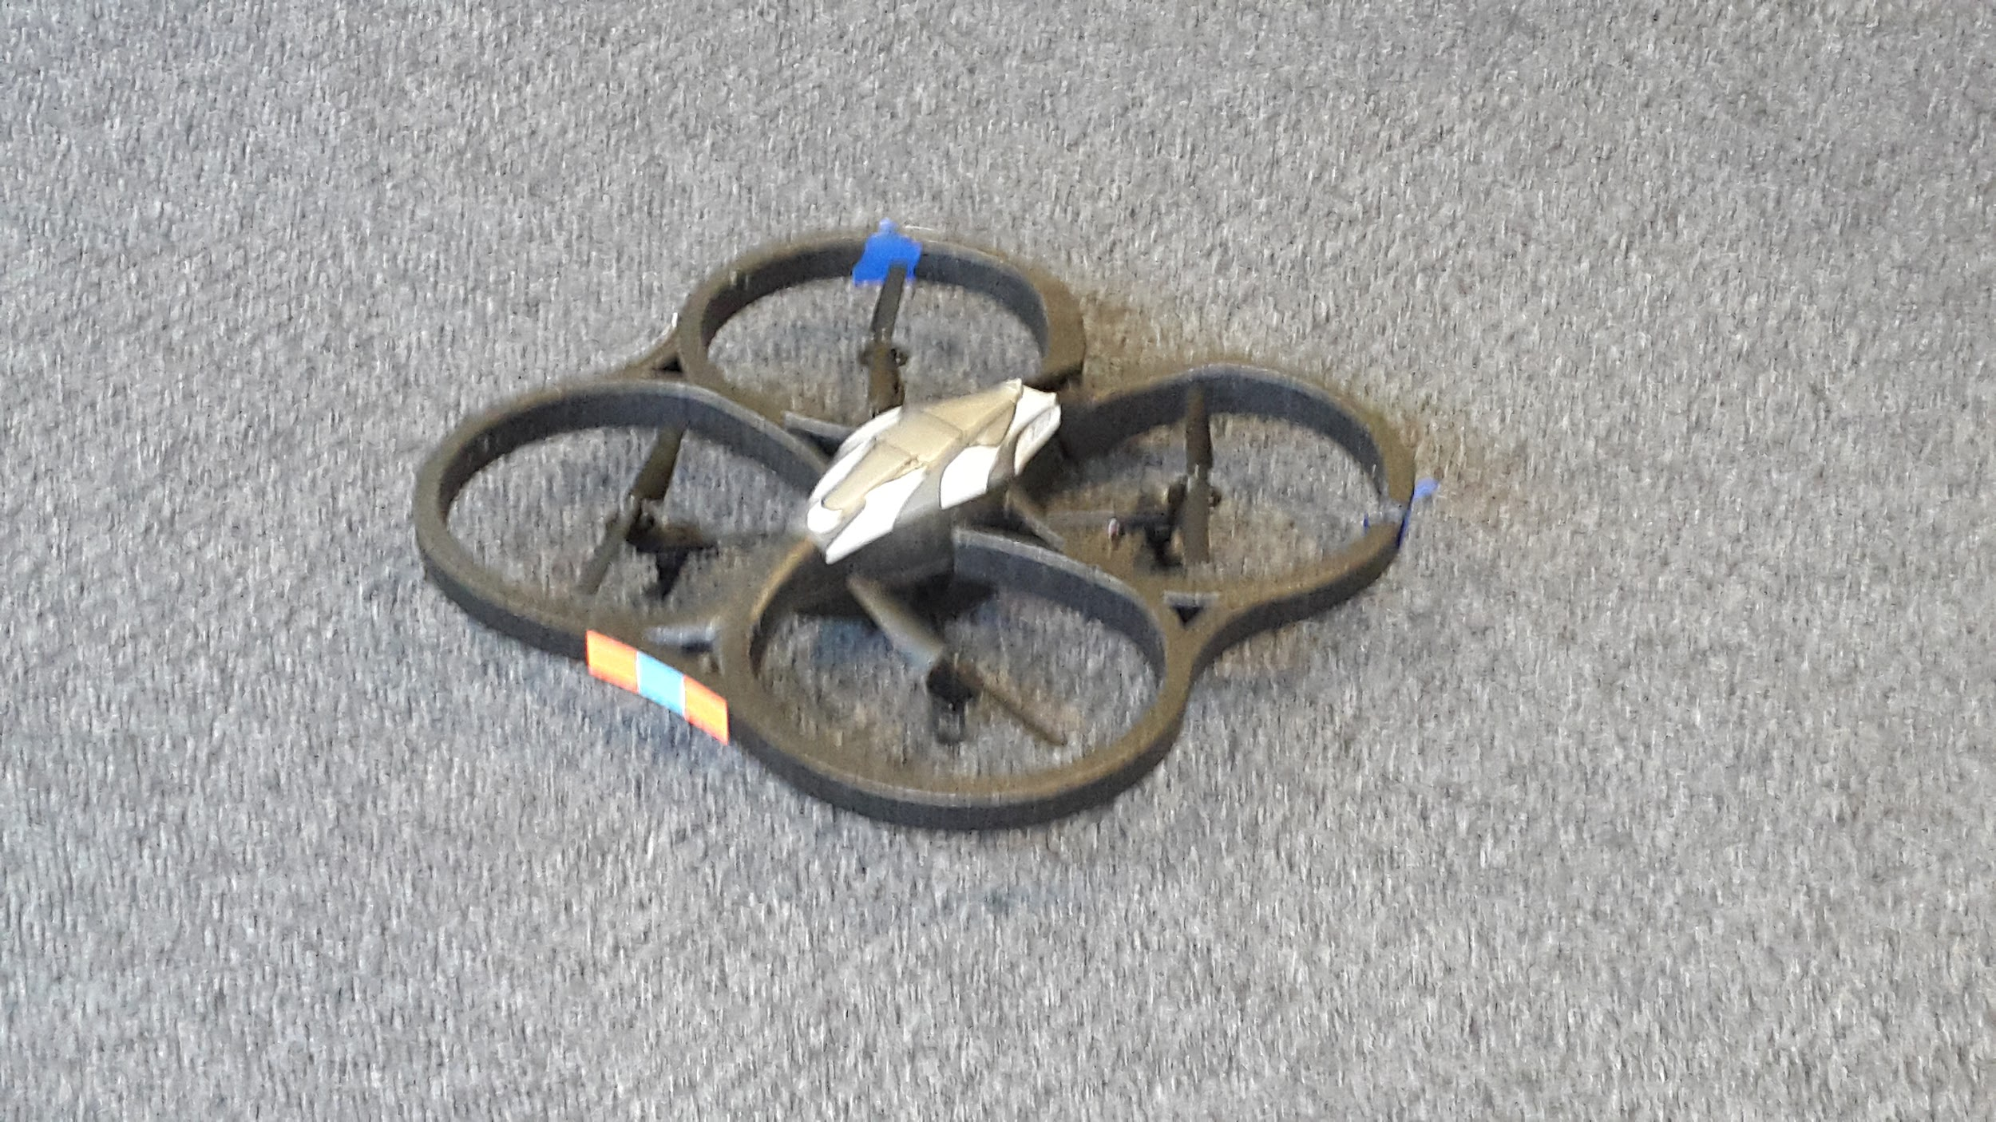
SDR & Spectrum
Massive MIMO
Week 5
Nicholas Lurski, Srijoy Dutta, Nithin Tammishetti, Shi Wang,
Bhargav Gokalgandhi

Slide 2





The Team
Nick Lurski
-RU Undergrad
Bhargav Gokalgandhi
- RU Grad Student
Shi Wang
- RU Grad Student
Srijoy Dutta - Maryland Undergrad
Nithin Tammishetti
-RU Undergrad

Slide 3
Project Description
SDR & Spectrum: We are manipulating a drone to fly around and collect spectrum from the ORBIT nodes. The spectrum will be collected and analyzed.
Massive MIMO: Collecting data from the testbed, performing offline and online processing of the data, and performing a channel estimation scheme.

Slide 4
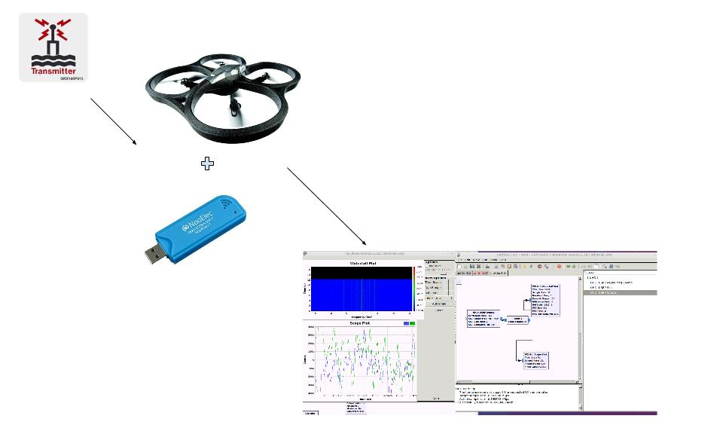

Slide 5
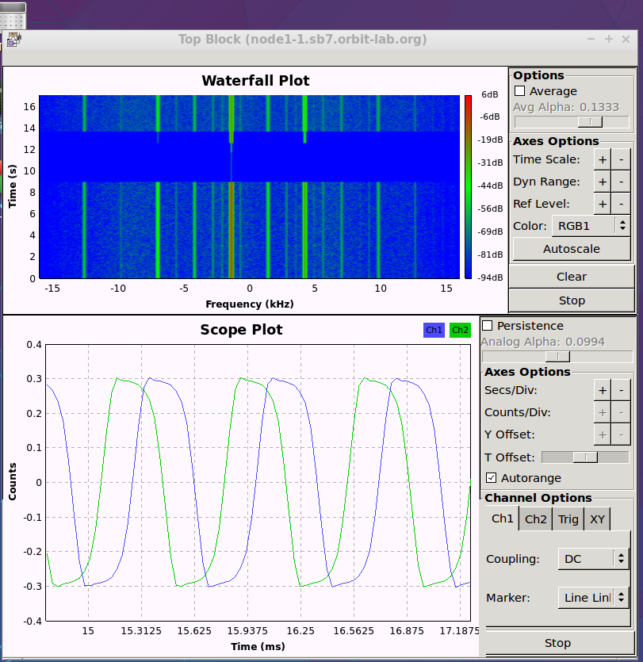
This Week’s Accomplishments - SDR and Spectrum
Learned basic signal processing in GNU-Radio
coupled with UHD
Worked on OEDL experiment script for wideband
spectrum sensing
WiSERD signal transmission
RTL_SDR spectrum analysis on the grid

Slide 6
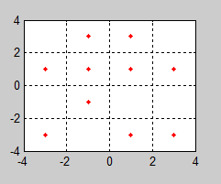
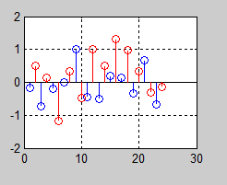
Massive MIMO
Understood how to use OFDM to transmit symbols.
Simulated using Matlab.
Read different lectures and papers related to pilot signals in OFDM.
Created Website.
Random Symbols = [4 3 4 8 6 13 15 5 4 9 1 11]
After QAM = [-1.0000 + 3.0000i -3.0000 - 3.0000i -1.0000 + 3.0000i 1.0000 + 3.0000i -1.0000 - 1.0000i 3.0000 + 1.0000i 3.0000 - 3.0000i -1.0000 + 1.0000i -1.0000 + 3.0000i 1.0000 + 1.0000i -3.0000 + 1.0000i 1.0000 - 3.0000i]
After QAM
After IFFT
Imag
Ampl.
Real
Time

Slide 7
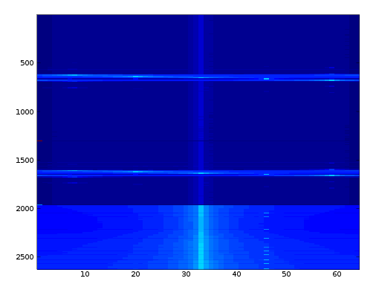
This Week’s Challenges
Getting a grid reservation
Signal analysis in Octave/Matlab
X-forwarding issues
Massive MIMO
Every wireless standard has different way
of defining and using pilot signals.
OFDM python scripts weren’t exactly helpful.

Slide 8
Next Week’s Goals - SDR and Spectrum
Meet with WiSERD grad student
Test out shielding of onboard RTL-SDR and learn more about spectrum analysis with RTL_SDR
Start experimenting with different antennas for wideband performance

Slide 9
Massive MIMO
Experiment
  Create a random stream of symbols using Matlab.
  Convert to equivalent OFDM symbols.
  Send the OFDM symbols using one of the grid nodes.
    The transmission will be in repetition mode after a certain amount of delay.
  Receive it on all 16 channels.
  Try to perform Least Squares and MMSE Estimation on the received data
Study about how Least Squares and MMSE estimation is performed for MIMO Systems.

