Slide 1
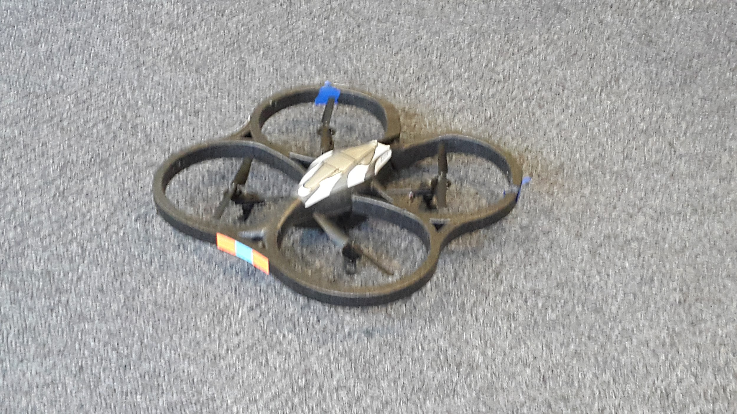
SDR & Spectrum
Week 6
Nicholas Lurski, Srijoy Dutta, Nithin Tammishetti, Shi Wang

Slide 2


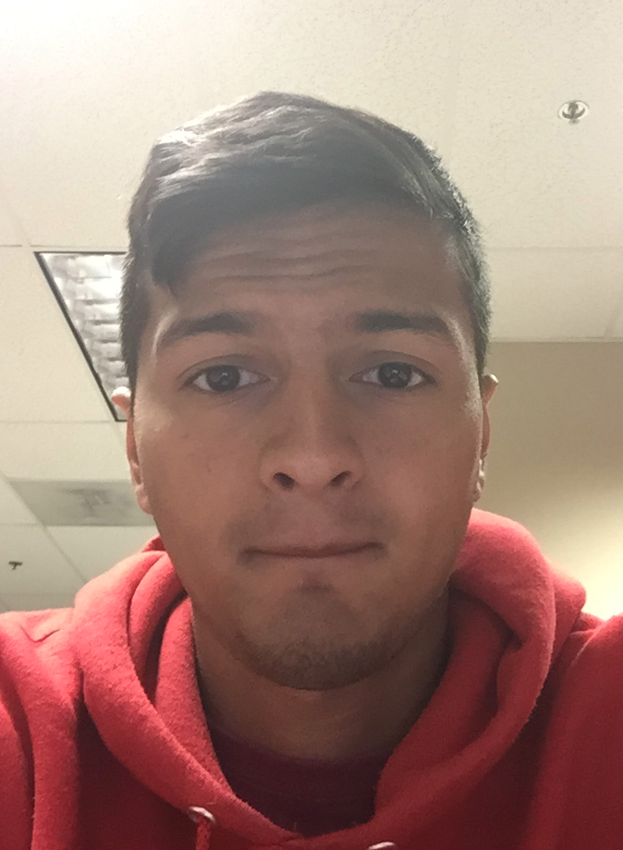

The Team
Nick Lurski
-RU Undergrad
Shi Wang
- RU Grad Student
Srijoy Dutta - Maryland Undergrad
Nithin Tammishetti
- RU Undergrad

Slide 3
Project Description
SDR & Spectrum: We are manipulating a drone to fly around and collect spectrum from the ORBIT nodes. The spectrum will be collected and analyzed.

Slide 4
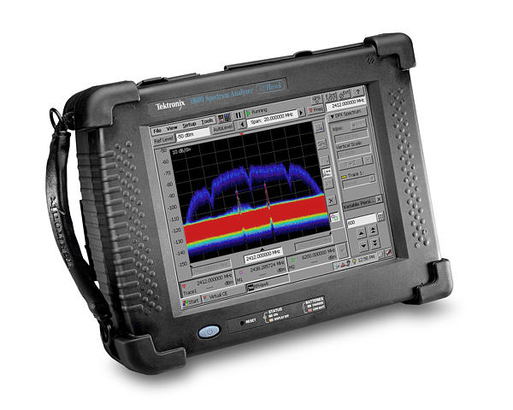
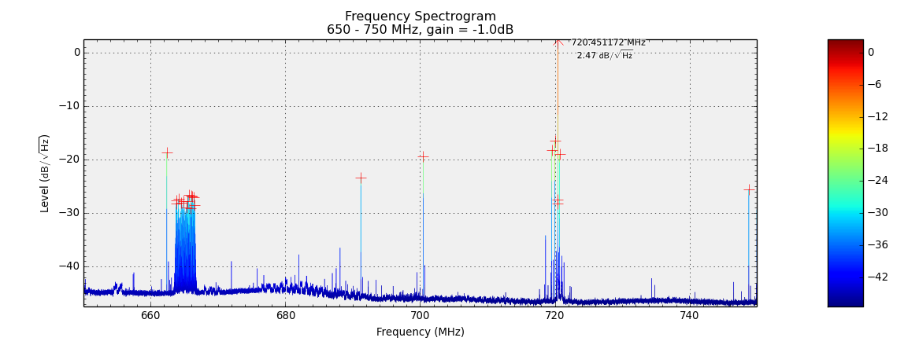
This Week’s Accomplishments
Used RTL-SDR as spectrum analyzer via ORBIT Grid
  “RTL2832_EZcap” script
Received Tektronix SA2600 (Spectrum Analyzer)
  Obtained user manuals and began reading/learning

Slide 5
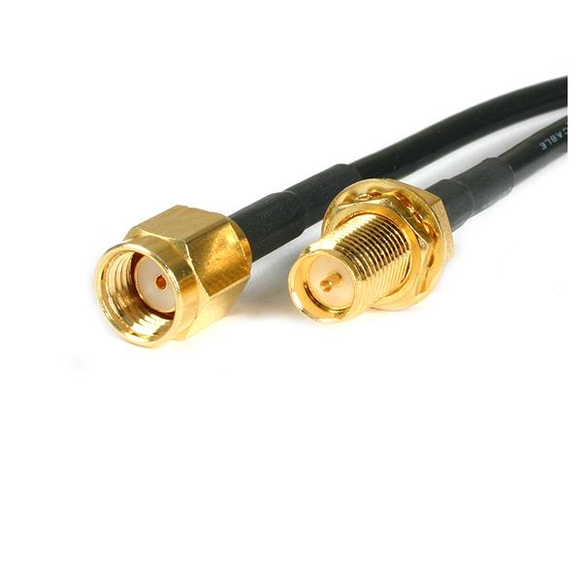
This Week’s Challenges
Learning how to use a spectrum analyzer
Trying to determine if drone motor produces noise
Waiting for materials on order to arrive
  SMA Adapter
Notes:
The version of the spectrum is old. Some functions such as signal classification and spectrum correlation measurement require a new version.
But we have not decided whether we need to use those functions.
Second, we are still waiting for the materials that we ordered. SMA adapter.
So far, we presume that the noise is coming from the 33-feet long line. But we are still trying to determine if drone motor produces noise.

Slide 6
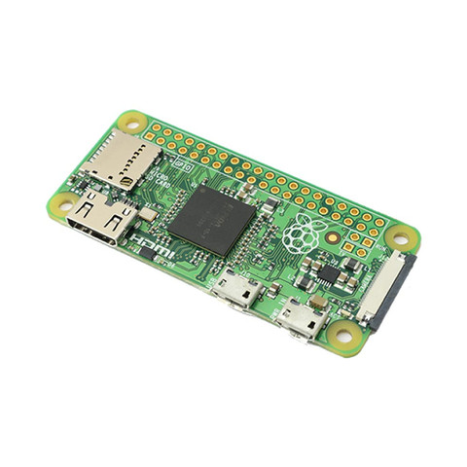
Next Week’s Goals
Continue reading up on how to operate Spectrum Analyzer
Begin to figure out how to eliminate noise
  Potential new Drone?
  Shielding the SDR?
  Look into Raspberry Pi Zero?
Wait for delivery of SMA adaptors to allow use of other antennas with SDR

