Slide 1
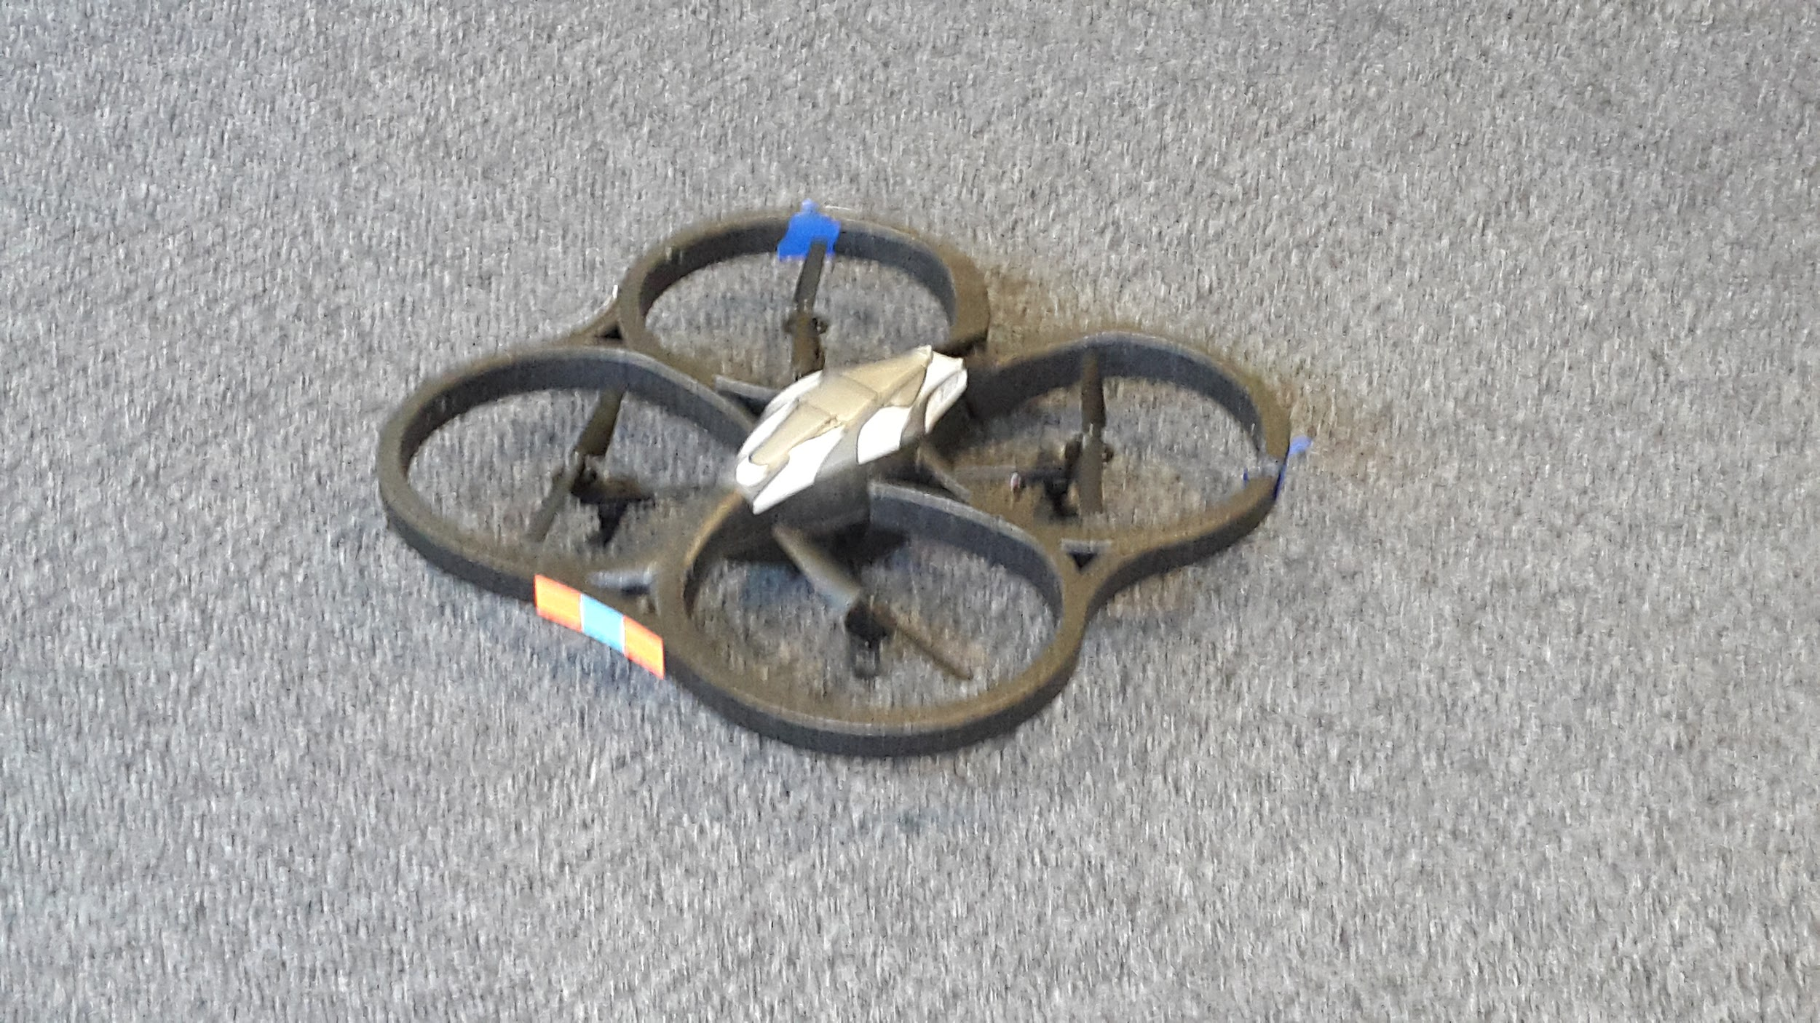
SDR & Spectrum
Week 7
Nicholas Lurski, Srijoy Dutta, Nithin Tammishetti, Shi Wang, Noah Paladino

Slide 2
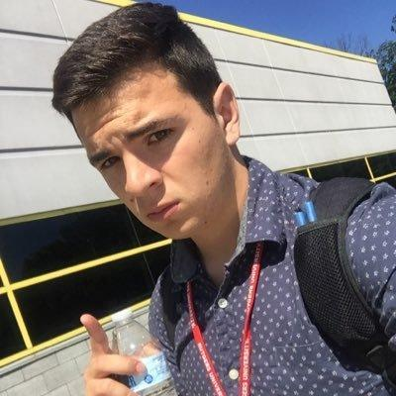

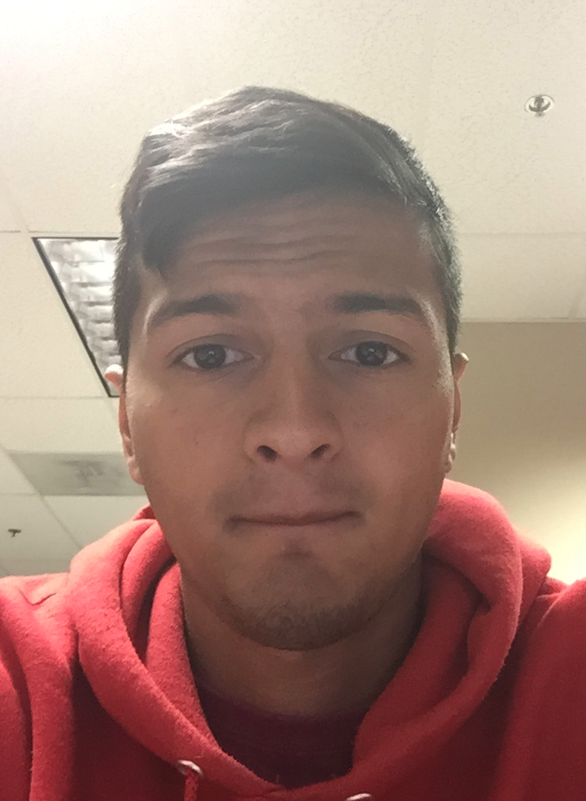
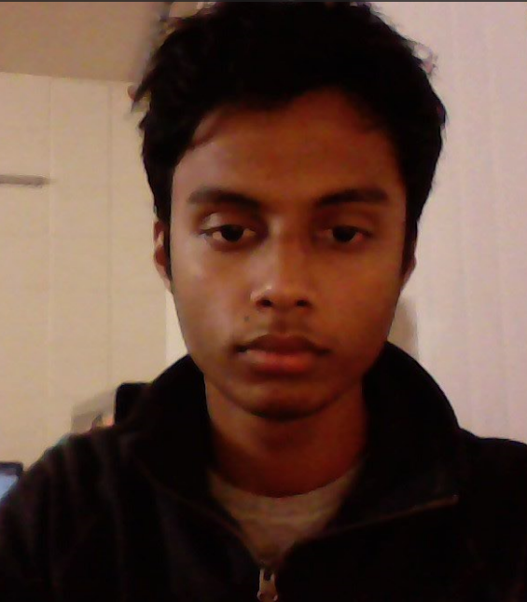
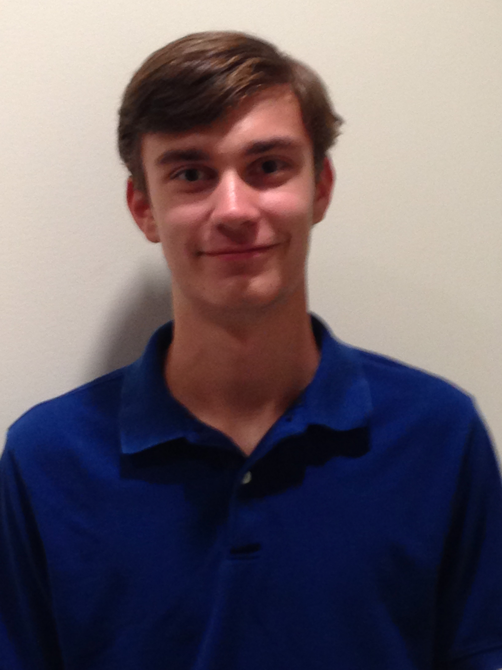
The Team
Nick Lurski
-RU Undergrad
Shi Wang
- RU Grad Student
Srijoy Dutta - Maryland Undergrad
Nithin Tammishetti
- RU Undergrad
Noah Paladino
- High School

Slide 3
Project Description
SDR & Spectrum: We are manipulating a drone to fly around and collect spectrum from an area for the purpose of regulation and enforcement. The spectrum will be collected and analyzed.

Slide 4
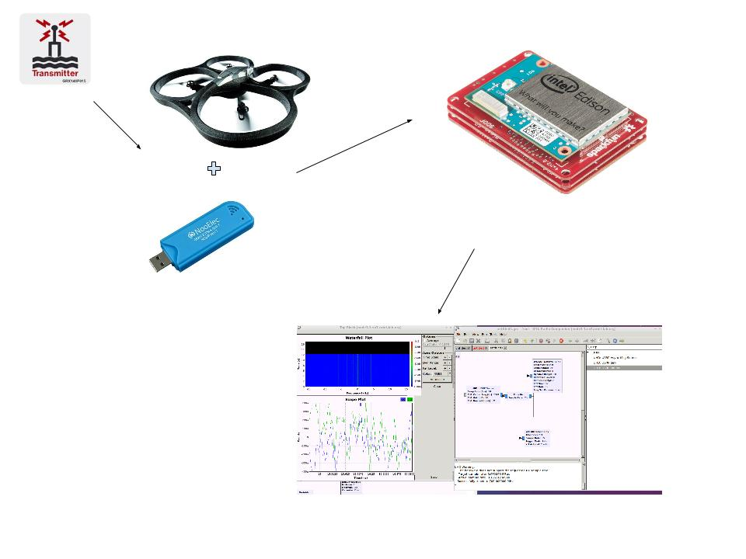

Slide 5
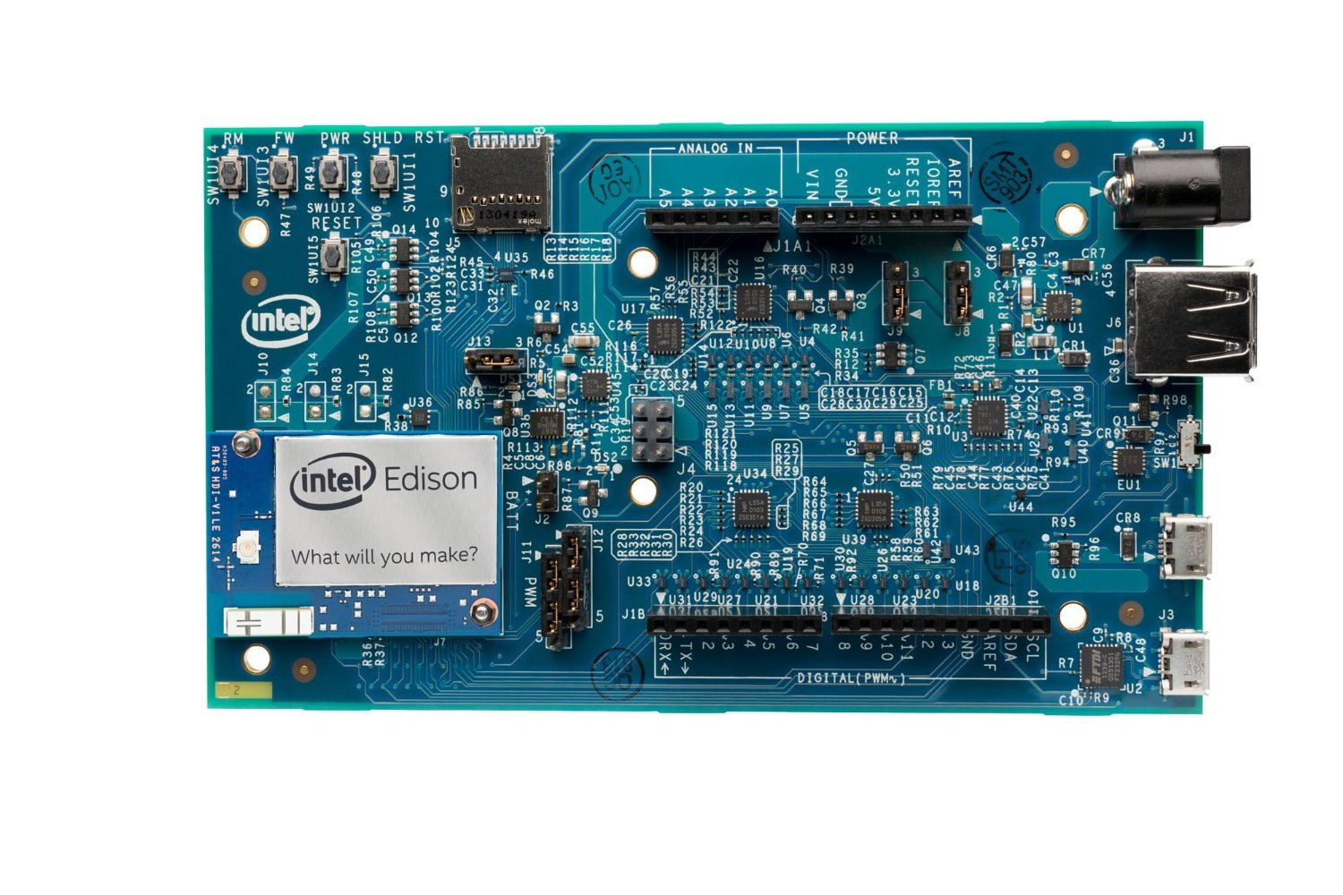
This Week’s Accomplishments
Attained and set up an Intel Edison
  Compiled RTL-SDR software in Edison
Tested out different Antennas to use with RTL-SDR
Started developing GUI to control Drone

Slide 6
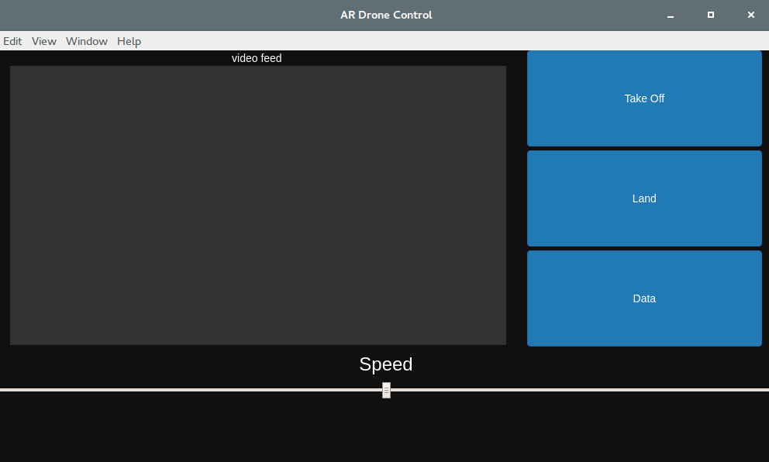
AR Drone Control GUI

Slide 7
This Week’s Challenges
Waiting for adapter to connect RTL-SDR to Intel Edison
Learning to work with the Intel Edison
Adapting past configuration to new setup
Getting control GUI to work with Drone
Getting Drone to fly/elevate

Slide 8
Next Week’s Goals
Test RTL-SDR connecting using Intel Edison
Test Drone’s payload capabilities with Edison, RTL-SDR, and antenna attached
Continue testing different antennas
Learn 3dr controls

