Slide 1
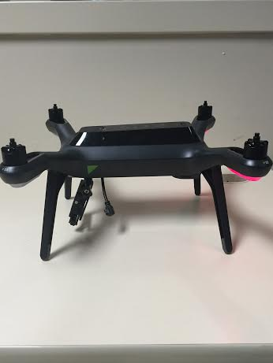
SDR & Spectrum
Week 8
Nicholas Lurski, Srijoy Dutta, Nithin Tammishetti, Shi Wang, Noah Paladino

Slide 2
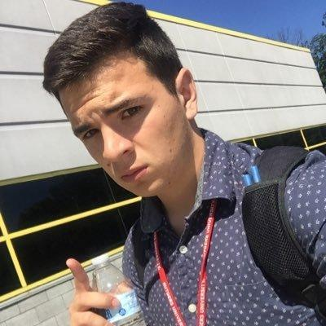

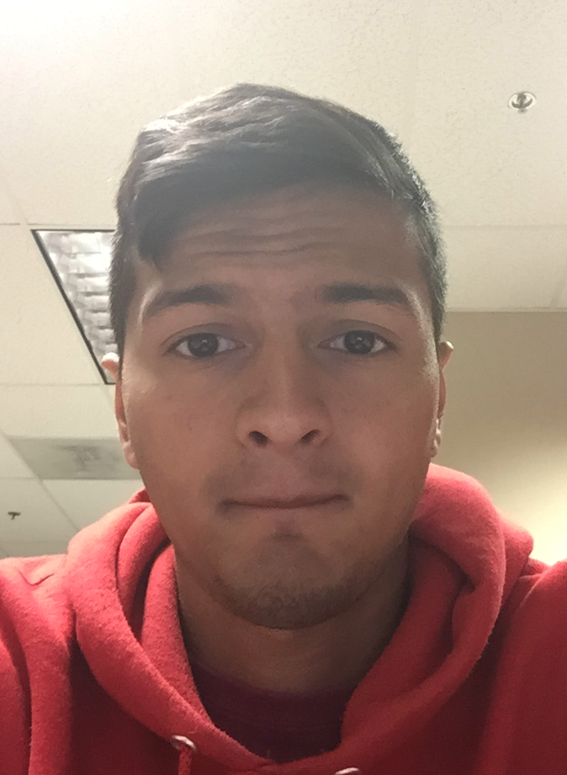
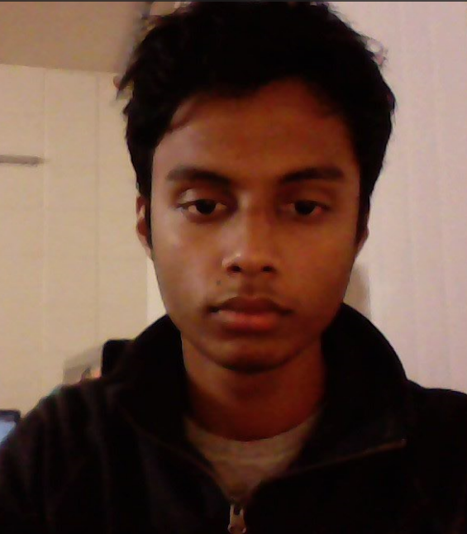
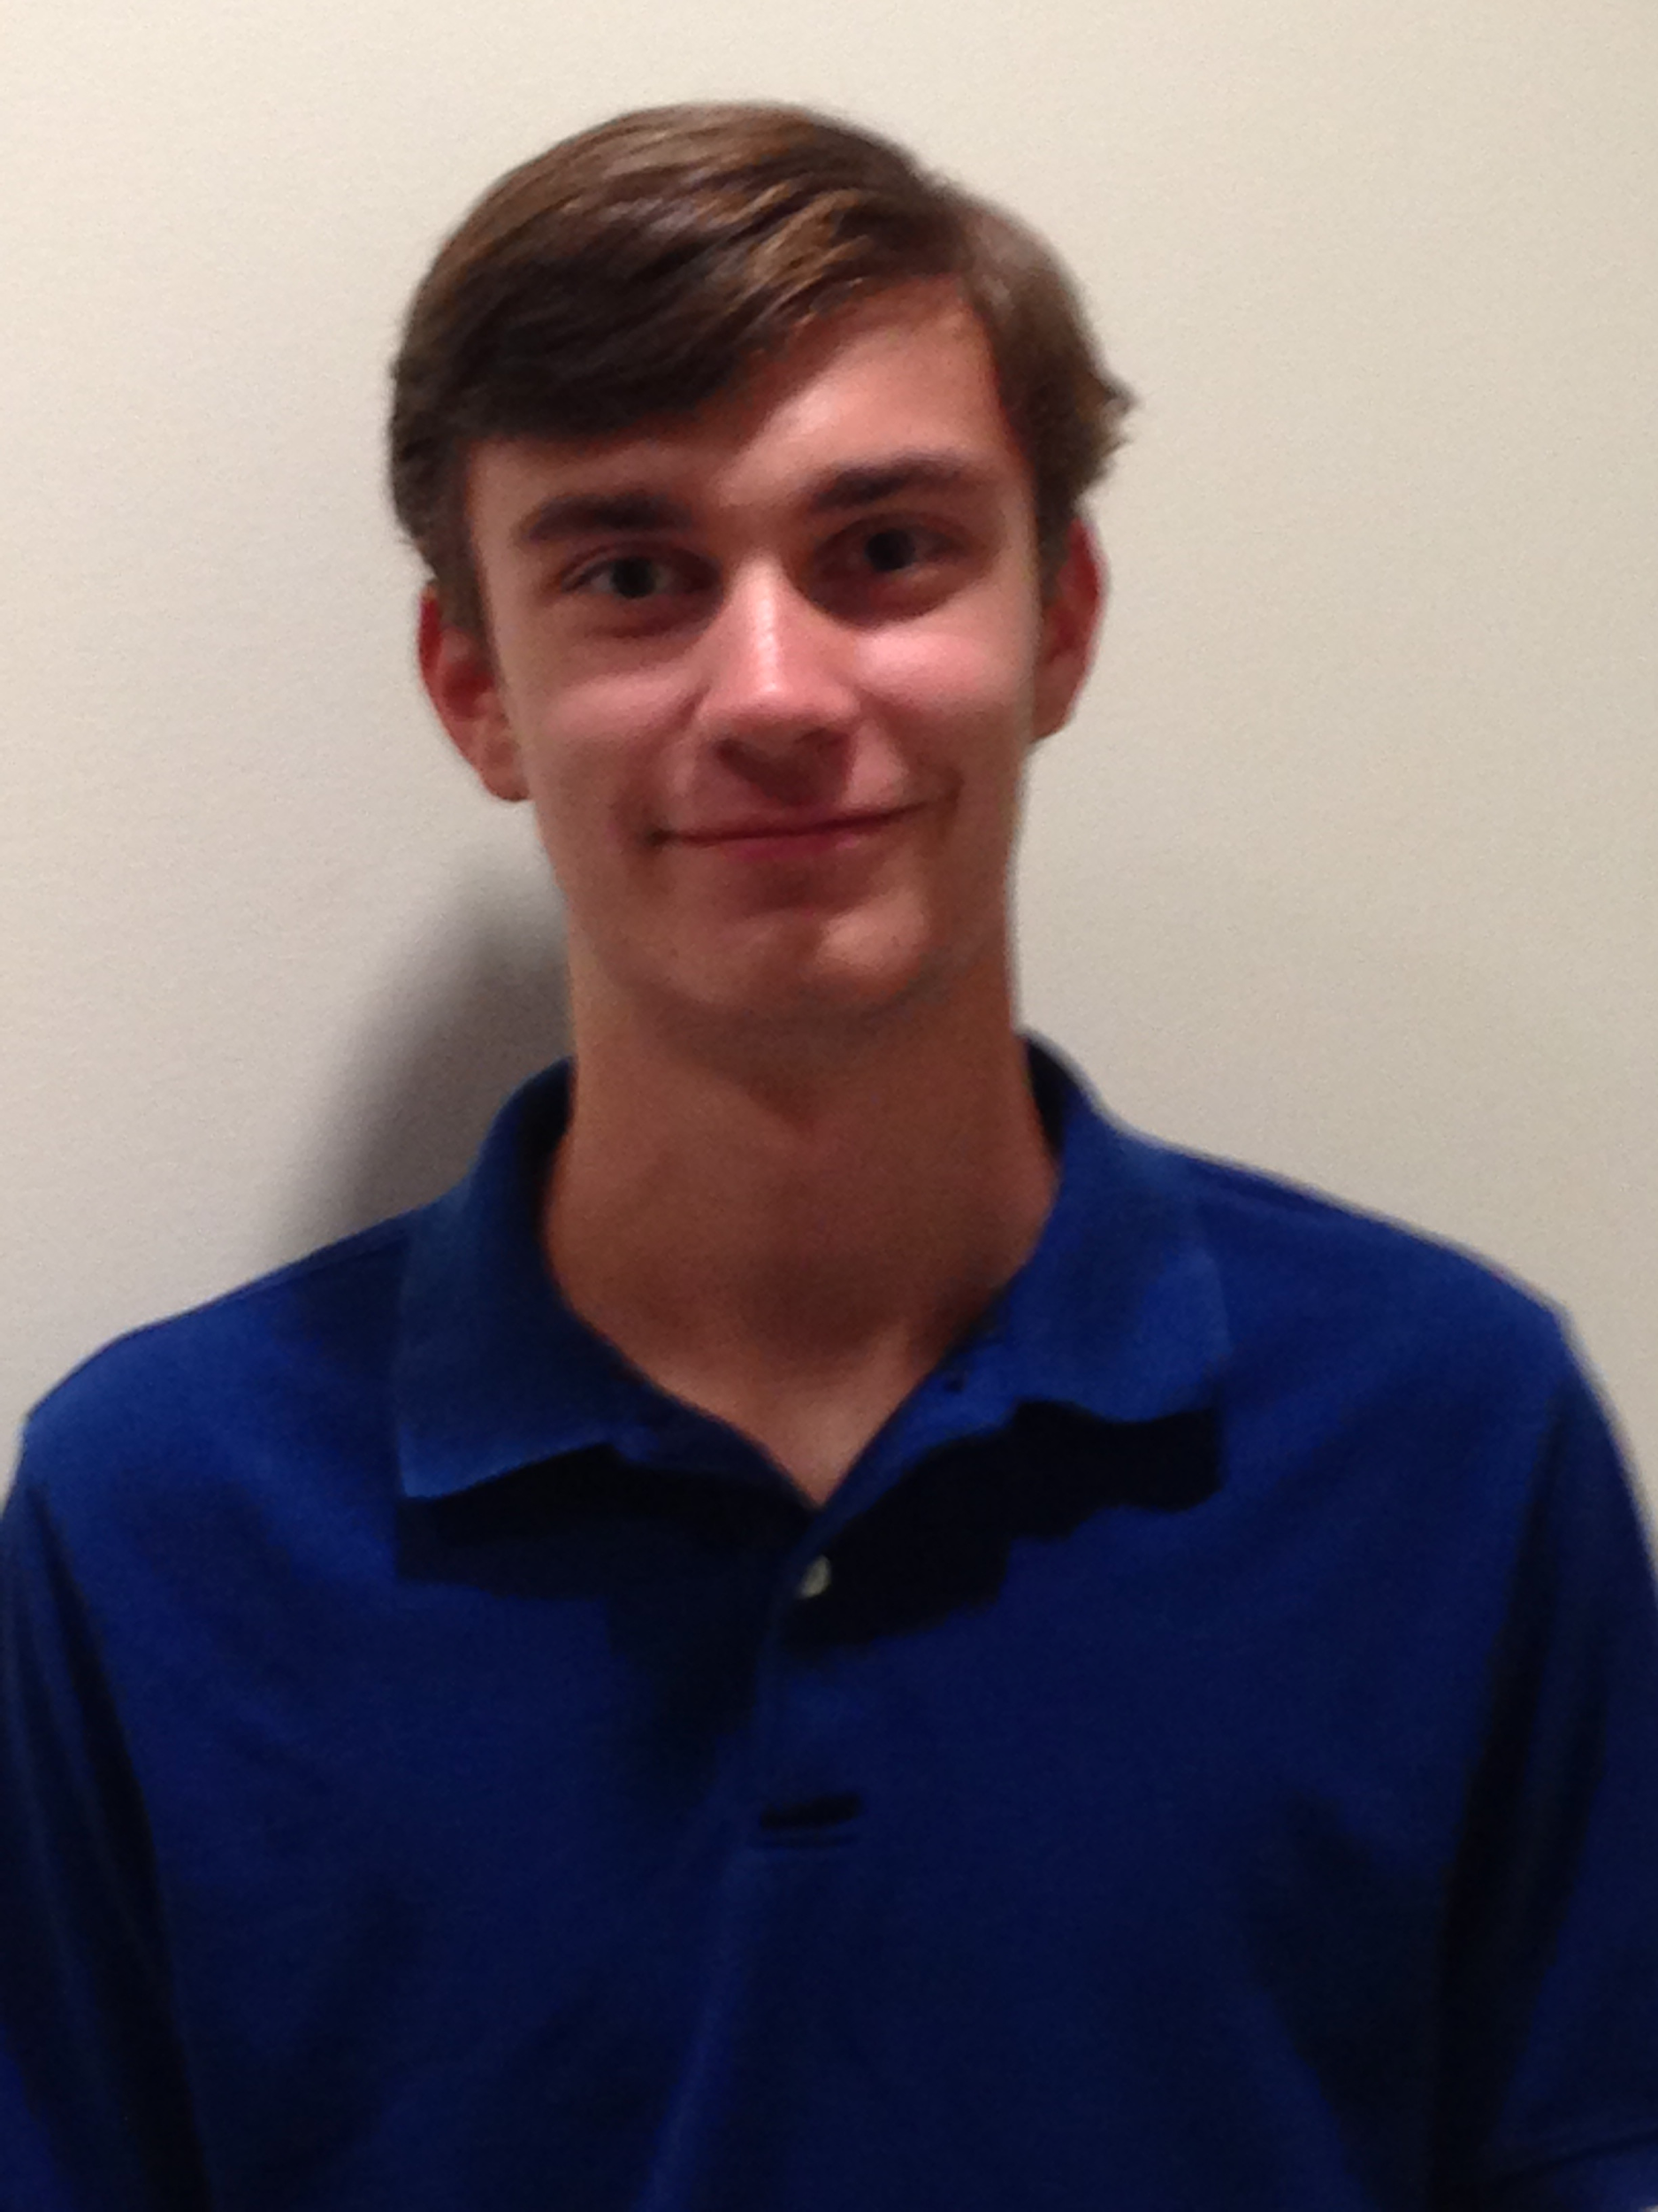
The Team
Nick Lurski
-RU Undergrad
Shi Wang
- RU Grad Student
Srijoy Dutta - Maryland Undergrad
Nithin Tammishetti
- RU Undergrad
Noah Paladino
- High School

Slide 3
Project Description
SDR & Spectrum: We are manipulating a drone to fly around and collect spectrum from an area for the purpose of regulation and enforcement. The spectrum will be collected and analyzed.

Slide 4
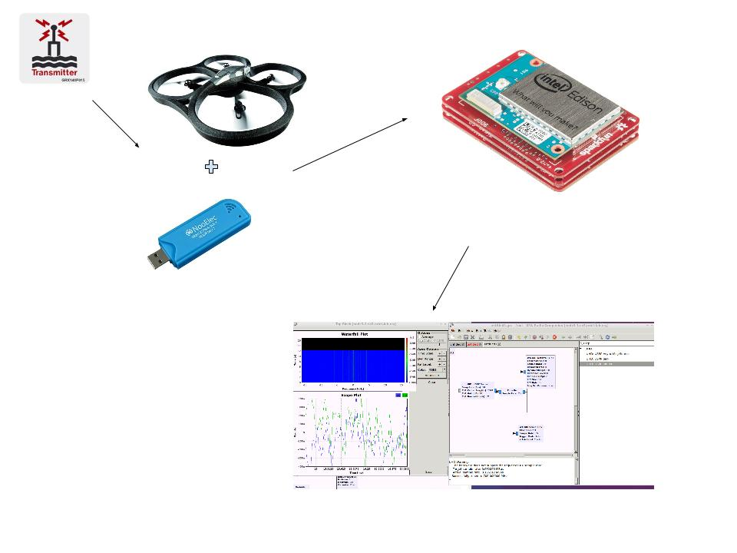
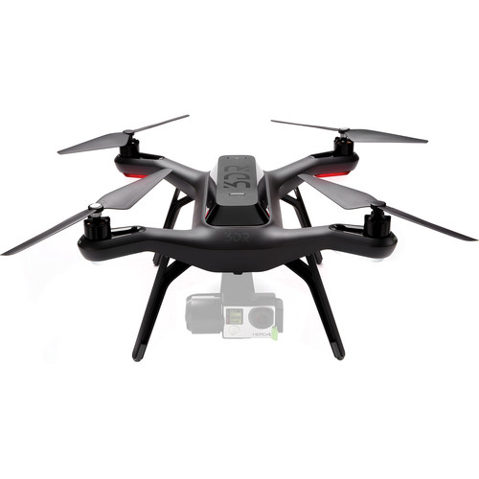

Slide 5
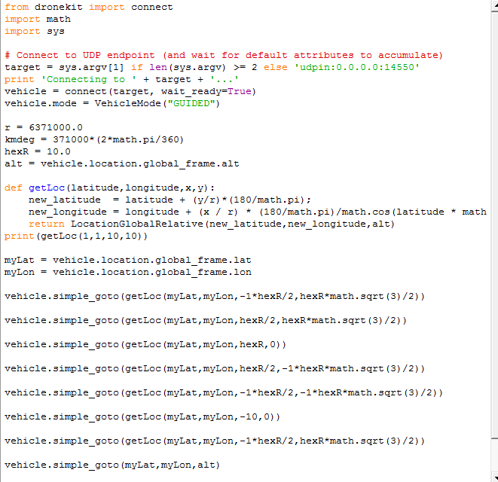
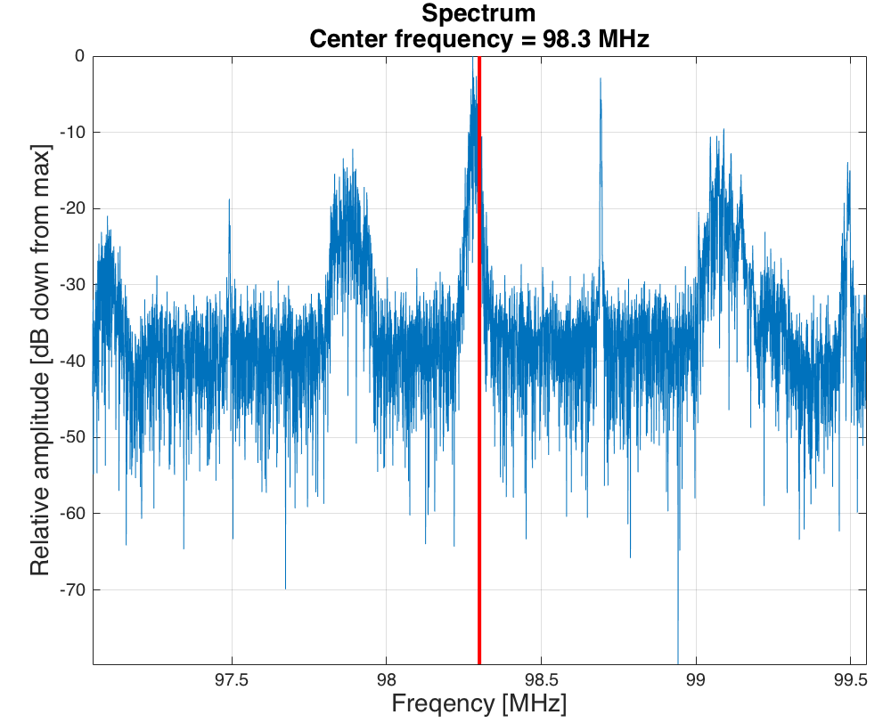
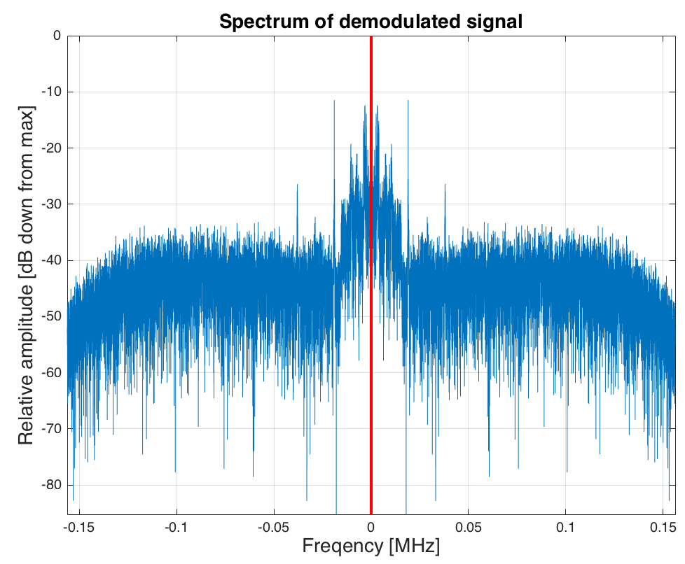
This Week’s Accomplishments
Transitioned from ARDrone to 3DR Solo
RTL_SDR now works on Intel Edison platform
  Finally obtained OTG USB Adaptor
Started testing/sending scripts to 3DR Solo
FM demodulate raw I/Q data with MATLAB

Slide 6
This Week’s Challenges
Actually sending scripts to 3DR Solo
Network limitations of streaming spectrum
Setting up the drone
  Updating software, etc

Slide 7
Next Week’s Goals
GPS info with timestamps
Collect radio information with timestamps
Figure out autonomous routing

