Slide 1
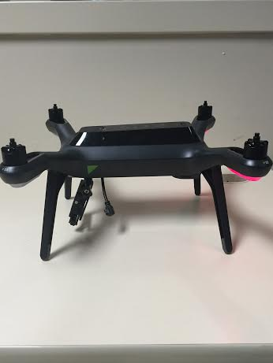
SDR & Spectrum
Week 9
Nicholas Lurski, Srijoy Dutta, Nithin Tammishetti, Shi Wang, Noah Paladino

Slide 2
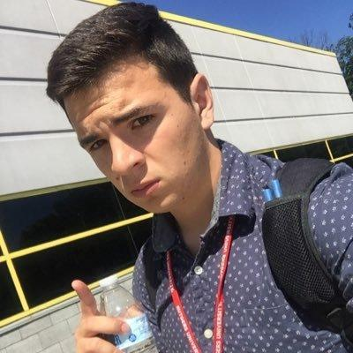

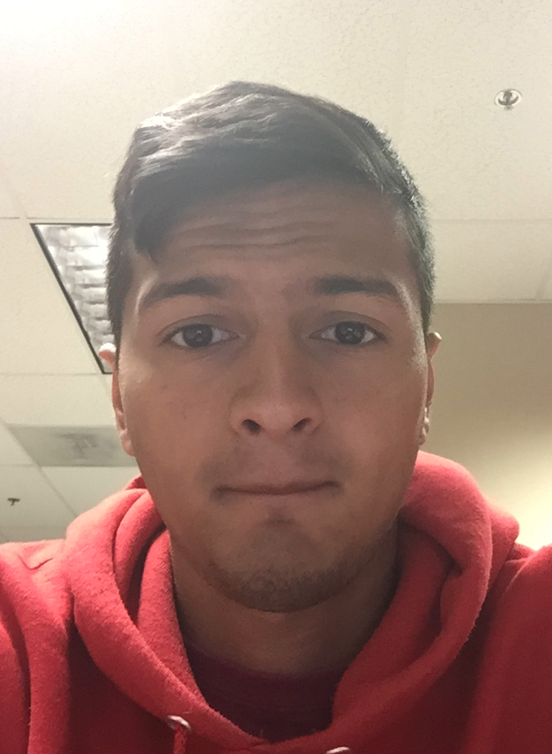
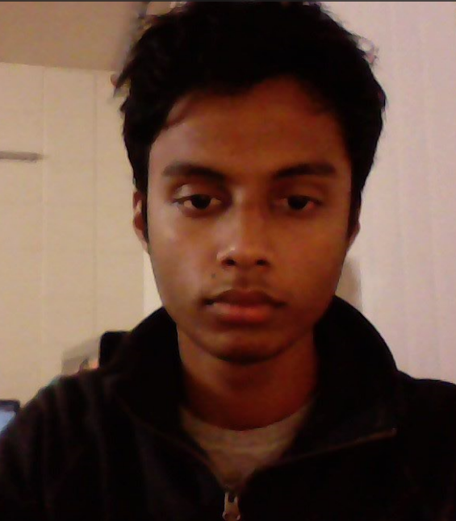
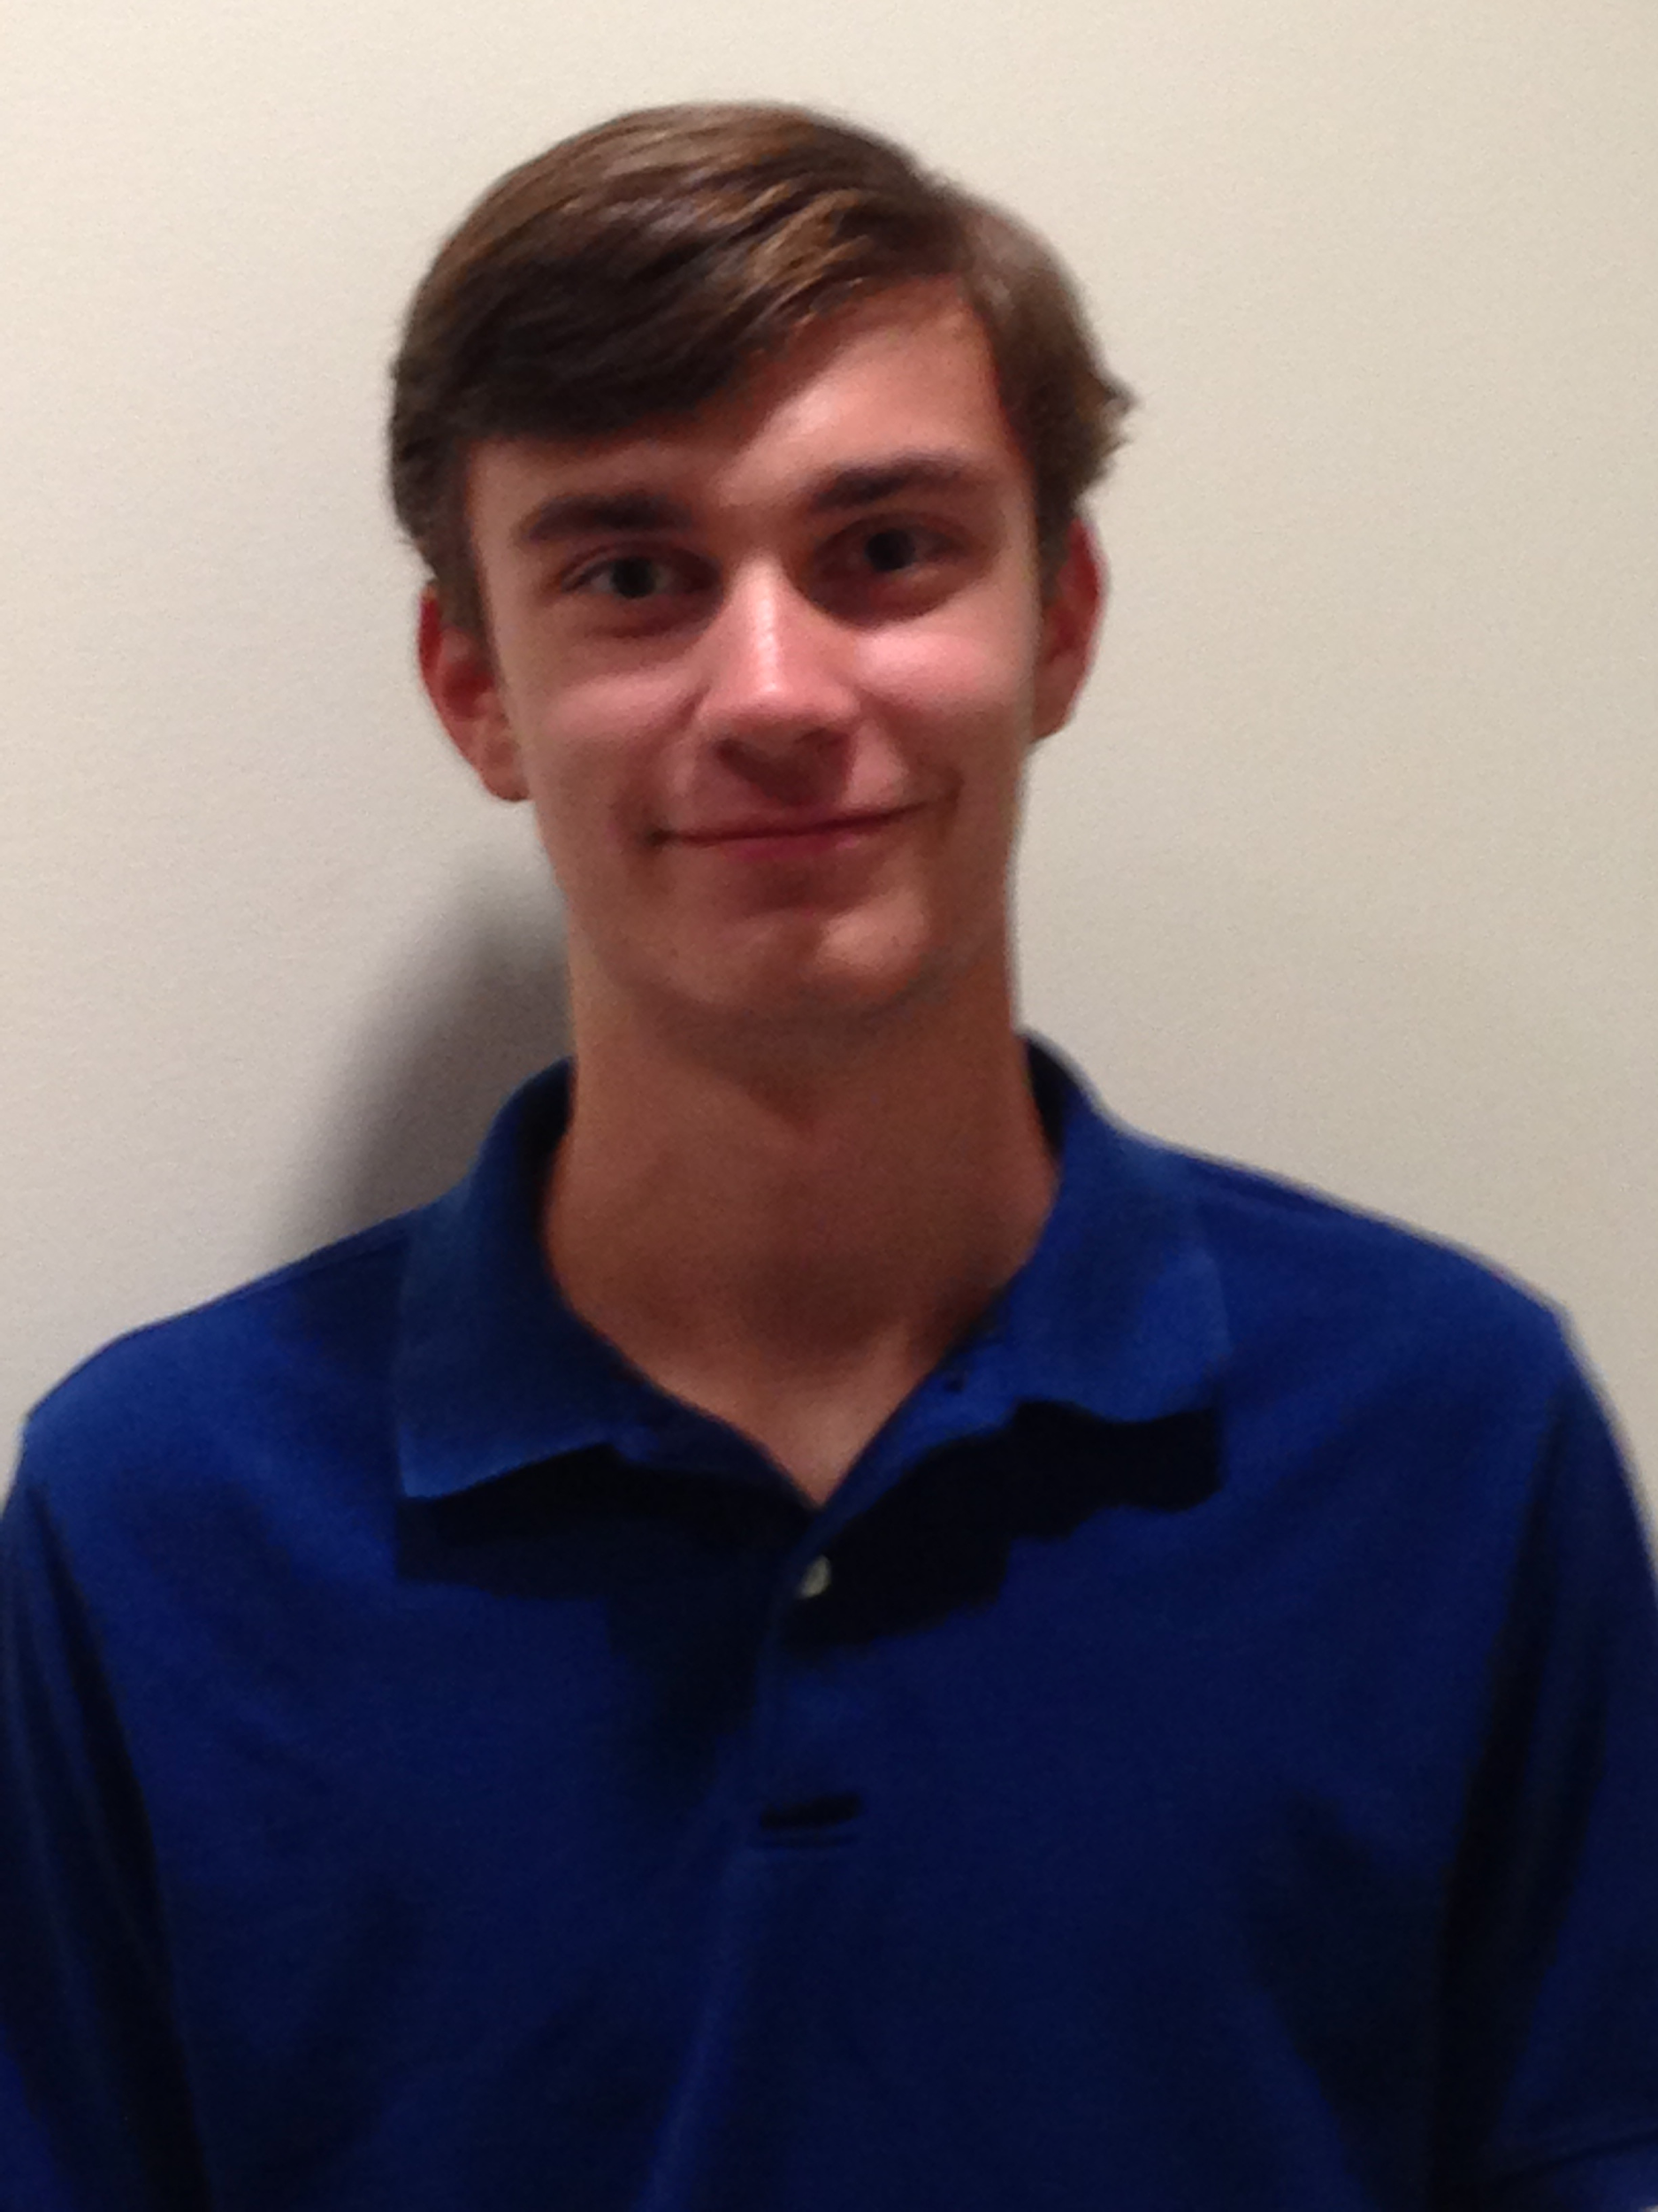
The Team
Nick Lurski
-RU Undergrad
Shi Wang
- RU Grad Student
Srijoy Dutta - Maryland Undergrad
Nithin Tammishetti
- RU Undergrad
Noah Paladino
- High School

Slide 3
Project Description
SDR & Spectrum: We are manipulating a drone to fly around and collect spectrum from an area for the purpose of regulation and enforcement. The spectrum will be collected and analyzed.

Slide 4
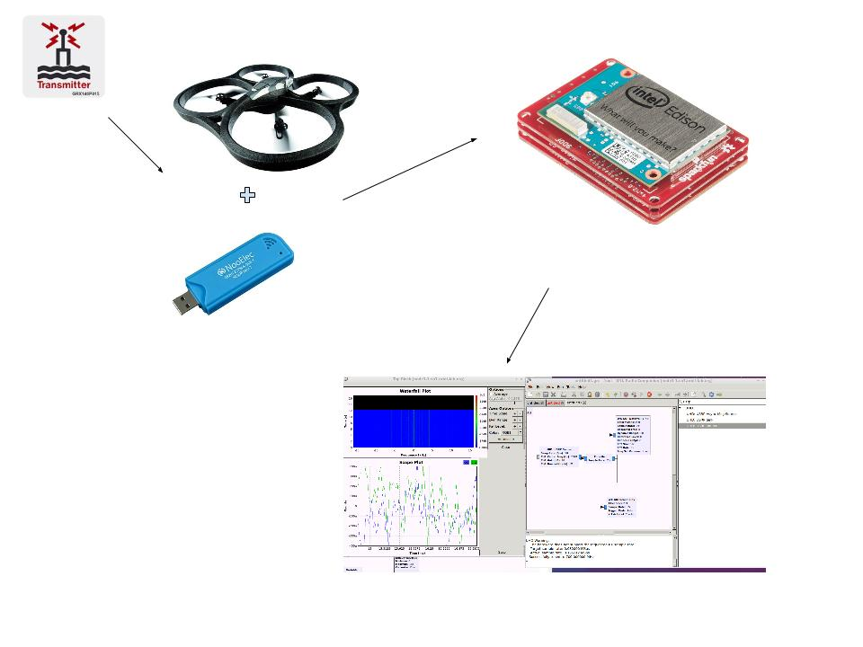
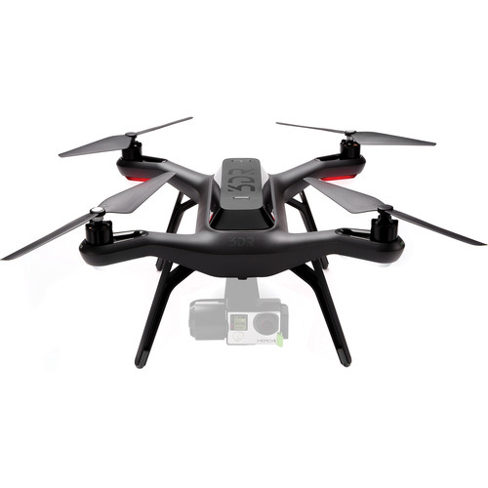

Slide 5
This Week’s Accomplishments
Data Collection
  Python code to record gps data with timestamps
Shell script to upload and run python code on drone
Website updates
Learn concept about I/Q data. Accomplish SSB modulation and demodulation of audio signal.

Slide 6
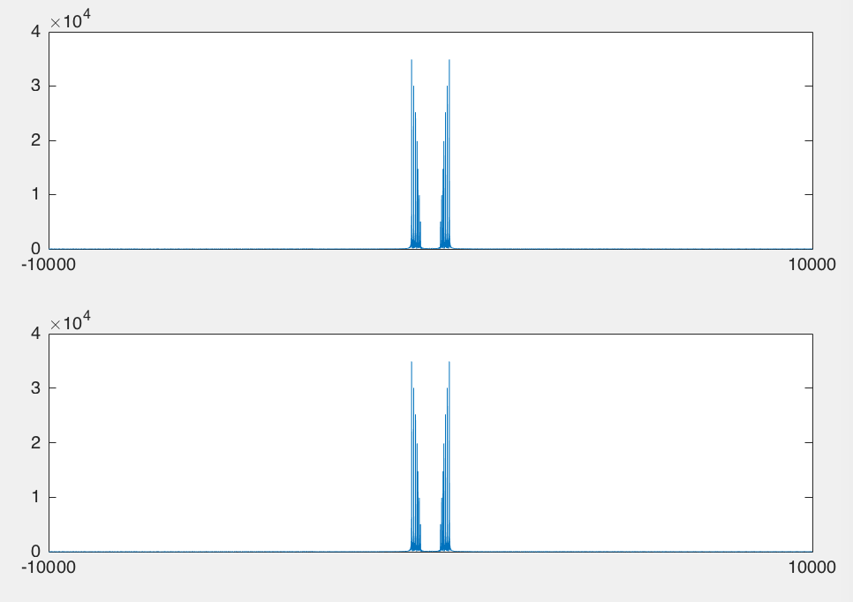
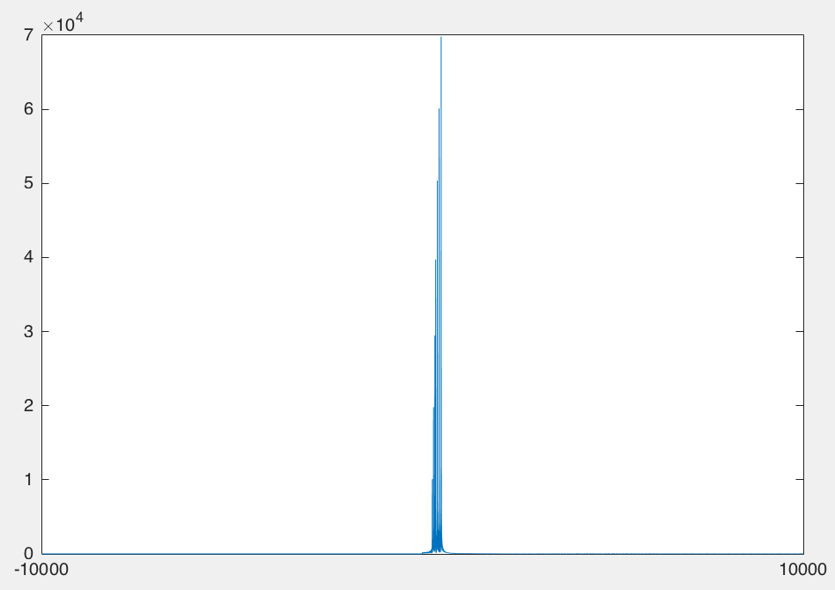
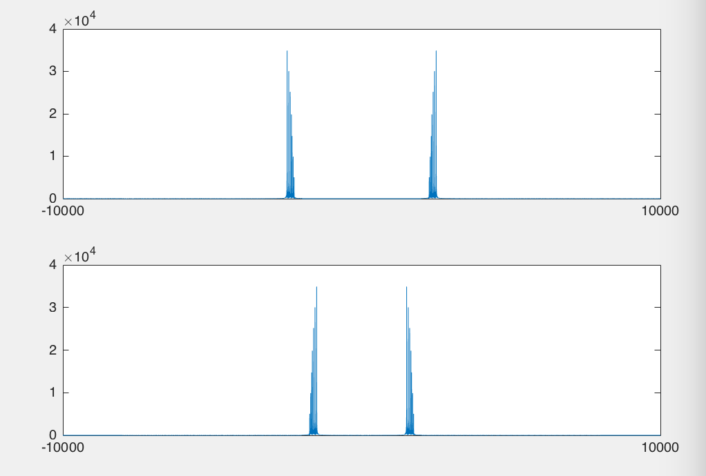
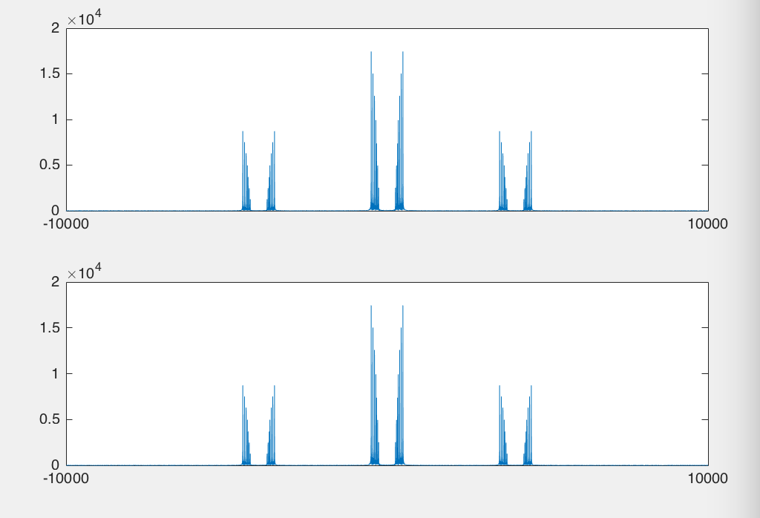
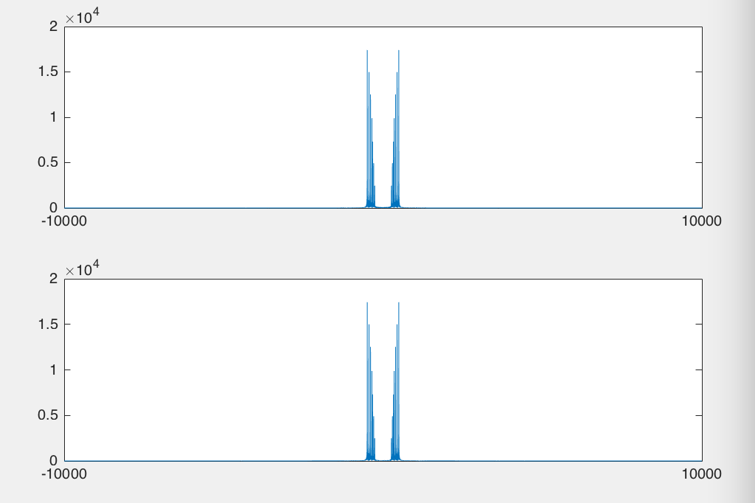
SSB modulation and demodulation

Slide 7
This Week’s Challenges
3DR Simulator
  Random errors on various laptops
Drone issues
  Connection to GPS was very inconsistent
Trying to install additional python modules onto Drone
  Pygame

Slide 8
Next Week’s Goals
Mount RTL_SDR on drone, along with antenna
  Design and 3D print sturdy mounting hardware
Collect data during a flight
Figure out post-processing of data

