Slide 1
SDR in ORBIT: Spectrum Sensing
by Nicole DiLeo, Michael Collins, and Christina Baaklini

Slide 2
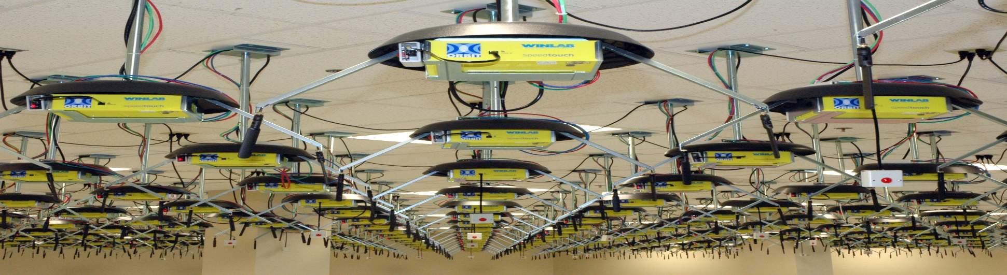
SDR in ORBIT
SDR (software-defined radio) – radio communication system in which components that would usually be implemented using hardware are instead implemented using software

Slide 3
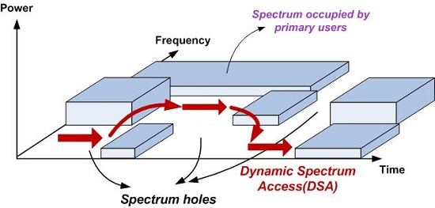
Spectrum Sensing Game
Detecting a randomly generated signal from an unknown source
“Whack-a-Mole”
The goal: To scan the spectrum of available radio frequencies for bands that are currently in use, so that other applications can use open frequency bands and minimize interference

Slide 4
Next Week
Signal processing (DSP Tutorial)
GNU Radio (perform signal processing)
MATLAB (functions such as fft, “Finite Fourier Transform”)

