Slide 1
GNRS Assisted Inter-Domain Routing
Mobility First FIA

Slide 2
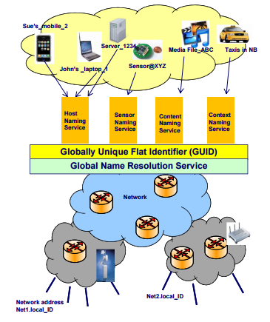
GNRS (Global Name Resolution Service)
Separation of names (identifier/GUID) from the location (network address(NA))
Low delay GUID to NA translation
Large Scale, Distributed System
DMap Implementation of GNRS
  GUID to K hash functions( hashed to NA)
  GUID to NA translations advertised by the Autonomous Systems(AS) having the NA.
  Lookups choose the closest among the K mappings

Slide 3
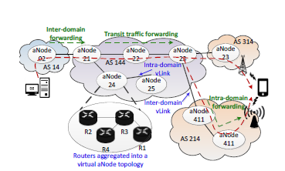
Inter-Domain Routing
Nodes in an AS are grouped into aNodes connected by vLinks.
The link state packets exchanged have additional information such as the quality of link – used for forwarding decisions.
Telescopic dissemination is used to control the flooding traffic overhead.
This aggregation into aNodes allows an AS to control extent of internal structure details advertised.

Slide 4
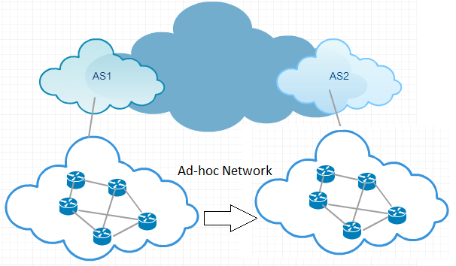
GNRS Assisted Inter-Domain Routing
Possible migration of routing functions into the GNRS
Basic routing protocol still required to ensure reachability to the GNRS servers
Sample use case
  A stub ad-hoc network migrates from one AS to another
  Individual updates through the routing protocol will be time consuming and costly
  With GNRS assisted routing, an update to the GNRS system would suffice

Slide 5
Next Steps
Study previous work on Edge Aware Inter-Domain Routing and Virtual Networks
Explore how GNRS can be extended to support the inclusion of routing information

Slide 6
Thank you!

