Slide 1
GNRS Assisted Inter-Domain Routing
Mobility First FIA
Suja Srinivasan

Slide 2
Modifying GNRS
Currently the GNRS (Global Name Resolution Service) has only a GUID(Globally Unique Identifier) to Network Address(NA) mapping.
This has to be extended to support GUID to a generic key-value pair mapping.
Changes identified
1. Mapping object structure
2. Network Protocol(insert, update & lookup)
3. Database/Cache

Slide 3
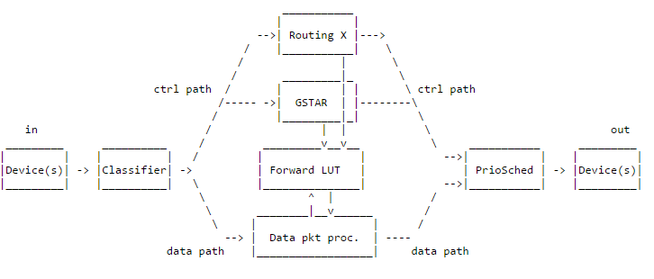
Edge-Aware Inter-Domain Routing
Implemented using the Click Modular Router
EIR included in the GSTAR (intra-domain routing) module

Slide 4
Next Steps
Start with the GNRS code changes
Continue the EIR code understanding

Slide 5
Thank you!

