Slide 1
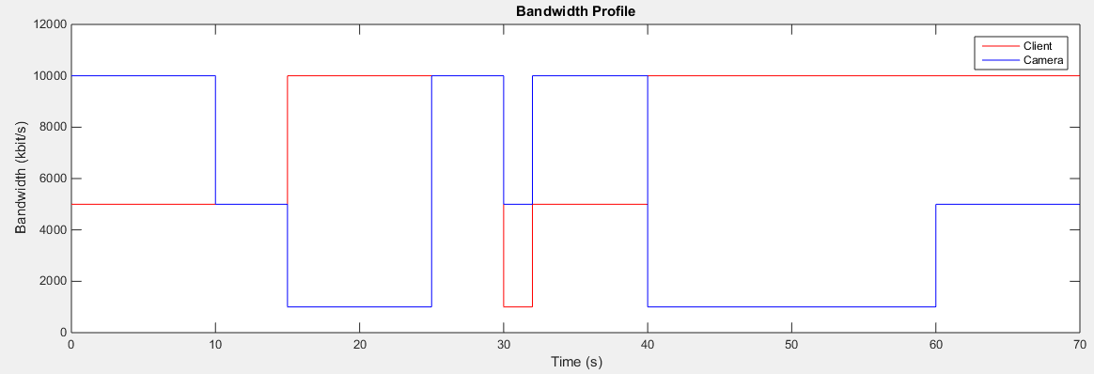
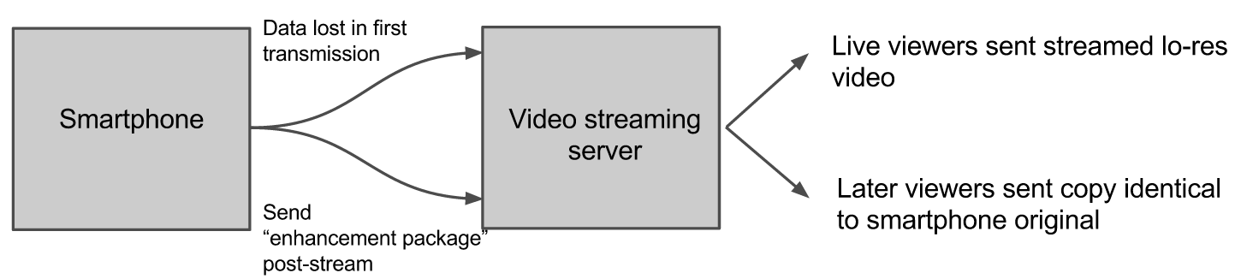
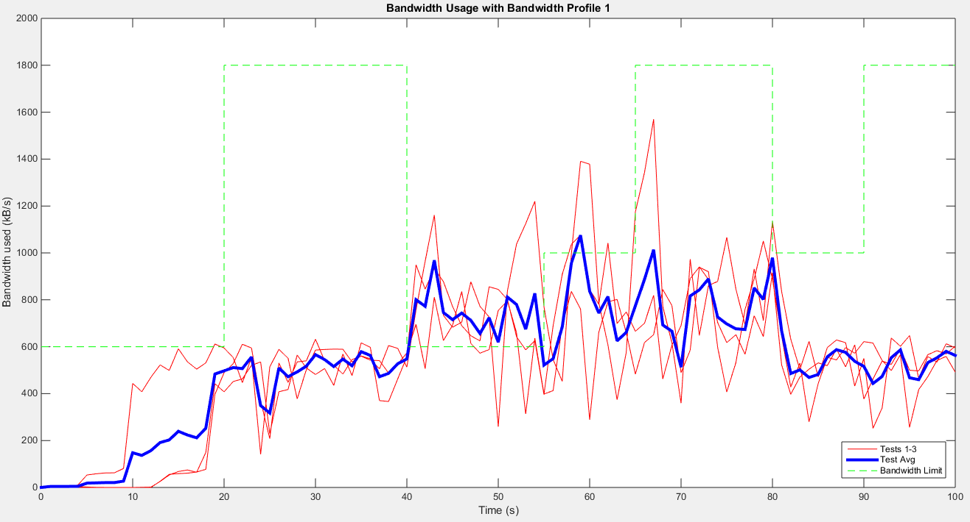









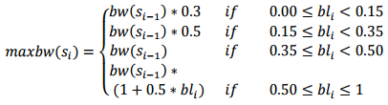

Dynamic Video Encoding
Daniel Ayoub
Kush Oza
Roy Yates
Anand Sarwate
Unconventional Sources
MPEG-DASH
Live-Streaming Application
Research methods of encoding video to reduce bandwidth requirements for streaming
Unconventional streaming sources call for live-streaming solution that can adapt to erratic network throughput
Mobile network throughput typically has cost associated with data usage
Live streams from mobile devices sacrifice quality for low-bitrate streaming
  Streaming providers use low single-bitrate stream (SBS)
Increase QoE while minimizing excess data usage
Design ‘enhancement package’
  Identify segments lost during single-bitrate stream
  Package lost segments
Improve video QoE without re-streaming high quality video
Specific needs of the project calls for a more flexible and powerful streaming protocols
MPEG-DASH
  MPEG Dynamic Adaptive Streaming over HTTP
  Incoming adaptive bitrate streaming (ABS) standard
Process
  Segment video file into arbitrary time segments (e.g. 2 seconds)
  Client estimates TCP throughput and requests segment
  Stream from streaming server to client side via HTTP
Server provides manifest file with video representation descriptions
Client estimates TCP throughput and requests appropriate segment
Livestream QoE limited by variable network throughputs
  Camera-Server & Server-Client
Sample bandwidth profile relationship:
  Shaded region is instantaneous camera-client throughput
Bandwidth measurement during live-stream:
Camera would simultaneously encode video at all bitrates
Server requests highest viable bitrate
  Throughput hovers near lowest available bitrate
Experienced significant QoE benefit over SBS while minimally increasing used bandwidth
Video File
Video Segment 0-2s
Video Segment 2-4s
…
Segment 1
700Kbit/s Throughput
480p
Segment 2
1500Kbit/s Throughput
720p
.
.
.
Segment x
HIGHER BANDWIDTH =
BETTER RESOLUTION
MPEG-4 SVC
MPEG-4 SVC (Scalable Video Coding) standard allows for layered encoding
  Framesets
  Layered resolution enhancements
  Layered SNR (QoE) using DCT coefficients
Decoding utilizes inter-layer prediction to decrease bitrate of successive layers
Current SBS solutions use RTP (over UDP) to transmit data
  Lost data not retransmitted
Tested single bitrate stream over wired connection between two ORBIT nodes
  Original bitrate: 10 Mbit/s
Existing SBS cannot accommodate erratic connections
0-10s | 700Kbit/s 480p
10-30s | 1500Kbit/s 720p
… | …
HTTP
R₅
R₄
R₃
R₂
R₁
R₀
T₀
T₂
T₁
T₂
T₀
T₂
T₁
T₂
T₀
Selection Algorithms
Sources & Acknowledgements
(i) Temporal Scalability
(ii) Spatial Scalability
Throughput Estimation Method
  Averages past bandwidth estimates to create smooth throughput estimation curve
  Standard deviation determined by recent deviation from expected throughput
DASH Adaptation Algorithm
  Measures average download time of each segment
  Constructs an adaptation decision based on download time and average bitrate of video
We’d like to thank our advisors, Professor Yates and Professor Sarwate, for their guidance through frustrating portions of this project as well as many wonderful conversations during our research meetings. We’d also like to thank Ivan Seskar, as this project wouldn’t have been possible without his helpful tutorials, explanations, and patience. Finally, we’d like to thank our peers in the internship program for all the helpful information and tips shared during conversations at WINLAB.
Sources:
[1] Truong Cong Thang; Quang-Dung Ho; Jung Won Kang; Pham, A.T., "Adaptive streaming of audiovisual content using MPEG DASH," Consumer Electronics, IEEE Transactions on , vol.58, no.1, pp.78,85, February 2012
[2] Christopher Muller, Stefan Leder, Christian Timmerer, "An Evaluation of Dynamic Adaptive Streaming over HTTP in Vehicular Environments“
[3] Kovacevic, J.; Miljkovic, G.; Lazic, K.; Stankic, M., "Evaluation of adaptive streaming algorithms over HTTP," Consumer Electronics ?? Berlin (ICCE-Berlin), 2013. ICCEBerlin 2013. IEEE Third International Conference on , vol., no., pp.1,4, 9-11 Sept. 2013
[4] Computer art: pixelbay.com, https://pixabay.com/p-32743/
(a) 5 % Packet Loss
(b) 8 Mbit Connection
(c) 12 Mbit Connection
WINLAB

