Slide 1

Porting RC5 Encryption to a FPGA
Week 1
Nicholas Lurski

Slide 2
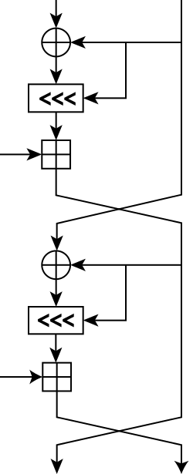
Project Description
Porting an encryption scheme to a Field Programmable Gate Array(FPGA)
Theoretically improves scalability of encryption
RC5 (Rivest’s Cipher) encryption is simple but powerful

Slide 3

This Week’s Accomplishments
Installed Vivaldo Integrated Development Environment (IDE)
  Performed some tutorials
Installed Xillybus and Xilinux
Created a test bench for streamlined work

Slide 4
This Week’s Challenges
Not much really
Installing software is not hard
However, some hardware challenges
Also processing time

Slide 5
Next Week’s Goals
Get a basic algorithm running in the test bench

