Slide 1
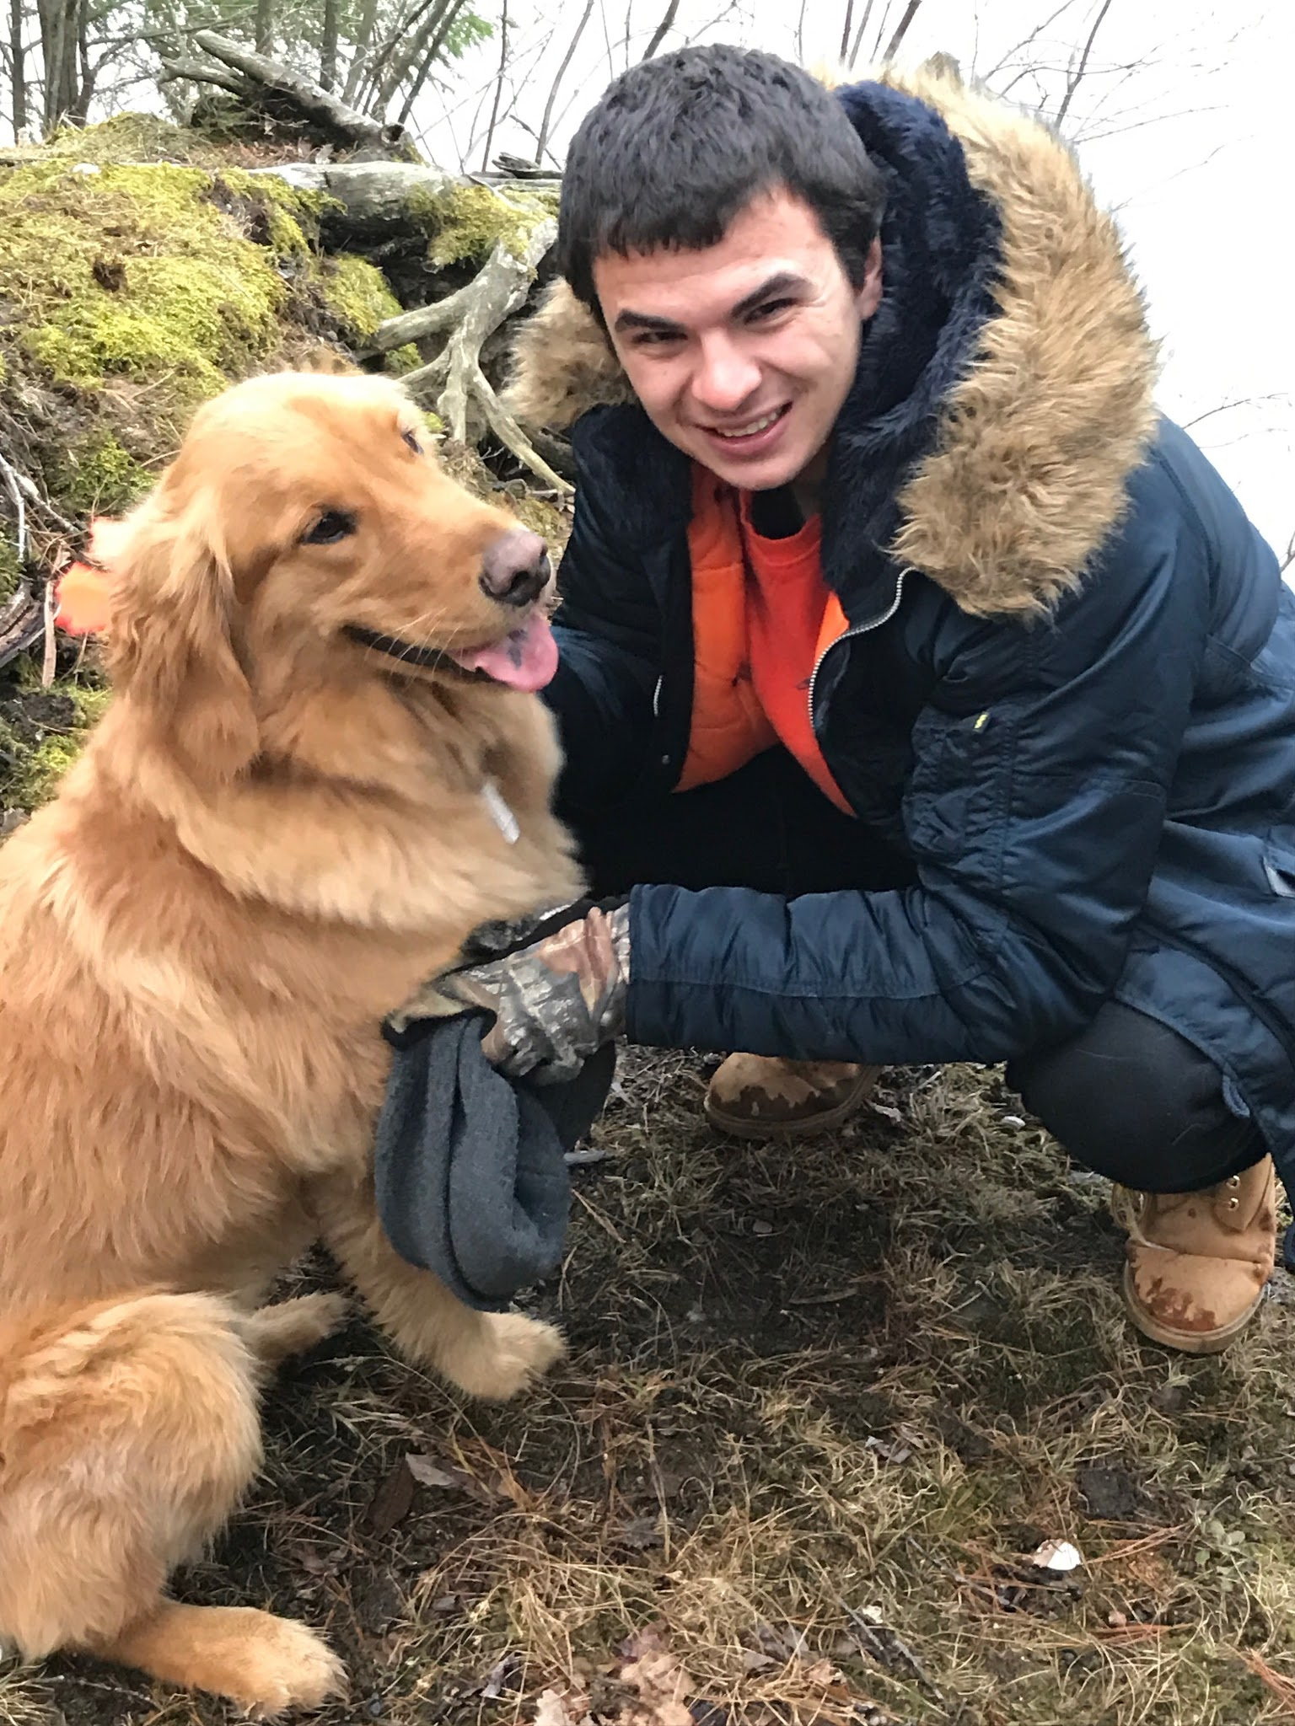
Design of a pseudo-language for Field Programmable Gate Array (FPGA) programming
Week 10
Nicholas Lurski and Zarir Hamza

Slide 2
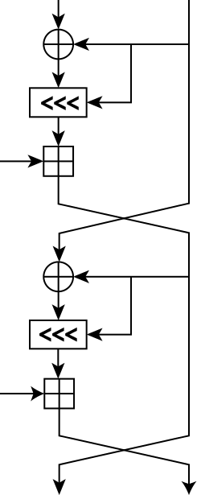
Project Description
Developing a quasi-language to make FPGA design easier
Implementing different math functions (RC5 Encryption and CRC generation) to work out bugs
Basically want to lower the entrance level to FPGAS

Slide 3
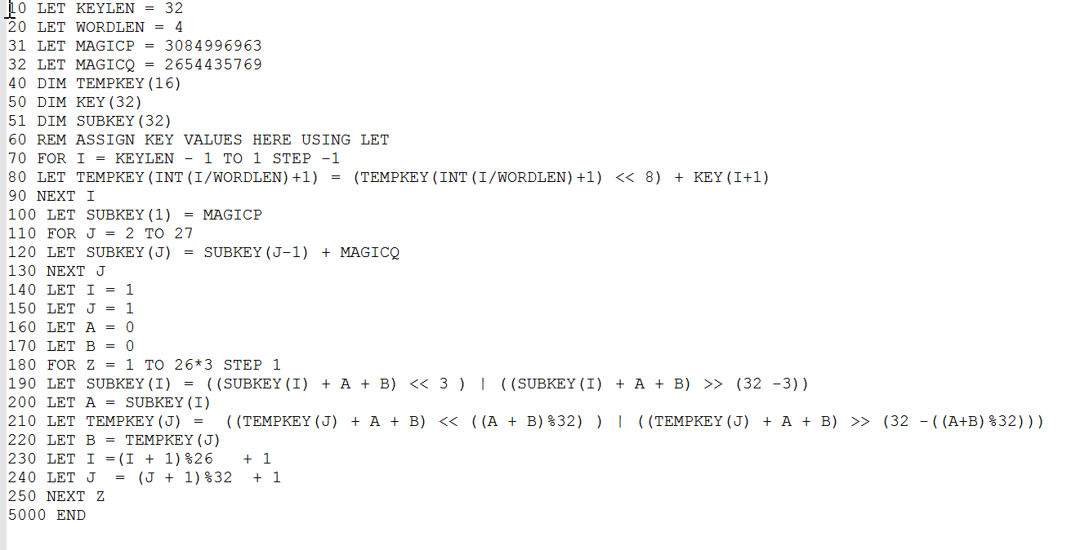
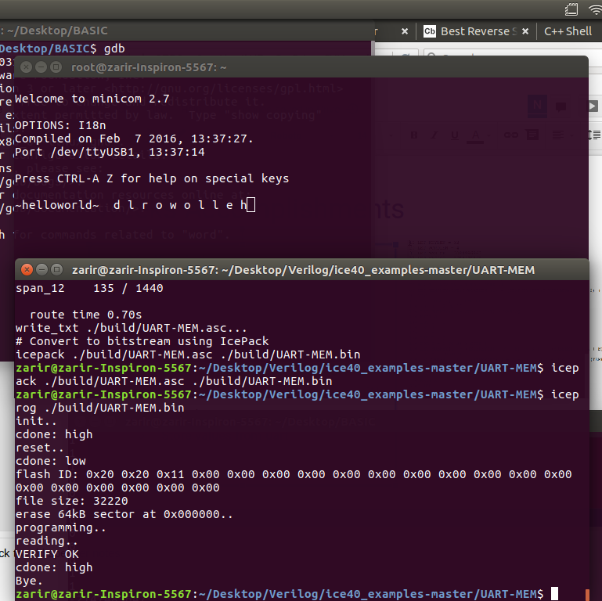
Weeks Accomplishments
Verifiable input/output from BASIC implementation
Cleaned up BASIC code further
Setup IceStorm compiler for Verilog on Linux Ubuntu 17.04
Created UART communication with GO Board
  Store values from uart

Slide 4
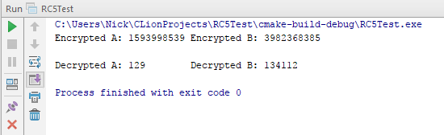
Challenges
Debugging BASIC code
Documentation
Unsigned vs Signed
CRC32 protocol

Slide 5
Work on Next Week
Implement RC5 on the board now that we have it fully working
Finish CRC32 in BASIC
Create better UART interface

