Slide 1

Design of a pseudo-language for Field Programmable Gate Array (FPGA) programming
Week 10
Nicholas Lurski and Zarir Hamza

Slide 2
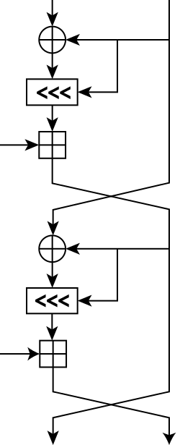
Project Description
Developing a quasi-language to make FPGA design easier
Implementing different math functions (RC5 Encryption and CRC generation) to work out bugs
Basically want to lower the entrance level to FPGAS

Slide 3
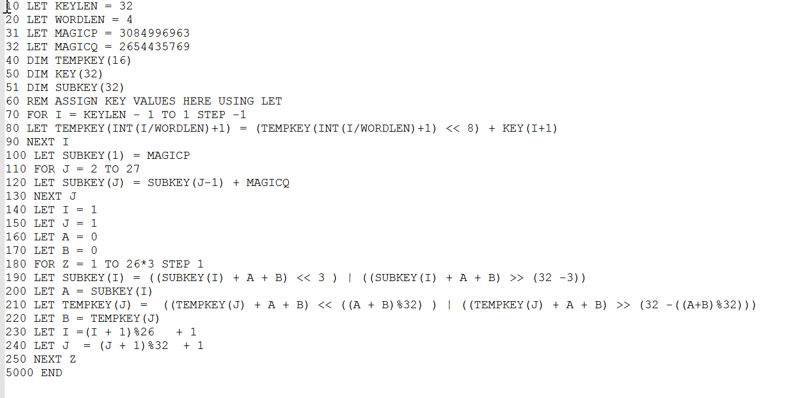
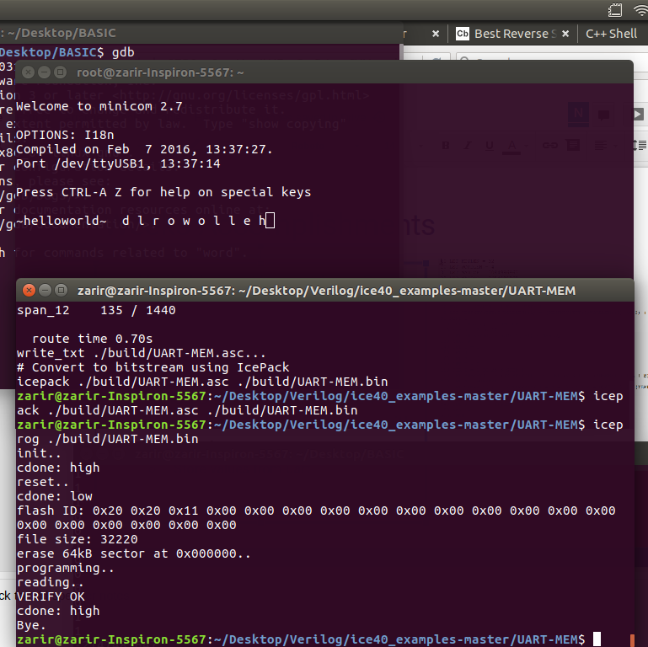
Weeks Accomplishments
Implementation of a Finite State Machine in python structure
  May sound unrelated
  Actually a grad project to make compiling a state machine to verilog code easier which fits into the scope of our project
CRC32 in BASIC
Implement a few more things into the interpreter to make the language easier to use and design with
  Queue type variable

Slide 4
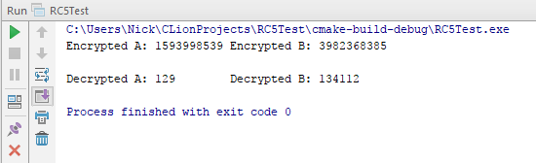
Challenges
Learning regular expressions for the FSM project
  Goal is to use regular expressions as a benchmark
UART/Serial communication in Zybo Board

Slide 5
Work on Next Week
Get serial communication working with the Zybo board
Use the FIFO variable to grab input
  Process the input with RC5 or CRC and output it
Finish poster and print it

