Slide 1

Porting RC5 Encryption to a FPGA
Week 2
Nicholas Lurski

Slide 2
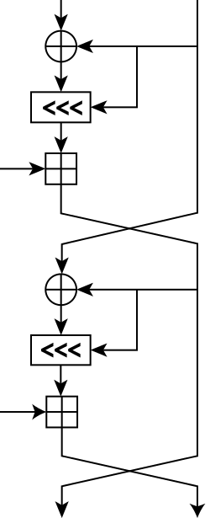
Project Description
Porting an encryption scheme to a Field Programmable Gate Array(FPGA)
Theoretically improves scalability of encryption
RC5 (Rivest’s Cipher) encryption is simple but powerful

Slide 3
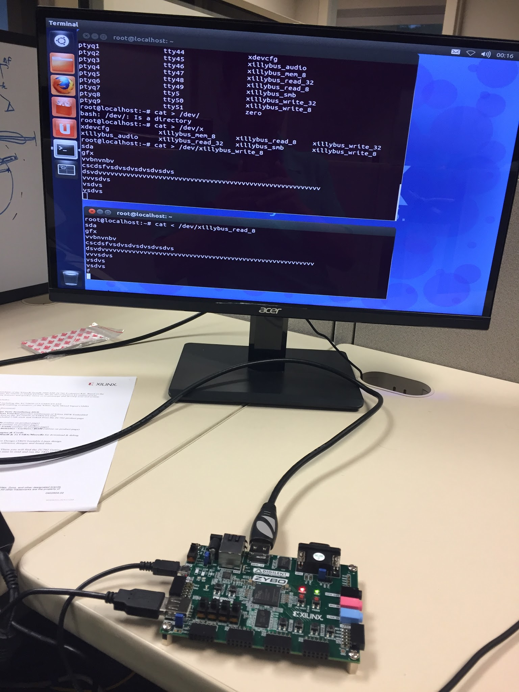
This Week’s Accomplishments
Found past code and documentation
Started porting it into the current bitstream setup
Was able to emulate input and output devices

Slide 4
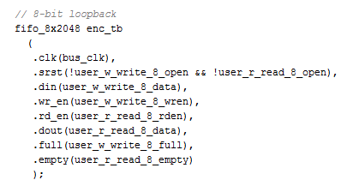
This Week’s Challenges
Figuring out verilog
  Blend of hardware and software with coding
  Not all code is synthesizable
    Means you can put it on real life hardware

Slide 5
Next Week’s Goals
Get the past code running on the zybo board
Begin fixing the past code due to synthesis issues.

