Slide 1

Porting RC5 Encryption to a FPGA
Week 3
Nicholas Lurski

Slide 2
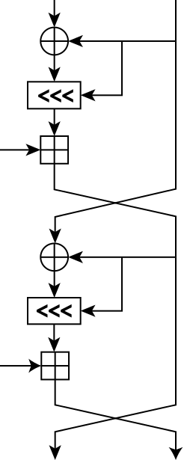
Project Description
Porting an encryption scheme to a Field Programmable Gate Array(FPGA)
Theoretically improves scalability of encryption
RC5 (Rivest’s Cipher) encryption is simple but powerful

Slide 3
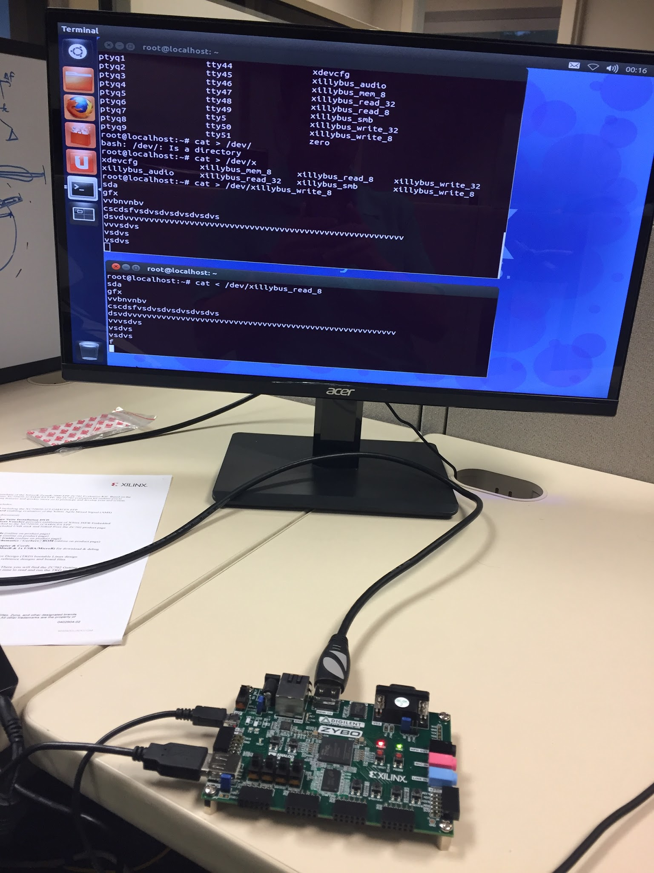
This Week’s Accomplishments
Finished website
Worked on Applesoft BASIC implementation of RC5
  Going to use switch case for sequential execution
  Easier to implement if already written in another lang
Got rotational shifting to work

Slide 4
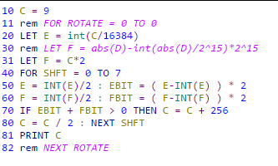
This Week’s Challenges
Working with Applesoft BASIC
  Many modern features missing
  Both a pro and a con for this project

Slide 5
Next Week’s Goals
Work on key generation in BASIC
Along with finishing the encryption code in BASIC
Learn more about the Zynq platform for when this is implemented on the hardware

