Slide 1

Porting RC5 Encryption to a FPGA
Week 4
Nicholas Lurski

Slide 2
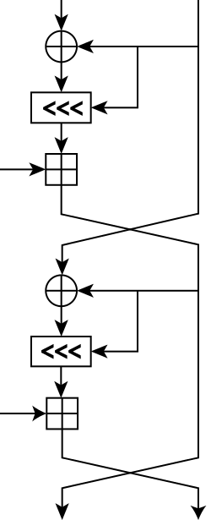
Project Description
Porting an encryption scheme to a Field Programmable Gate Array(FPGA) through using a Basic-Verilog Compiler
Theoretically improves scalability of encryption
RC5 (Rivest’s Cipher) encryption is simple but powerful

Slide 3
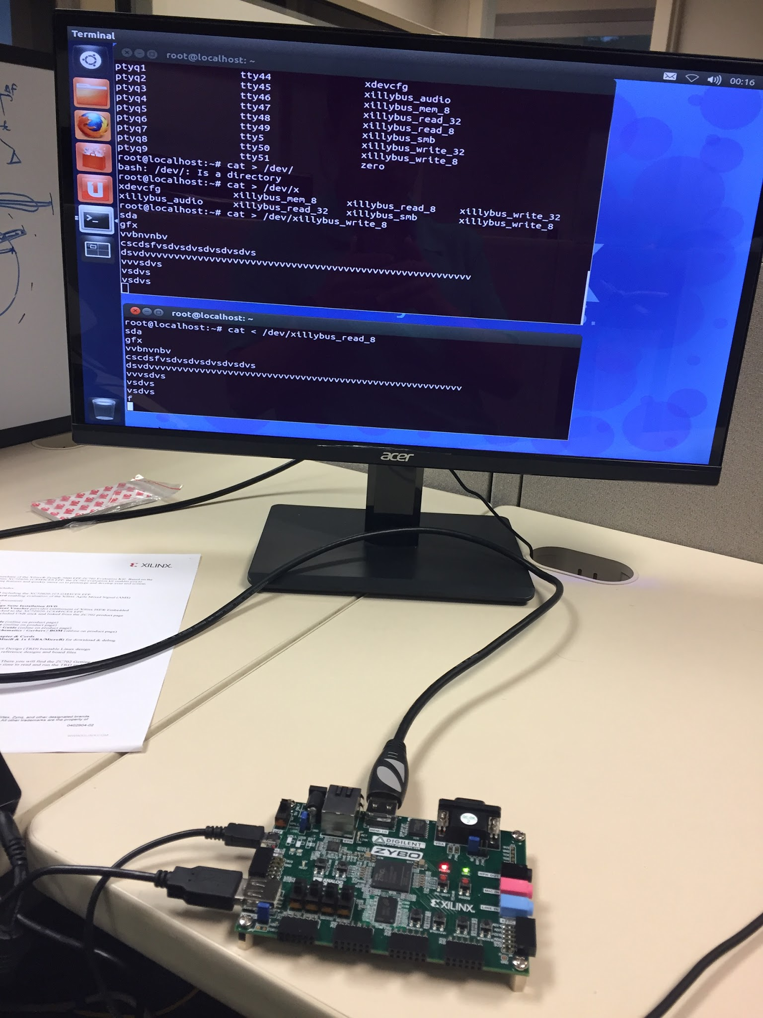
This Week’s Accomplishments
Implemented RC5 in quasi-basic
  Basic intrepreter written in python
  We can implement functions not in BASIC
Compiled Basic code to verilog

Slide 4
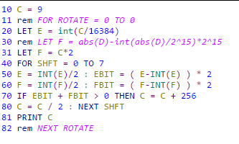
This Week’s Challenges
Not that many
  Figuring out how to bring some
  functions to our quasi-basic
  Verification of the code

Slide 5
Next Week’s Goals
Verify the code through Xillybus/Xilinux
Learn more about the Zynq platform to see how scalable the code is
Try to optimize out some things in the code to make it work better with Verilog.

