Slide 1

Porting RC5 Encryption to a FPGA
Week 5
Nicholas Lurski

Slide 2
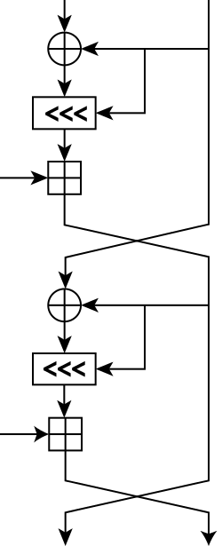
Project Description
Porting an encryption scheme to a Field Programmable Gate Array(FPGA) through using a Basic-Verilog Compiler
Theoretically improves scalability of encryption
Developing a quasi-language to make FPGA design easier

Slide 3
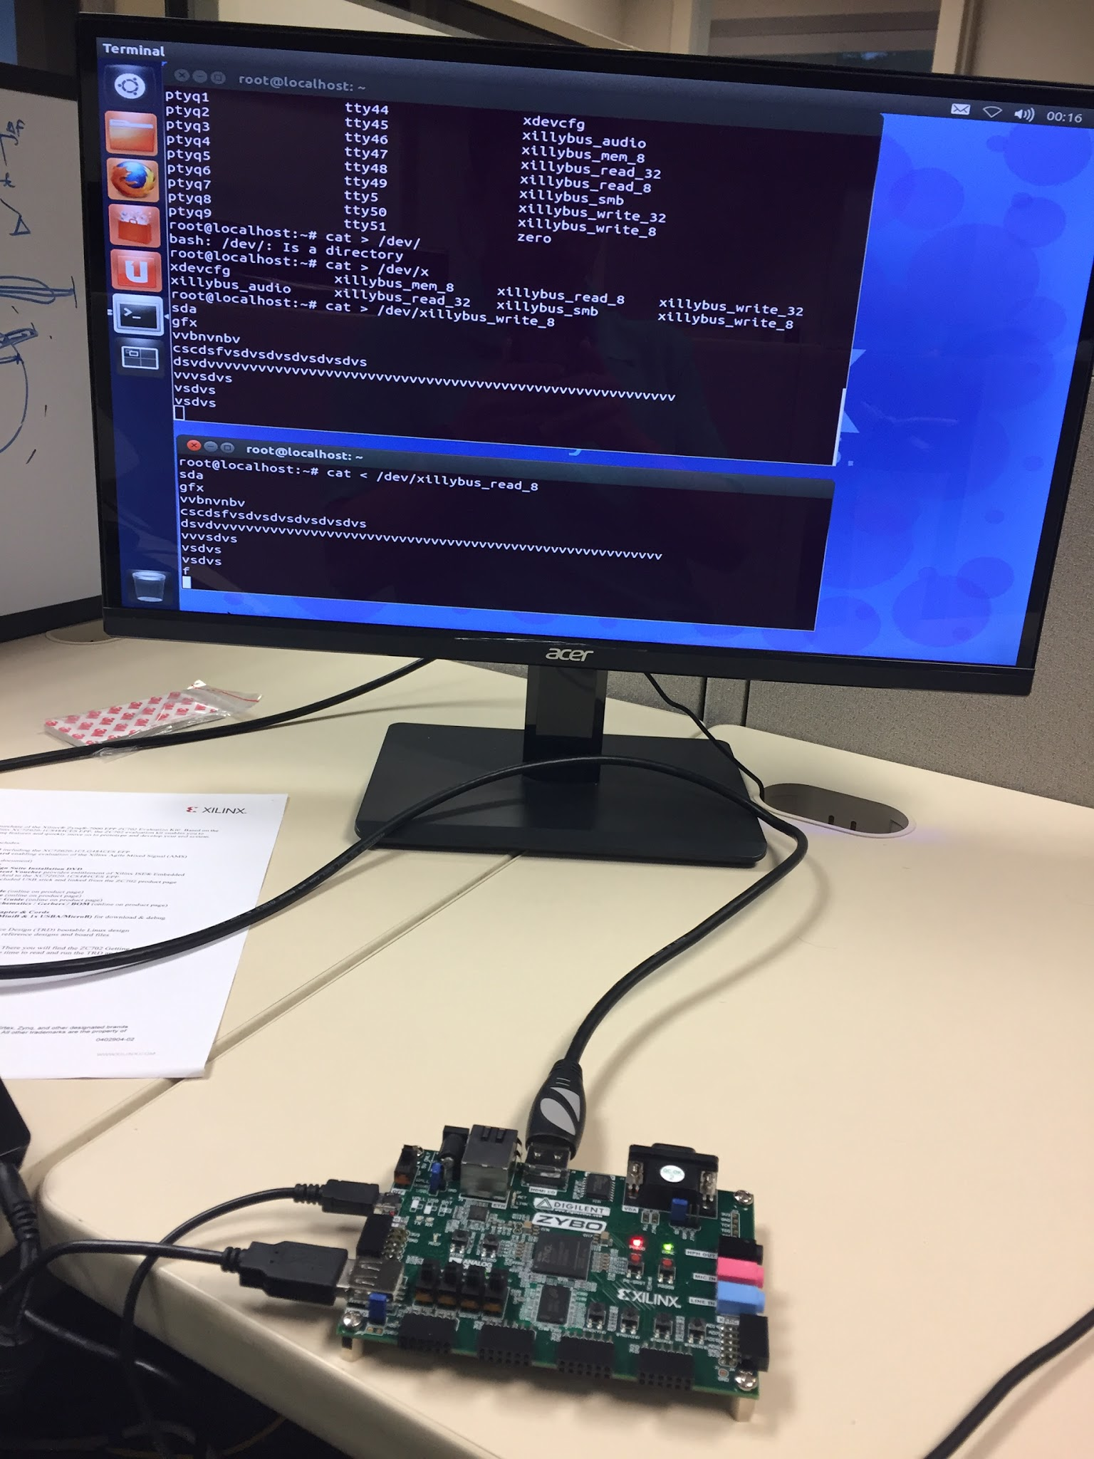
This Week’s Accomplishments
Compiled Basic code to verilog
  Need to implement modulus function
  Can’t fully verify code until that is done
However I got a output so the program is working

Slide 4
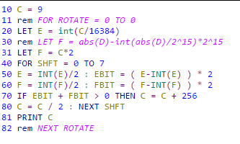
This Week’s Challenges
Verifying code that was eyeballed for
correctness
Trying to replicate modulus

Slide 5
Next Week’s Goals
Roundup the rest of the small bugs just from eyeballing the code
Verify the code through Xillybus/Xilinux
Learn more about the Zynq platform to see how scalable the code is
Try to optimize out some things in the code to make it work better with Verilog.

