Slide 1

Porting RC5 Encryption to a FPGA
Week 7
Nicholas Lurski

Slide 2
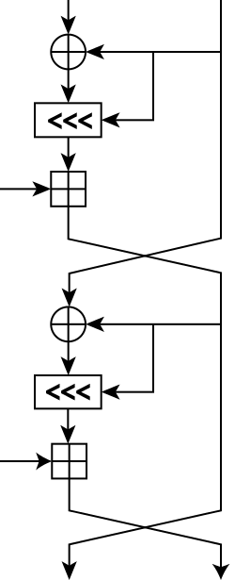
Project Description
Porting an encryption scheme to a Field Programmable Gate Array(FPGA) through using a Basic-Verilog Compiler
Theoretically improves scalability of encryption
Developing a quasi-language to make FPGA design easier

Slide 3
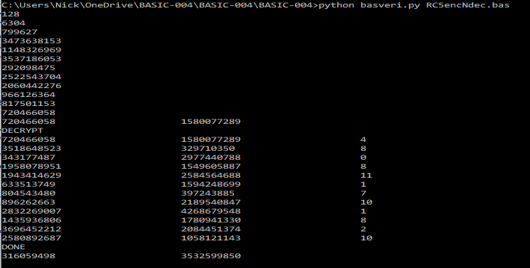
This Week’s Accomplishments
Found and fixed more bugs
  Introduced by the middle language
  32 bit integers -> longs

Slide 4
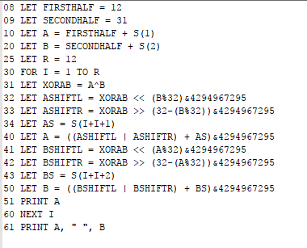
This Week’s Challenges
Fixing a lot of the problems
introduced through python
  Some math can be used to
  correct int problem
Refactoring code
  Nested logic is ugly as sin
  Fixed many errors just by rewriting

Slide 5
Next Week’s Goals
Verify the code on the GO board (New FPGA)
Try to optimize out some things in the code to make it work better with Verilog.
Make python code more applicable for our usage

