Slide 1
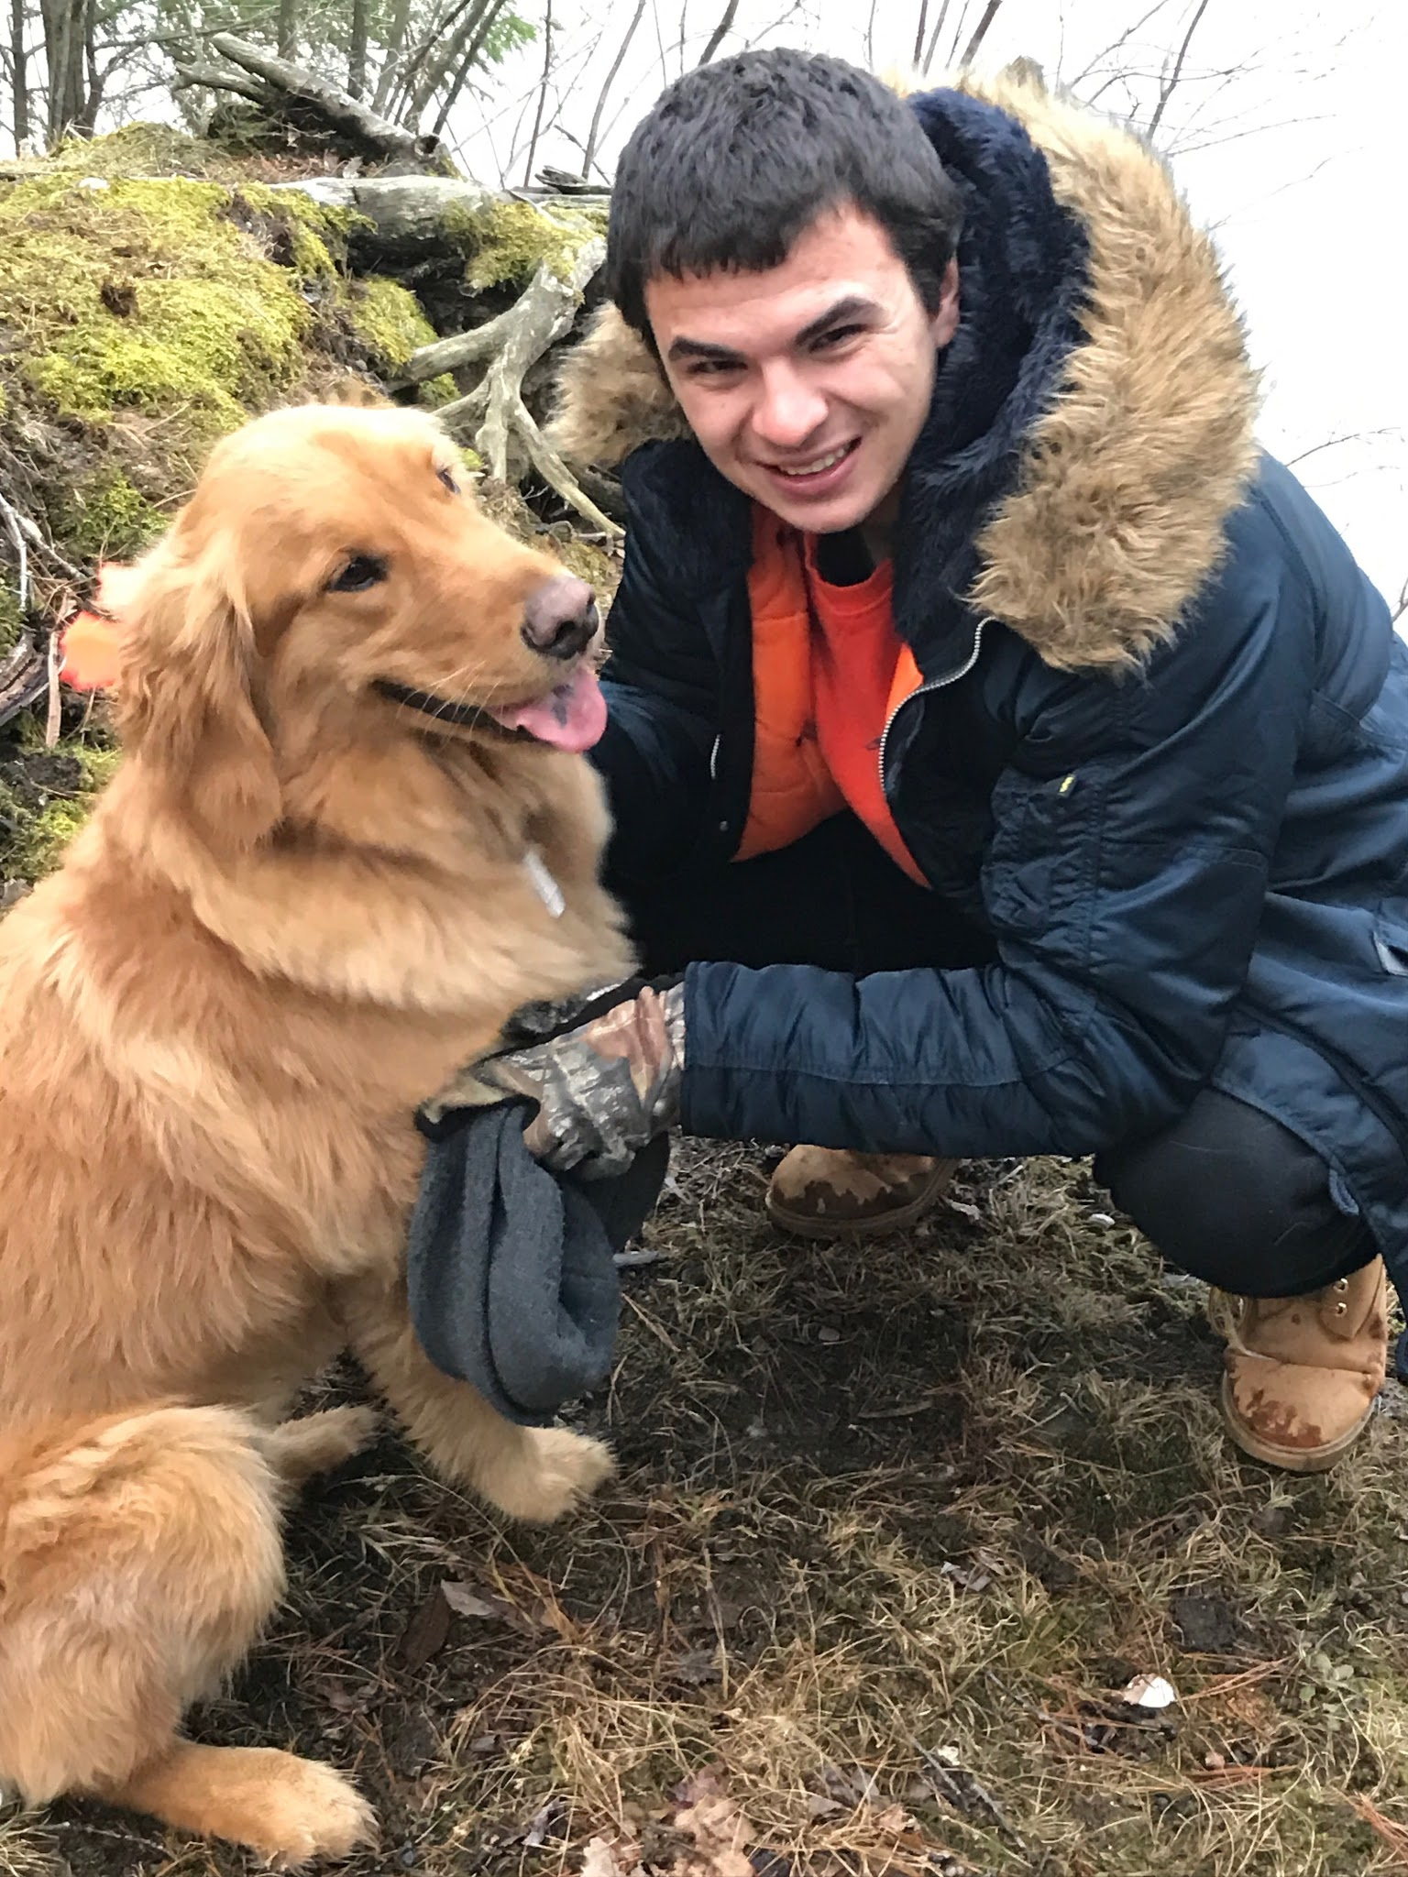
Design of a pseudo-language for FPGA programming
Week 8
Nicholas Lurski and Zarir Hamza

Slide 2
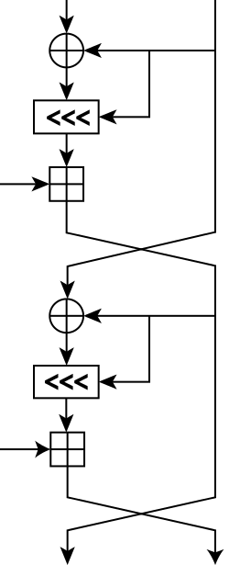
Project Description
Developing a quasi-language to make FPGA design easier
Implementing different math functions (RC5 Encryption and CRC generation) to work out bugs
Basically want to lower the entrance level to FPGAS

Slide 3
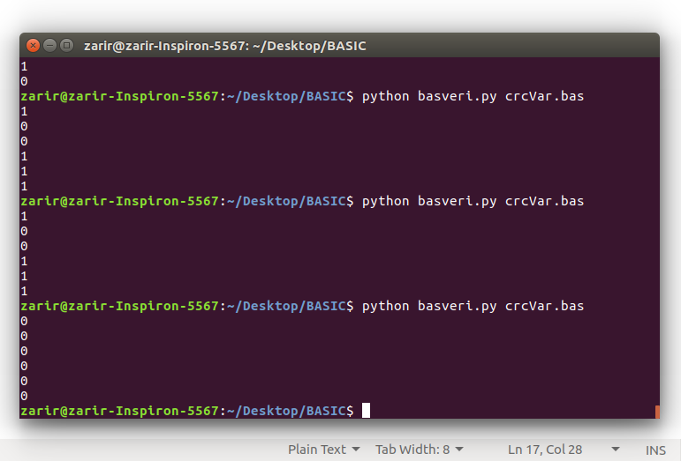
This Week’s Accomplishments
Familiarized with project goals
Learned BASIC and implemented CRC code
Set up GO Board Toolchain
Generated Bitstream for “Hello World”

Slide 4
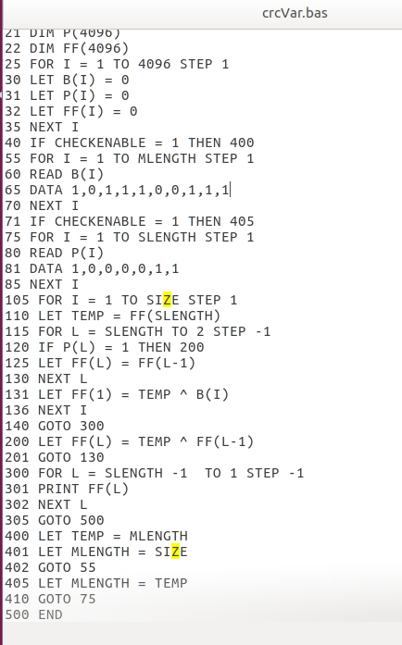
This Week’s Challenges
Problem understanding bitwise operators
  Fixed by using arrays
GO board issues
  Finicky(?) USB connecter prevented actual use
Reimplementing RC5 for the final time

Slide 5
Next Week’s Goals
Familiarize with FPGA board and tools to program
Output verilog code from the interpreter
Find a way to determine if proper output is given in FPGA

