Slide 1
ORBIT Emulation and Machine Learning for Enabling 5G and Satellite Network Coexistence in the FR3 Spectrum
Aadhil Anvar, Christos A. Bovolis, Aman Grandhi, Parth Karekar
Advisors: Prof. Narayan B. Mandayam, Ivan Seskar, Sreeram Mandava

Slide 2




Intro
Aman Grandhi:
Rising sophomore at Rutgers
Studying EE + CS
Parth Karekar:
Rising senior at Rutgers
Studying EE
Aadhil Anvar:
Graduate Student at Rutgers
Studying ECE
Christos A. Bovolis:
Student at NTUA
Studying ECE

Slide 3
Problem Definition
Notes:
Let’s start off with a brief description of our problem.

Slide 4
FR3
sub-6 mm-Waves
mid-Band
FR1
FR3
FR2
450MHz 7.1GHz 24GHz 71GHZ
Notes:
In our project we will be working in the FR3 spectrum, which is essentially range range of frequencies starting from 7 gigahertz to 24 gigaherts.
Our project will be working with the FR3 Spectrum, which is a range of frequencies starting from 7 to 24 GHz.

Slide 5


FR3
sub-6 mm-Waves
mid-Band
FR1
FR3
FR2
450MHz 7.1GHz 24GHz 71GHZ
Notes:
Due to the FR3 spectrum’s large bandwidth and strong signal propagation capabilities, many satellites transmit data and videos in this range. And as demande for this spectrum grows, research and commercialization is exploring 5G usage in the FR3 spectrum
Due to Fr3’s wide bandwidth and high signal propagation capabilities, this range is heavily utilized by satellite systems for video broadcasting and data transmission. As demand for this spectrum increases, research and commercialization is exploring 5G usage in the FR3 Spectrum.

Slide 6




Motivation
Notes:
The problem occurs, when satellites and 5g base stations operate in the same frequency range. Oftentimes, 5G signals can interfere with the satellite transmission, causing some data to be lost at the receiver. Therefore to improve future wireless communications, it’s important to find a way for both these networks to coexist.
Ideally, both 5g and satellites works without interfering with each other. But, oftentimes the signals interfere. this can lead to data being lost at the receiver.
so for the future of wireless communication, it is important to find a way for these networks to coexist in the FR3 spectrum.

Slide 7

Our approach
?
Notes:
to help combat the issue, we will use measurements from just 4 fixed sensors, and leverage a machine learning model to estimate Interference at any possible location.

Slide 8
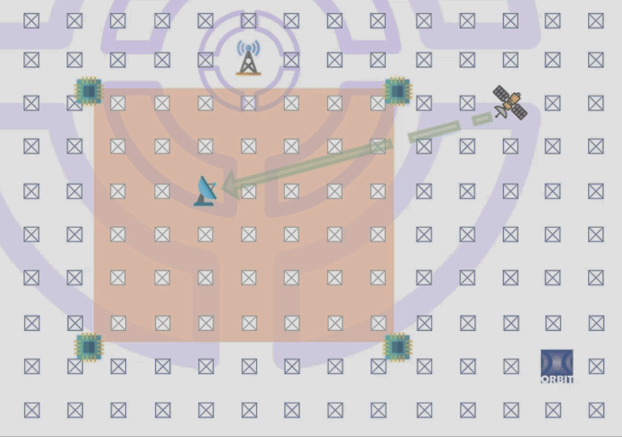
Topology
Notes:
For our experiments, We will be utilizing the Orbit Testbed, which is comprised of all these nodes on the ceiling.
These nodes have Software Defined Radios, meaning they have radios components operated by software rather than hardware.
We can use these to run emulations of signals being transmitted and received, to gather experimental data.
A satellite receiver is then moved to different locations on the grid to gain more interference measurements.

Slide 9

2) GNU Radio Implementations
Notes:
To control the aforementioned radios, we used a software platform called GNU Radio.

Slide 10
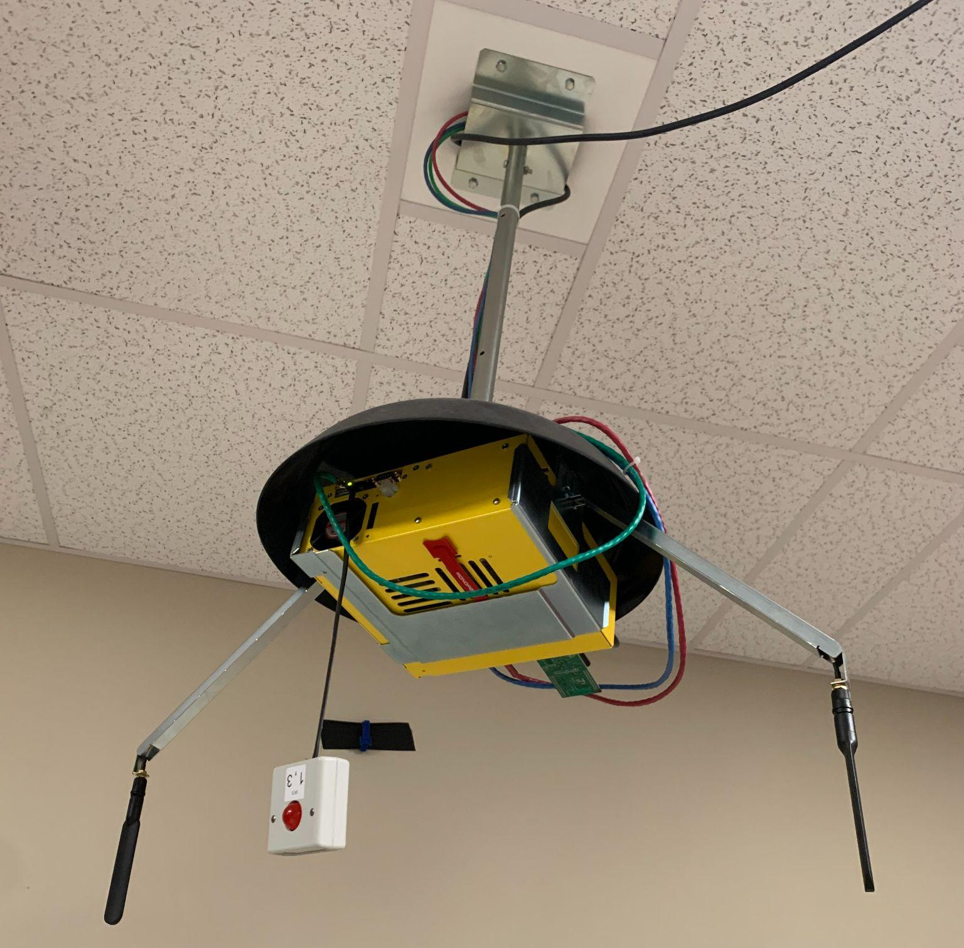
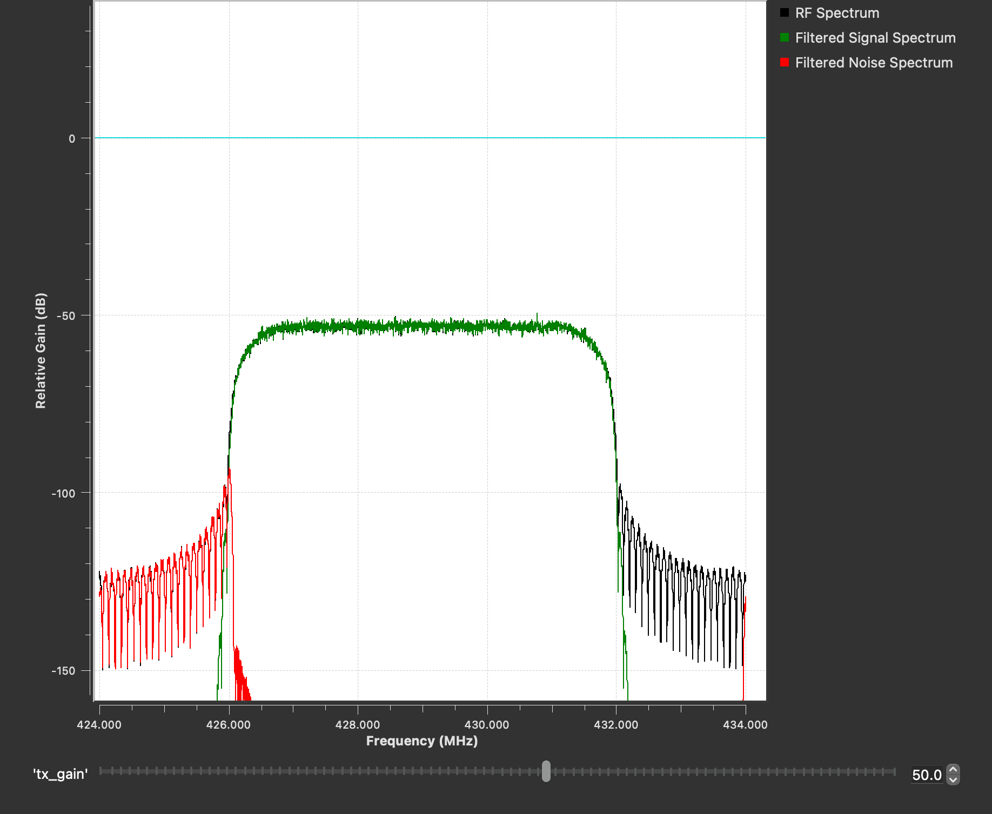
Simulated satellite transmitter
Notes:
We developed a Satellite transmitter to emulate a satellite signal for our proposed experiment.

Slide 11
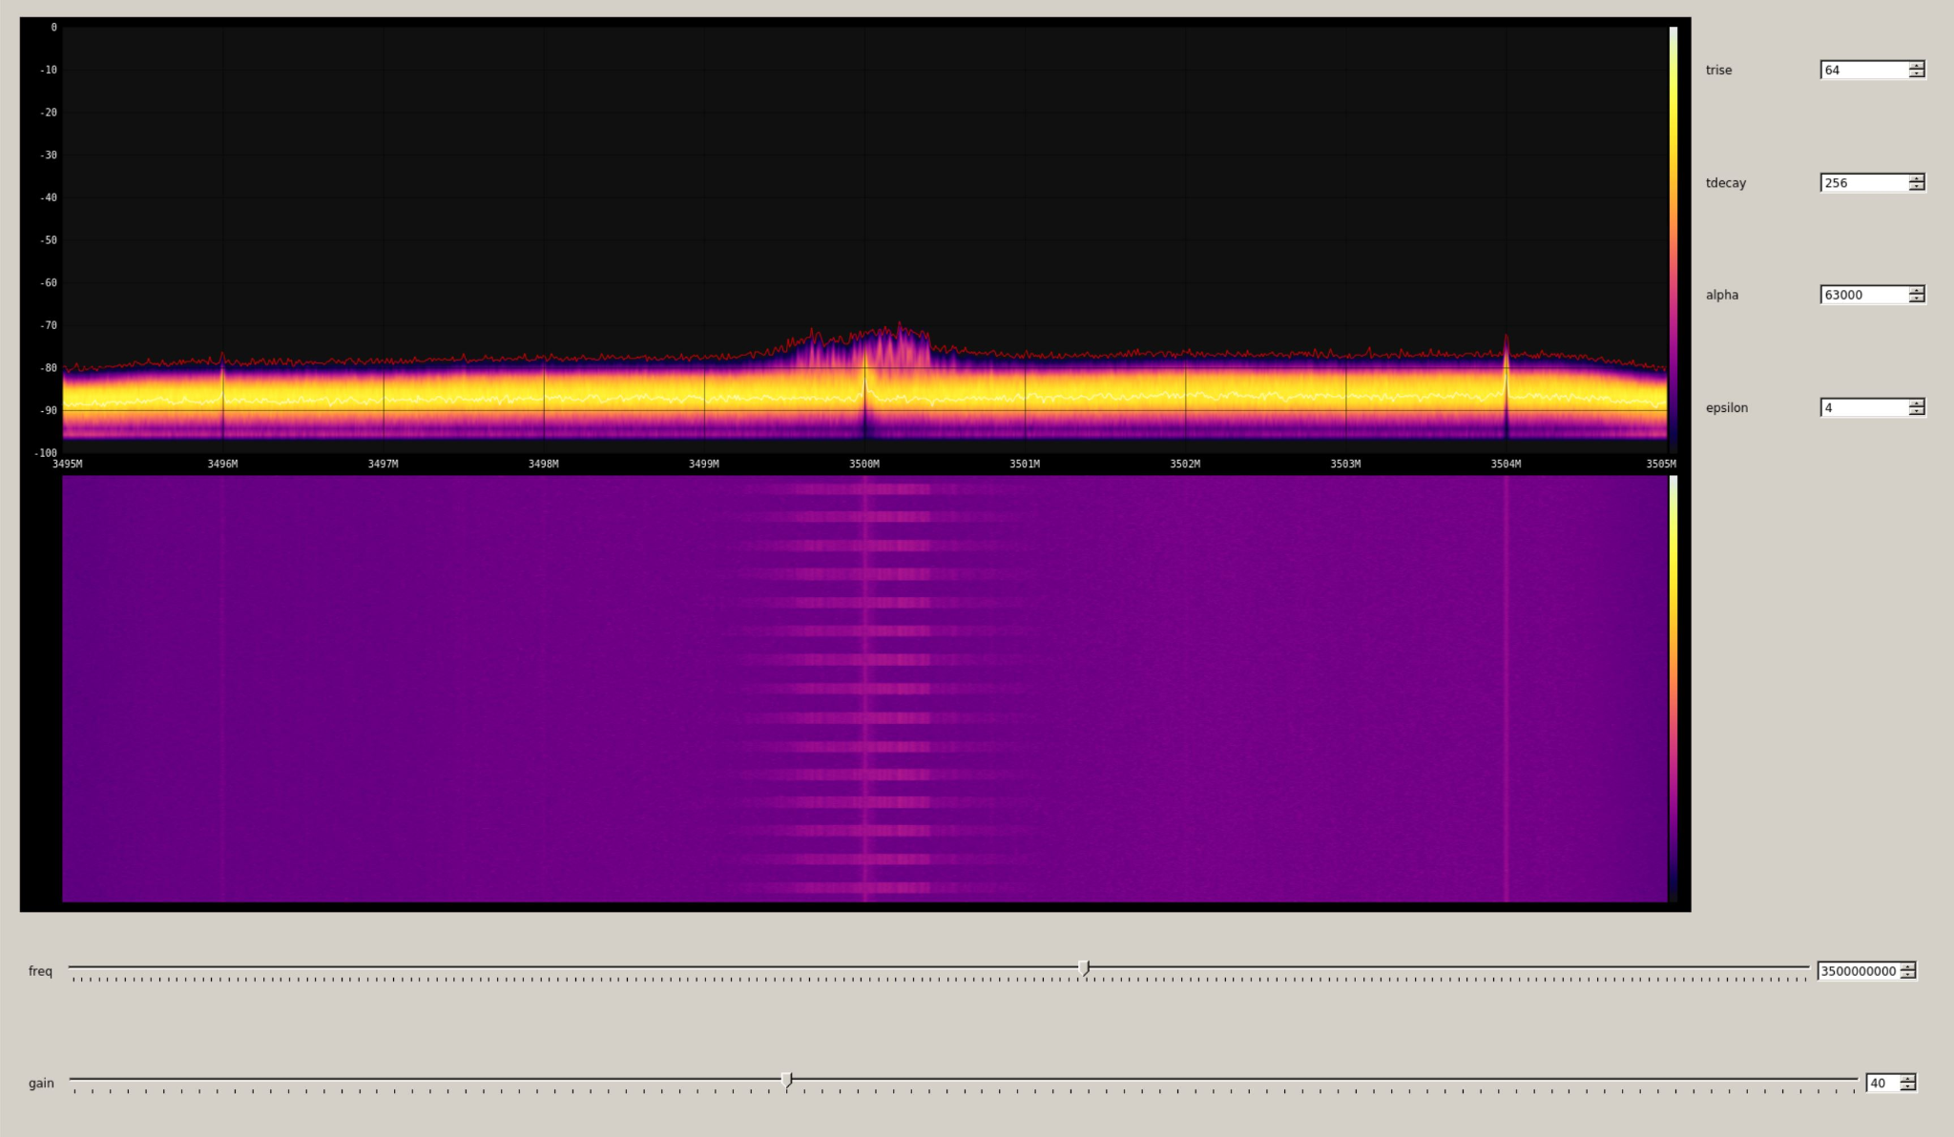
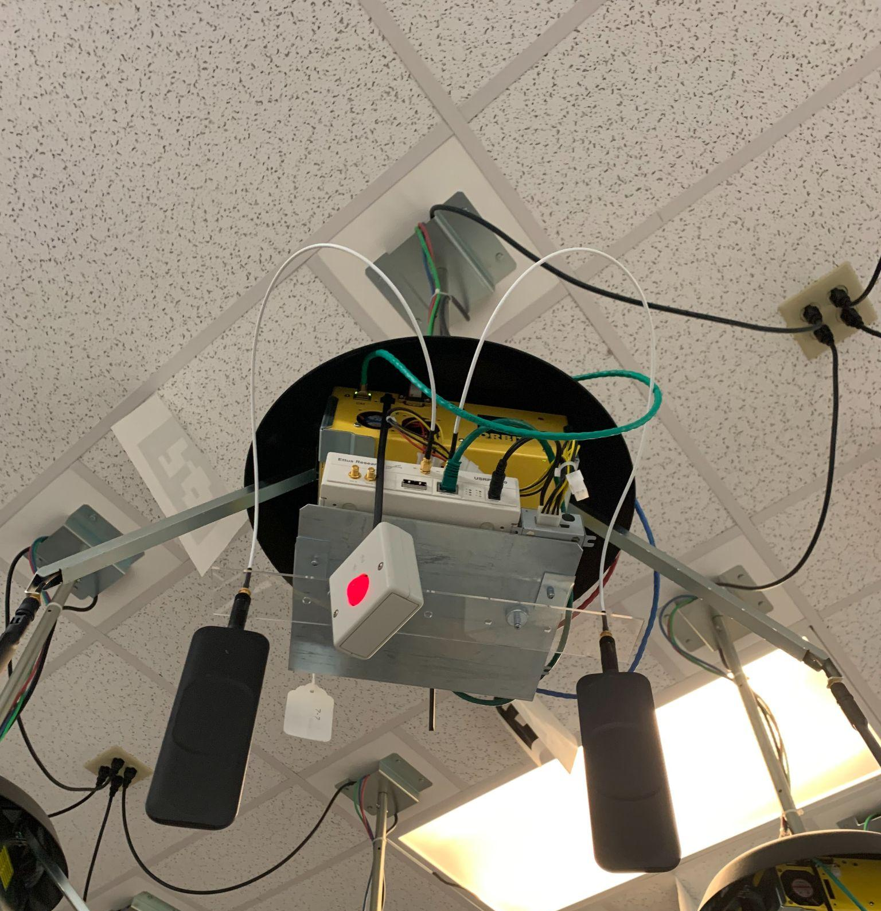
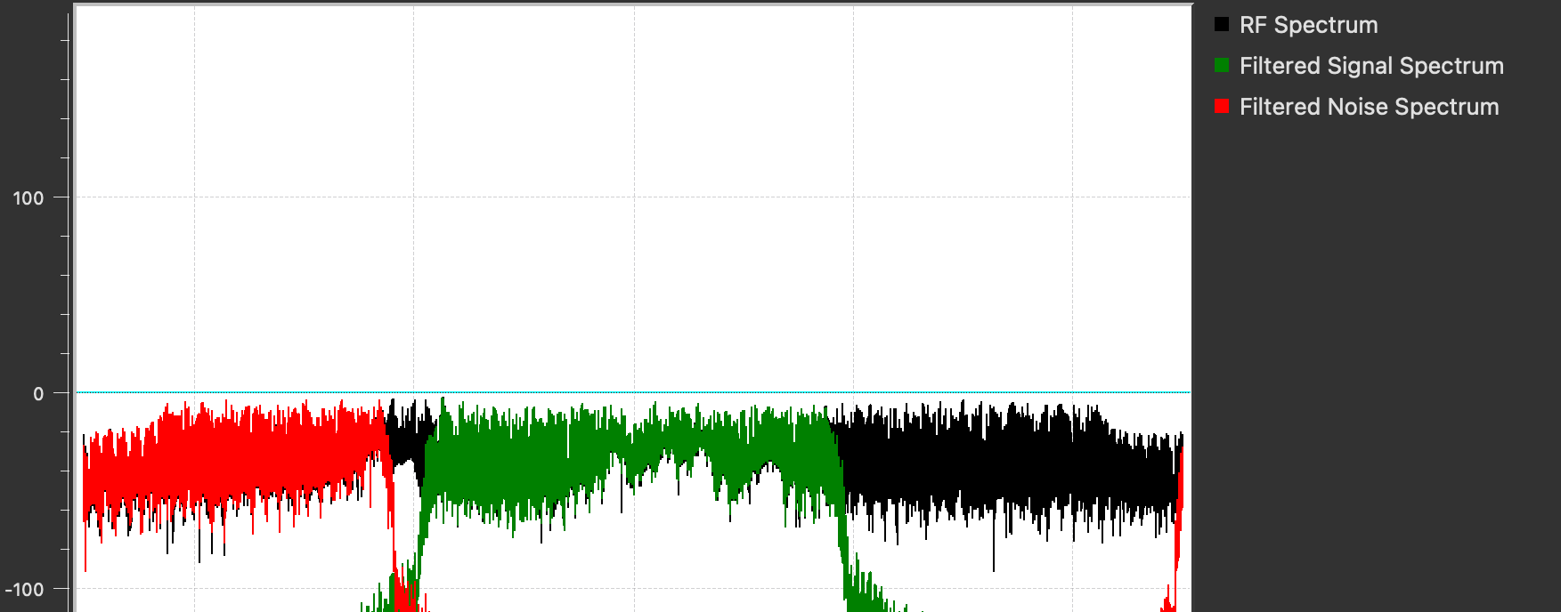
5G cell signal transmitter
Notes:
We also developed a 5G cell signal transmitter that emulates the interference. Below is a picture of the allocated space for signal and noise green and red respectively.

Slide 12
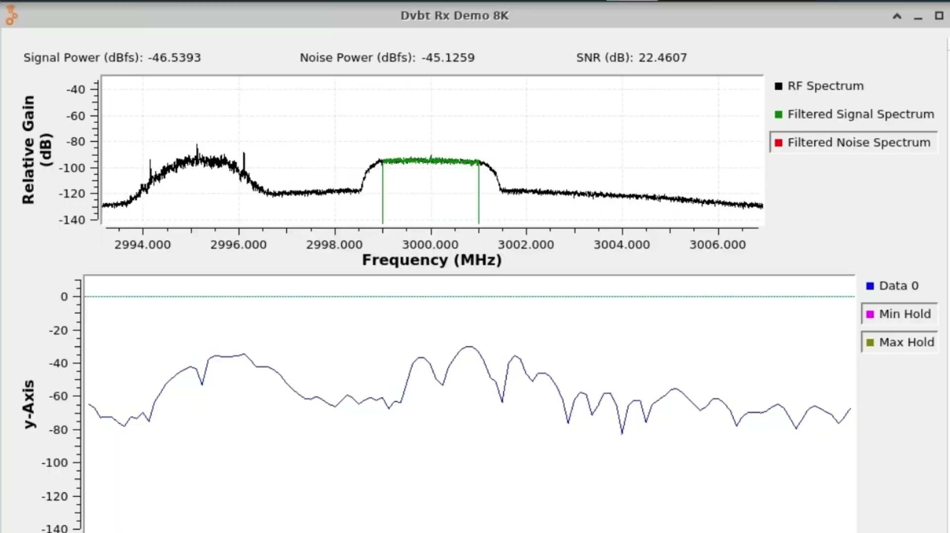
Signal Overlap
Notes:
Signal overlap refers to the potential interference that can occur when a satellite receiver and 5g base station operates in the same regions. So here we would like to show you the different level of interference that could happen during the satellite transmission, as the 5g signal approaches it.
Minimum, Moderate Severe Critical, back to minimum.

Slide 13
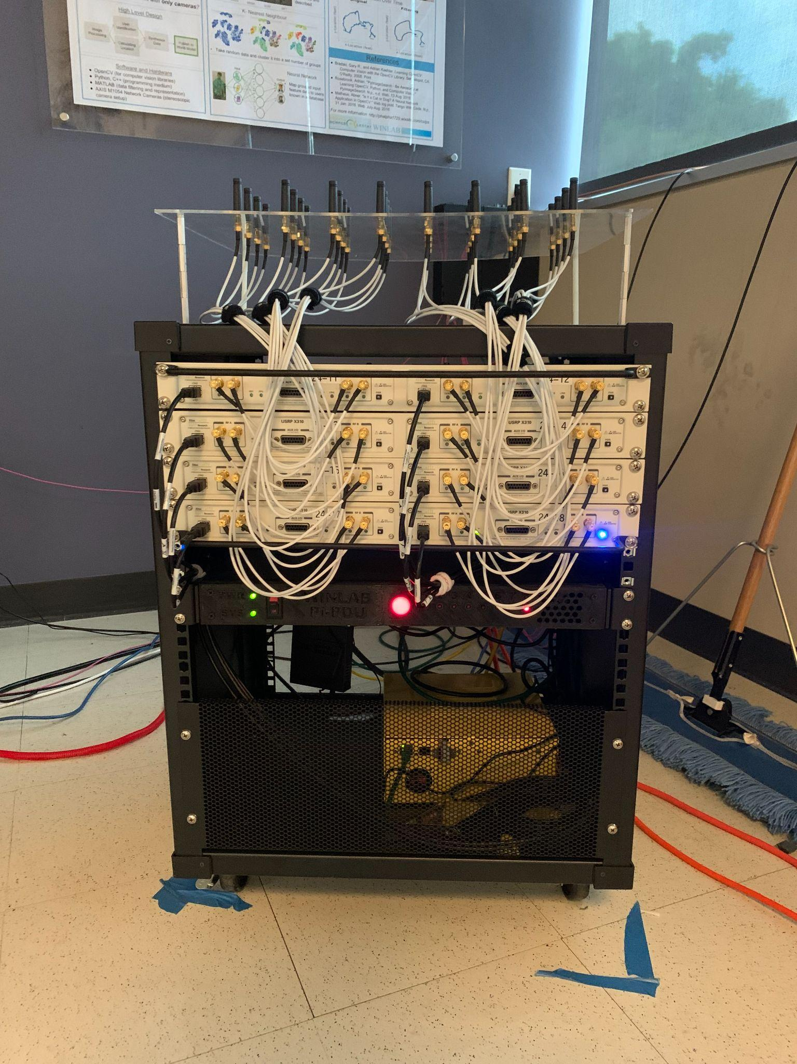
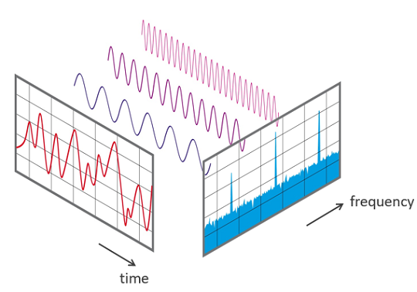
Measurement SDRs
FFT Data
Notes:
As aforementioned, we have four sensors in the corners of the orbit testbed. Each of these sensors measure the signals Fast Fourier Transforms (FFTS), which essentially gives us a way of viewing the frequency components that a signal is comprised of.

Slide 14

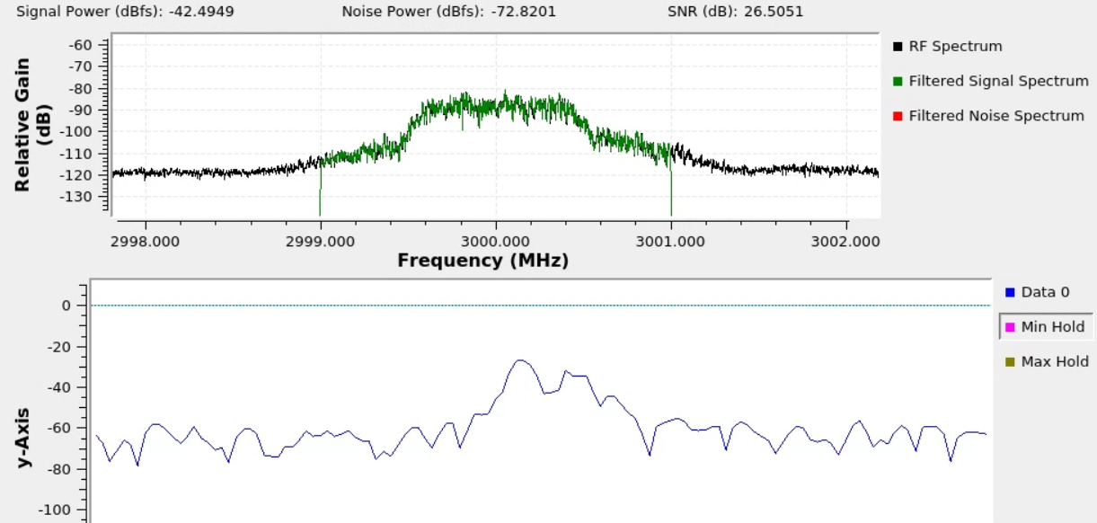
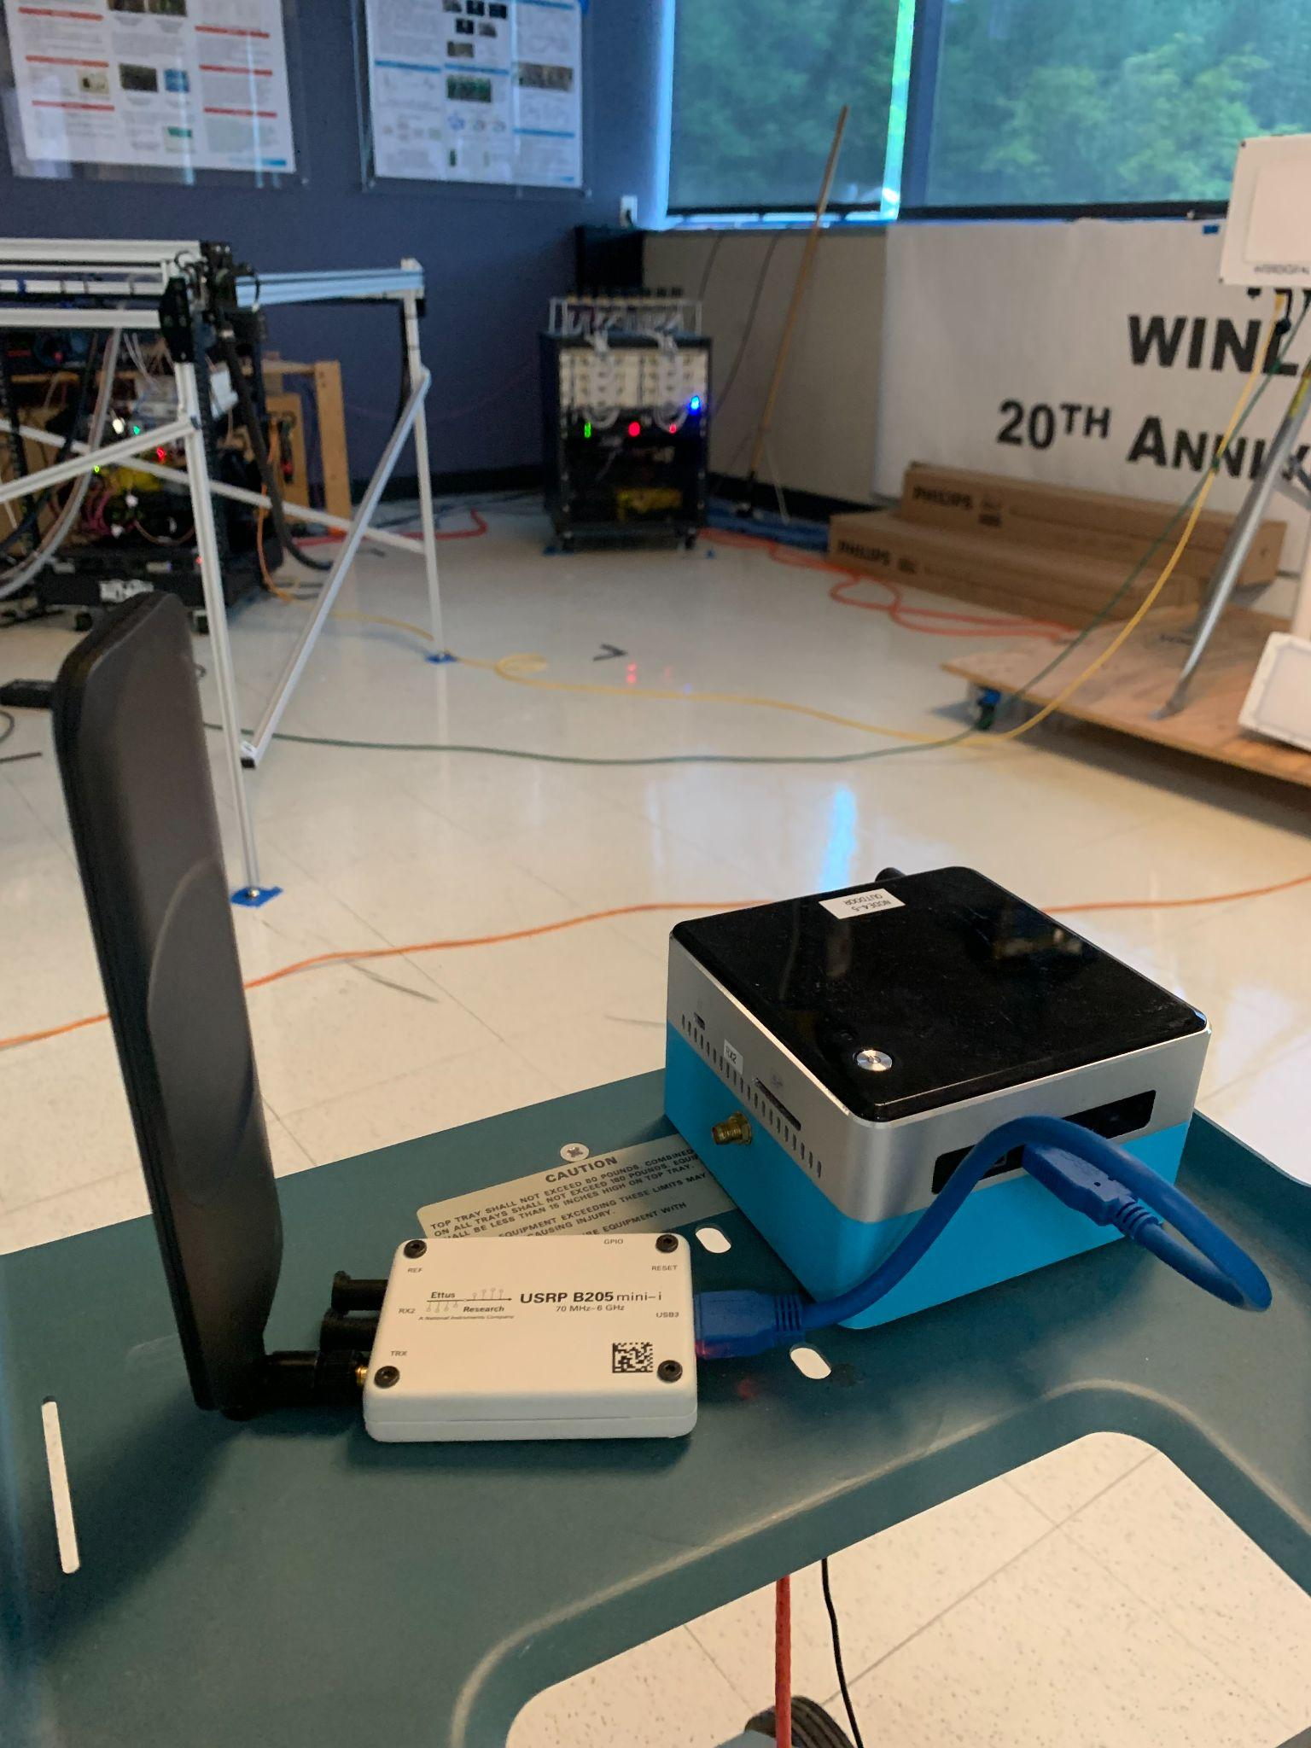
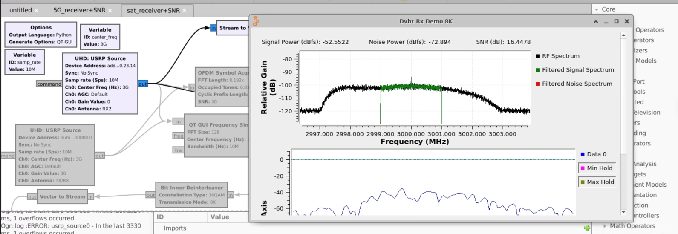
SINR Calculator
Notes:
We then set up a movable radio to imitate the satellite receiver. This receiver can measure the Signal to Interference and Noise Ratio (SINR) which is essentially the ratio of signal to unwanted information. We developed a model on gnuradio to measure the power (Green regions) of our signals so that we can calculate SINR via these measurements in different locations.

Slide 15
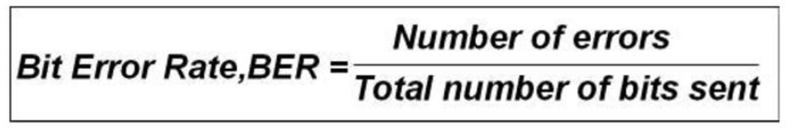
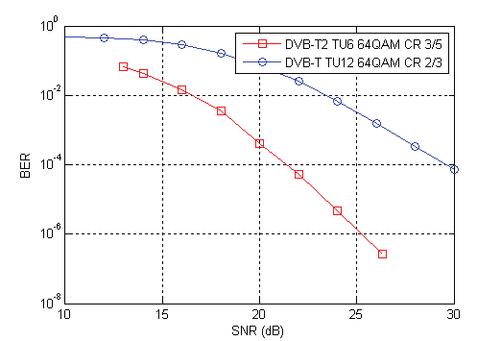
Performance Metrics
Notes:
Apart from SINR, we also used another performance metric for our received signal. We created a GNUradio model to successfully decode the received signal, to then calculate Bit Error Rate model, by dividing the number of errors compared by the total quantity of information sent.

Slide 16
3) ORBIT Experiment
Notes:
To carry out experiments, we had to synchronize all these components and automate their processes

Slide 17
Setup
SAT TX
5G TX
PC
(.SH SCRIPT1)
PC
(.SH SCRIPT1)
GRID CONSOLE
GRID CONSOLE
FFT 1
FFT 1
TEXT FILE
Parameters:
5G Center Frequency
5G Transmitter Gain
LOCAL USER
FFT 2
FFT 2
FFT 2
TEXT FILE
FFT 3
FFT 3
FFT 3
TEXT FILE
PC
(.SH SCRIPT1)
PC
(.SH SCRIPT1)
OUTDOOR CONSOLE
via SSH
OUTDOOR CONSOLE
FFT 4
FFT 4
FFT 4
TEXT FILE
via BASH
SAT RX
SAT RX
SAT RX
TEXT FILE
Notes:
We do that using Bash scripts, which originate from our computers to connect to the computer of the ORBIT Testbed. In turn, ORBIT’s computer connects with the transmitters, the receivers, and the sensors, which write their contents into text files. In each experiment, we varied the 5G center frequency and the 5G transmitter gain.

Slide 18
Time Diagram
Average
SAT TX
5G TX
FFT Sensor 1
FFT Sensor 2
FFT Sensor 3
FFT Sensor 4
SAT RX
TIME
Notes:
Although all these connections are timed, the fact that the components are turned on sequentially means that we have small discrepancies in the running time, so we have to use an approximate time frame at which all of the components are up and running, and average over that time frame to produce our measurements.

Slide 19
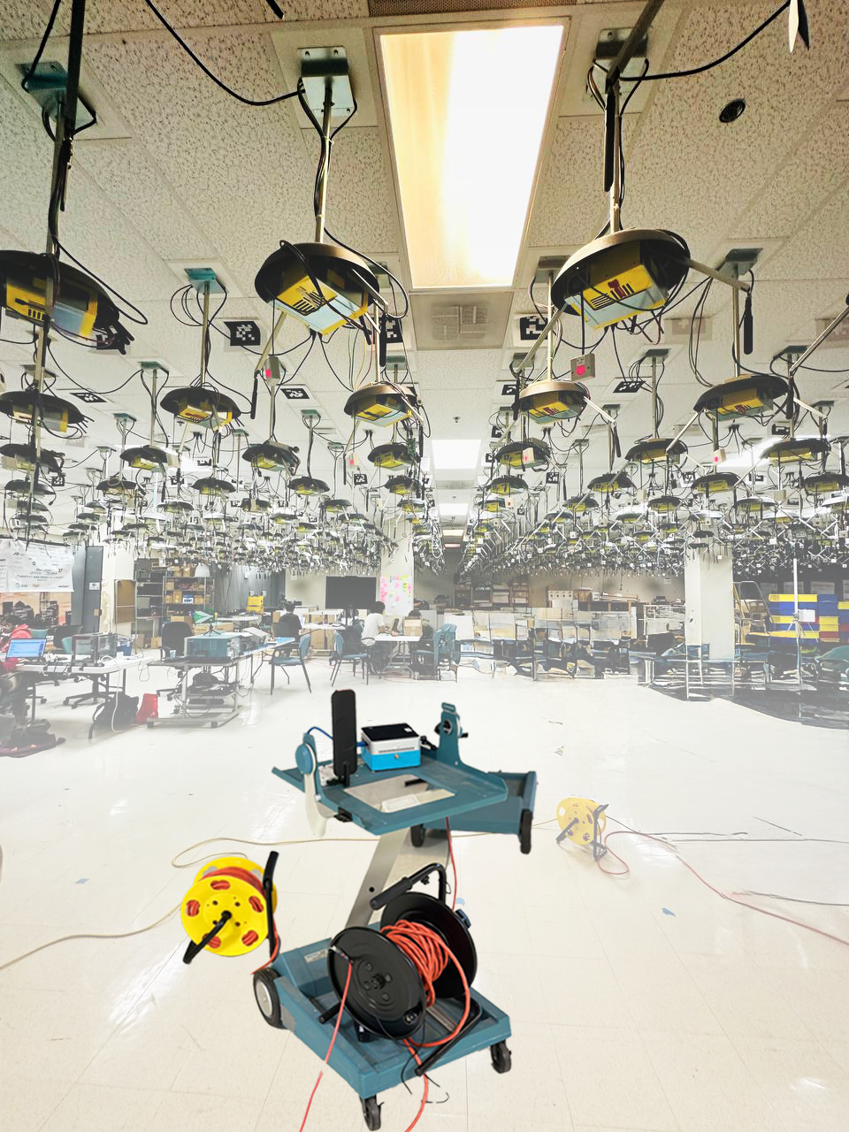
Experiments
3000 measurements
15 locations
Notes:
We collected 3000 measurements, during which we moved the satellite receiver emulator to 15 different positions underneath the grid.

Slide 20
4) Machine Learning Model
Notes:
This way, we gathered data to feed to a machine learning model.

Slide 21
Neural Network as a Black Box
Estimated SINR
NEURAL NETWORK
S1
FFT SAT
S2
FFT SAT
S3
FFT SAT
S4
FFT SAT
SAT REC. LOCATION
S1
FFT
5G
S2
FFT
5G
S3
FFT
5G
S4
FFT
5G
NOISE LEVEL
Notes:
Here is a sketch of the general design of our neural network. As a reminder, from the R3 Group, a neural network is a structure that learns from lots of examples to recognize patterns and make predictions, so that it can then take an input and produce an output.
The input consists of the measurements of the 4 sensors for Satellite transmission, the measurements of the sensors for 5G transmission (our interference), as well as the noise level and satellite receiver location.
This however does not reflect the inner workings of it. What actually happens inside is…

Slide 22
Simplifying the Neural Network
Estimated SINR
SINR
Calculation
ESTIMATE SIGNAL (S)
ESTIMATE SIGNAL (S)
ESTIMATE NOISE (N)
ESTIMATE INTERFERENCE (I)
S1
FFT SAT
S2
FFT SAT
S3
FFT SAT
S4
FFT SAT
SAT REC. LOCATION
S1
FFT
5G
S2
FFT
5G
S3
FFT
5G
S4
FFT
5G
NOISE LEVEL
Notes:
that there’s a separate mechanism that predicts the received Satellite Signal Power in every satellite receiver location, based on the 4 sensor measurements in the corners, and another one that performs the equivalent prediction for the received interference, using again the sensor measurements. These two predictions are then combined with the noise level to calculate the total SINR at the satellite receiver.

Slide 23
Simplifying the Neural Network
Estimated SINR
SINR
Calculation
ESTIMATE SIGNAL (S)
ESTIMATE SIGNAL (S)
ESTIMATE NOISE (N)
ESTIMATE INTERFERENCE (I)
S1
FFT SAT
S2
FFT SAT
S3
FFT SAT
S4
FFT SAT
SAT REC. LOCATION
S1
FFT
5G
S2
FFT
5G
S3
FFT
5G
S4
FFT
5G
NOISE LEVEL
Notes:
Essentially, since the signal and interference predictors, which are the fundamental blocks of the whole network, perform the same task, we focus on making one of them work properly, in our case the interference predictor.

Slide 24
Universal
Signal
Power
Estimator
Estimated Interference
DENSE (32)
DENSE (64)
DENSE (256)
DENSE (512)
SAT REC. LOCATION
S1
FFT
5G
S2
FFT
5G
S3
FFT
5G
S4
FFT
5G
Notes:
So here you can see that interference predictor in more detail. It consists of consecutive layers, each of which handles its input to perform mathematical operations and lead its output to the next layer. The final output is our interference estimation.

Slide 25
5) Data Preprocessing

Slide 26
A possible issue
Dataset includes spatial coordinates as features,
  represented as location codes: (e.g. 1_1, 1_2, …, 2_1, 2_2).
Data Collection limited to few locations.
Model incorrectly interprets these locations as distinct classes.
Notes:
We collect the location of the Satellite Receiver as spatial coordinates . So, We face a challenge here, as our data is collected from only few different locations - due to time constraints, there might be a chance that our model might misinterpret these data n memorizes the location, instead of treating them as variables.

Slide 27
Noise Injection
Introduce small random variations to location coordinates
Encourages treating location coordinates in continuous form
Combats overfitting
4 => 3.99, 4.03, 4.11
Notes:
So as a resolution, we decide to inject noise into our location data to produce a more diverse dataset that prevents overfitting. You can see here that i introduce small random variations to the data, and i get back data that is close to 4.

Slide 28
6) Evaluation
Notes:
Evaluating our work

Slide 29
Evaluation Metric
ACTUAL
POWER
SIGNAL POWER RANGE (SPECIFIC LOCATION)
Notes:
we classify a prediction as correct if it falls within 10% of the actual value, with respect to the total possible power range for a specific receiver location.

Slide 30
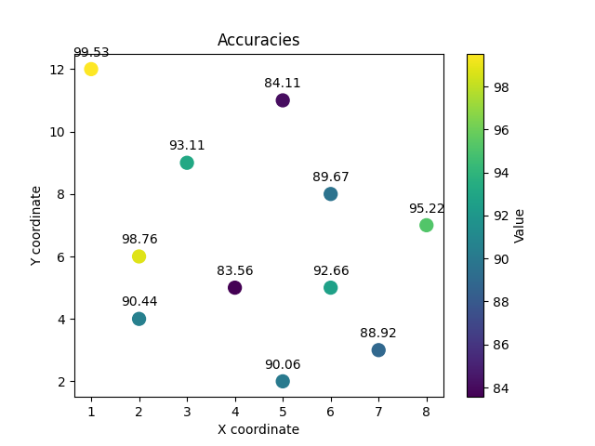
Accuracy in Known Locations
Train: 80% Test: 20%
Average accuracy: 91.44% Pretty Good!
Notes:
For known locations, meaning locations our moving receiver went thru to collect data, the average accuracy was very high, specifically 91.44%.

Slide 31
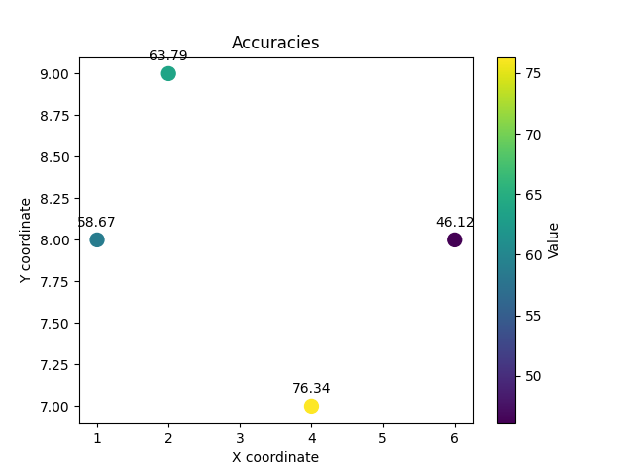
Accuracy in Unknown Locations
Average accuracy: 61.23% Location granularity is not enough!
Notes:
This is not the case for unknown locations, where accuracy was around 60%. The reason is that the training data for the neural network includes only a limited set of locations, so the network didn't have enough data to learn how to handle the X and Y coordinates of a new location.

Slide 32
7) Conclusion

Slide 33
Conclusion
Neural networks reliably estimate interference
(4 fixed FFT sensors)
High accuracy for known locations
Sparse training lacks spatial awareness
Dense measurements could enable a universal estimator
Notes:
Neural networks were able to reliably estimate interference. we achieved a very high accuracy for known locations,
but because we have a sparse training environment, meaning that we gathered data from only a few locations,
the neural network cannot acquire spatial awareness to be able to generalize for every location.

Slide 34
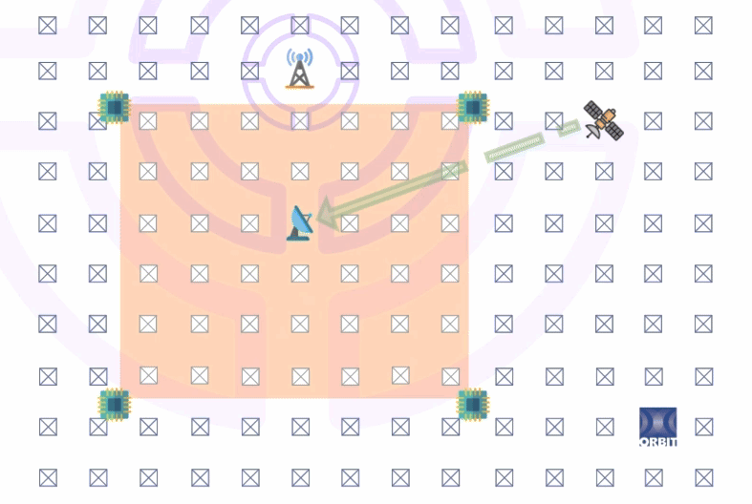
Future Work
Notes:
In the future we could experiment with resource allocation if we have multiple 5G base stations and satellites transmitting at the same time.

Slide 35
Thank You!

