Slide 1
Radio Spectrum Characterization
Ashton Sopher & Ryan Davis

Slide 2
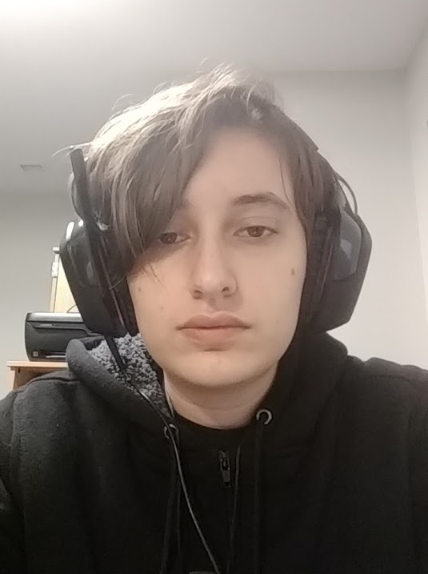
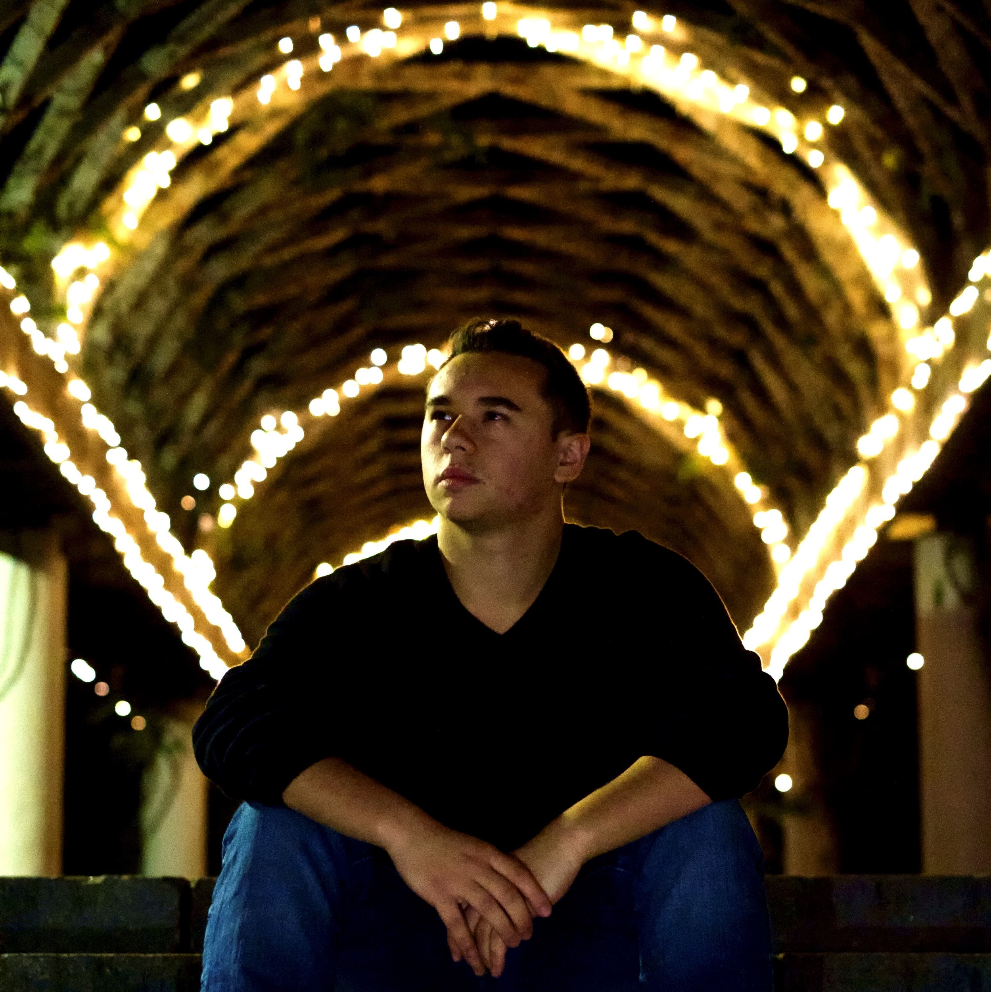
Who We Are
Ashton Sopher
University of Rochester
Computer Science / Mathematics
Ryan Davis
Rutgers University
Computer Engineering / Computer Science

Slide 3
Overview
Determine current usage of radio spectrum
Use this information as training data for a machine learning system to predict future usage

Slide 4
Next Week
Collect experimental data on radio spectrum by transmitting and receiving between Software-Defined Radios (SDRs)
Parse data into a series of Power vs Frequency graphs presented as black-and-white images varying over time
  In the future, we will use these images as a training set with an off-the-shelf machine learning algorithm to predict future power levels

