Slide 1
Radio Spectrum Characterization
Ashton Sopher & Ryan Davis

Slide 2


Who We Are
Ashton Sopher
University of Rochester
Computer Science / Mathematics
Class of 2021
Ryan Davis
Rutgers University
Computer Engineering / Computer Science
Class of 2021

Slide 3
Our Project
Find out everything we can about the radio spectrum usage in a building.
What are we looking for?
How are we finding it?
Notes:
What are we looking for?
We want to know everything we can: what transmitters are present, their capabilities, and who they are talking to.
How are we finding it?
Using Software Defined Radios to gather I/Q data

Slide 4
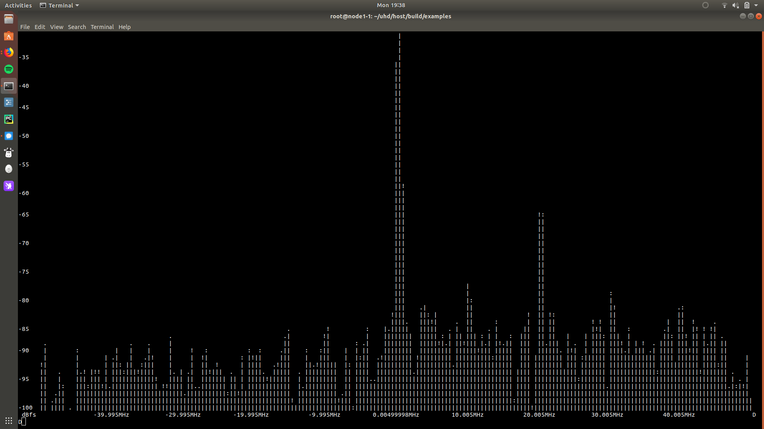
Over the Past Week
Successfully transmit and receive signals
Several Issues
  Corrupt USRP images
  Determining USRP’s subnet
  Noise
*USRP = Universal Software Defined Radio
Notes:
Using the Universal Software Radio Peripherals (USRPs) attached to each of the two nodes on sandbox 2, we were able to transmit and receive signals.
Issues
One of our USRP’s had a corrupt image loaded onto it, so we needed to reimage it via JTAG, as we were unable to establish a network connection to the device
The USRP’s are not configured to the default subnet, so we made a shell script to “brute force” the correct subnet (essentially reconfiguring our ethernet adapter until we were able to recognize the device)
When receiving, the USRP picked up a lot of noise. Our solution to this is to simply gather high frequency data during the day (high attenuation) and all other data when ORBIT usage is low, typically during the evening.

Slide 5
Over the Next Week
Gather Sample I/Q Data
Parse data into 2D images
  Fast Fourier Transform (FFT)
Readings
Notes:
Gather Sample I/Q data
Gather some sample I/Q data by sending and receiving sine waves at varying frequencies between two USRP’s
Put simply, I/Q data shows us the change in amplitude and phase angle of a sine wave
We are looking specifically for Power Magnitude Vs Freq and Power Magnitude Vs time
Putting data into 2D images
Use Fast Fourier Transforms on our I/Q data, using MATLAB or Octave, to generate our graphs
Readings
There is a lot about I/Q data that we do not understand, so we are trying to learn as much as we can.

Slide 6
Questions?

