Slide 1
Radio Spectrum Characterization
Ashton Sopher & Ryan Davis

Slide 2
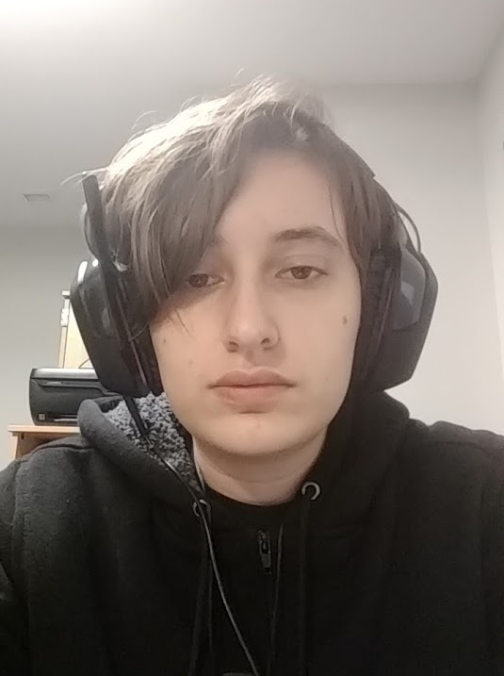
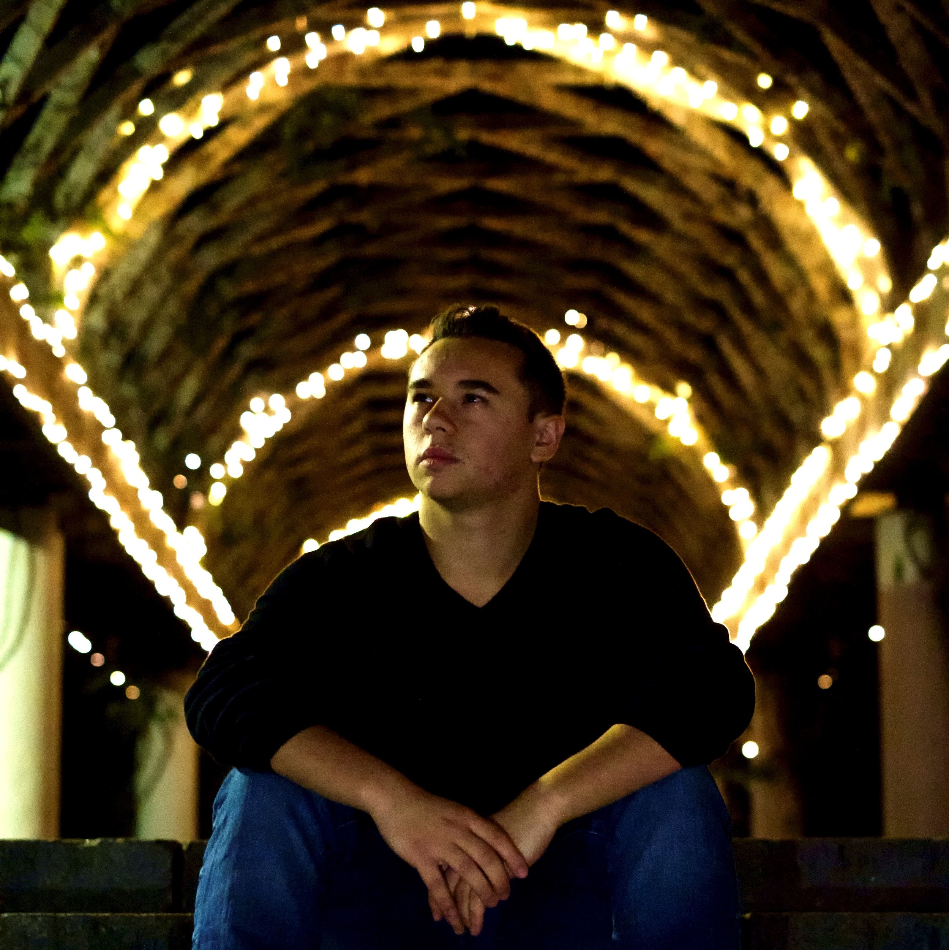
Who We Are
Ashton Sopher
University of Rochester
Computer Science / Mathematics
Class of 2021
Ryan Davis
Rutgers University
Computer Engineering / Computer Science
Class of 2021

Slide 3
Our Project
Find out everything we can about the radio spectrum usage in a building.
What are we looking for?
How are we finding it?

Slide 4
Our Setup
Receiver
Parse
2D Image
I/Q Data
USRP x310
Parse
Receiver
I/Q Data
2D Image
USRP x310
Machine
Learning
Transmitter
WiFi
Parse
Receiver
I/Q Data
2D Image
USRP x310
Receiver
Parse
2D Image
I/Q Data
USRP x310

Slide 5
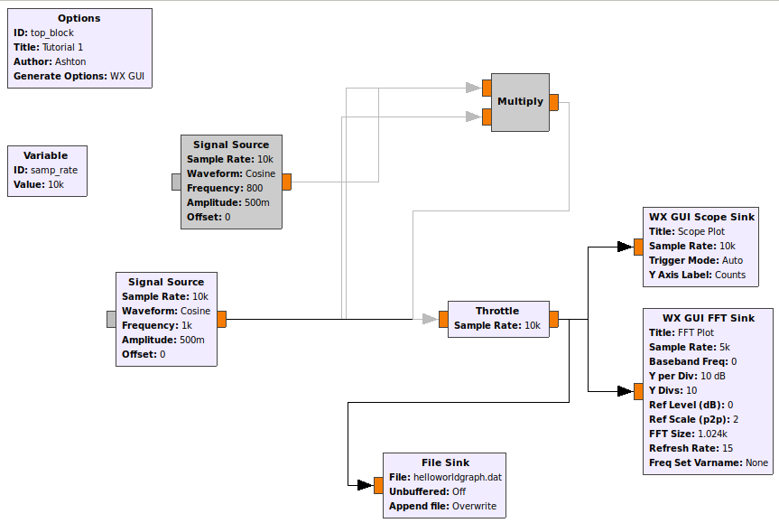
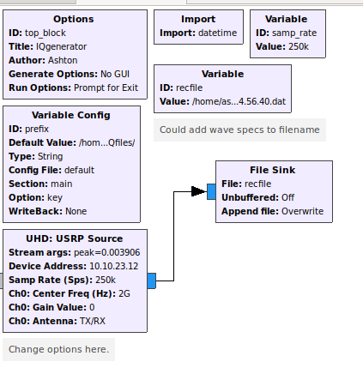
Past Week
GNURadio
GNURadio Companion
Gitlab
Reading
Notes:
GNURadio
Instead of using the sample uhd scripts, we are currently in the process of moving over to GNURadio to gather our data
Spent a lot of time on the GNURadio wiki
GNURadio Companion
Began testing out how to transmit and save data
Gitlab
Setup our repository
Reading
Read a lot about Quadrature signals (thanks to DSPguru)

Slide 6
Next Week
Recording I/Q data
Reading I/Q data in Octave
I/Q data —> 2D Image
ORBIT Wiki
Notes:
Recording I/Q data
Begin recording our data
I/Q Data —> Image
Looking to determine how we want to convert our I/Q data to a 2D image
Reading I/Q data outside of GNURadio Companion
Currently, our GNURadio Companion and Octave plots are not consistent
ORBIT Wiki
Start putting what we have so far on our wiki

Slide 7
Q’s & A’s

